Slide 4
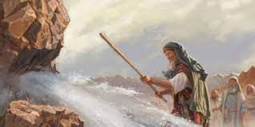
Powerful God still at Work!
Numbers 20:8-13

Slide 5
My Behavior is on Me!
excuses
victim
Psalm 106:32,33

Slide 6
My Behavior is on Me!
own your failings (even if others do not)
keep a cool spirit
involve the King
fight to maintain perspective

Slide 7
My Behavior is on Me!
Soul’s Status?
Resolve & Reach!

