Slide 1
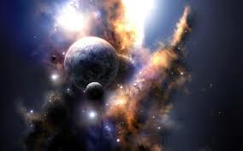
God of Macro
Psalm 19:1-6

Slide 2
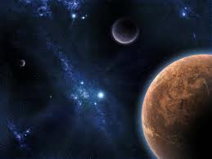
Psalm 19:1-6
The heavens declare the glory of God; and the firmament shows His handiwork. Day unto day utters speech, and night unto night reveals knowledge. There is no speech nor language where their voice is not heard. Their line has gone out through all the earth, and their words to the end of the world. In them He has set a tabernacle for the sun, which is like a bridegroom coming out of his chamber, and rejoices like a strong man to run its race. Its rising is from one end of heaven, and its circuit to the other end; and there is nothing hidden from its heat.

Slide 3
God of Everything
MACRO

Slide 4
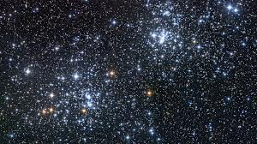
Universe
Radius of 46 billion light years
1 light year = 6 trillion miles
6 trillion miles x 46 billion =
276 sextillion light years (1 x 10²¹)
How long to traverse the universe?
At speed of light
28 billion years!

Slide 5
What Is Man?
Psalm 8:4-5 — “When I consider Your heavens, the work of Your fingers, the moon and the stars, which You have ordained, what is man that You are mindful of him, and the son of man that You visit him?”

Slide 6
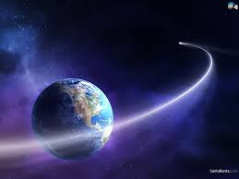
Who is God?
1 Kings 8:27 – “But will God indeed dwell on the earth? Behold, heaven and the heaven of heavens cannot contain You. How much less this temple which I have built!”
John 1:3 – “All things were made through Him, and without Him nothing was made that was made”

Slide 7
Divine Promises
35 times in
New Testament
2 Cor. 4:17 — “…a far more exceeding and eternal weight of glory”
Eph. 1:19 — “and what is the exceeding greatness of His power toward us who believe, according to the working of His mighty power”
Eph. 2:7 — “that in the ages to come He might show the exceeding riches of His grace in His kindness toward us in Christ Jesus”

Slide 8
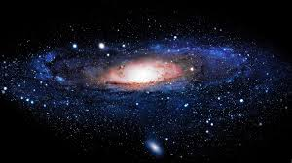
Milky Way Galaxy
200-400 billion stars

Slide 9
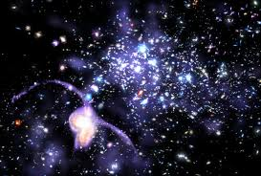
Galaxies in Universe?
100-200 billion galaxies!

Slide 10
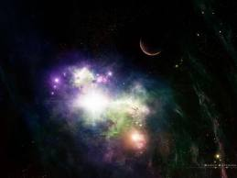
God, Creator
Job 22:12 – “Is not God in the height of heaven? And see the highest stars, how lofty they are?” - Eliphaz
Job 9:8-10 — “He alone spreads out the heavens, and treads on the waves of the sea; He made the Bear, Orion, and the Pleiades, and the chambers of the south; He does great things past finding out, yes, wonders without number” - Job

Slide 11
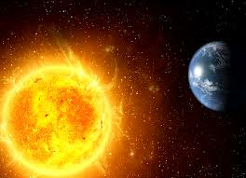
Comparisons
Sun would hold 1 million “earths” inside
Sun releases more energy than a billion major cities on earth – in one second

Slide 12
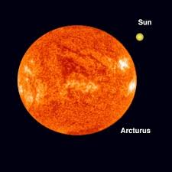
Comparisons
Arcturus – 4th brightest star in our night sky
100 times brighter than our sun!
20 times larger!

Slide 13
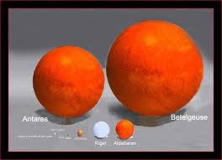
Comparisons
The red supergiant Betelgeuse has a radius 600 times that of our sun

Slide 14
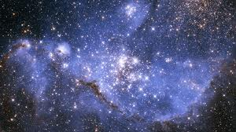
God has MACRO-power & knowledge!
He told Abraham “blessing I will bless you, and multiplying I will multiply your descendants as the stars of the heaven and as the sand which is on the seashore; and your descendants shall possess the gate of their enemies” Gen. 22:17

Slide 15
God has MACRO-power & knowledge!
Psalm 147:4-5 — “He counts the number of the stars; He calls them all by name. Great is our Lord, and mighty in power; His understanding is infinite”

Slide 16
God has MACRO-power & knowledge!
Isaiah 40:26 — “Lift up your eyes on high, and see who has created these things, who brings out their host by number; He calls them all by name, by the greatness of His might and the strength of His power; not one is missing”

Slide 17
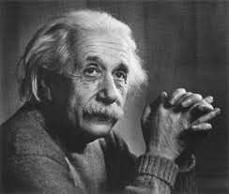
Albert Einstein
“He who can no longer pause to wonder and stand in rapt awe is as good as dead”

Slide 18
So What Does This Mean To Us?
God placed us here to please Him & obey Him, Eph. 1:11, 18-19
God deserves our worship & respect, Ex. 20:4-5

Slide 19
So What Does This Mean To Us?
Our concept of God is too small!
“Now to Him who is able to do exceedingly abundantly above all that we ask or think, according to the power that works in us” – Eph. 3:20
This affects our faith, Heb. 11:6
We must believe that “He is”!
He is “Rewarder”!

Slide 20
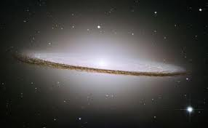
Man & God?
Isaiah 55:8-9 — “For My thoughts are not your thoughts, nor are your ways My ways,” says the LORD. For as the heavens are higher than the earth, so are My ways higher than your ways, and My thoughts than your thoughts”
Isaiah 40:28 – ““Have you not known? Have you not heard? The everlasting God, the LORD, the Creator of the ends of the earth, neither faints nor is weary. His understanding is unsearchable”

Slide 21
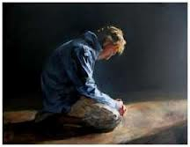
God Dwells with the Humble
Isaiah 57:15 — “For thus says the High and Lofty One Who inhabits eternity, whose name is Holy: ‘I dwell in the high and holy place, with him who has a contrite and humble spirit, to revive the spirit of the humble”
Matt. 5:3-4 – “Blessed are the poor in spirit…”
James 1:27 – “Pure and undefiled religion before God and the Father is this: to visit orphans and widows in their trouble, and to keep oneself unspotted from the world”

Slide 22
God Dwells with the Humble
Matt. 18:4 – whoever humbles himself as a little child
James 4:6 – “God resists the proud, but gives grace to the humble”

Slide 23
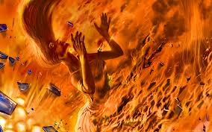
God Will Punish The Wicked & Arrogant!
Psalm 2:2-5 – “The kings of the earth set themselves, and the rulers take counsel together, against the LORD and against His Anointed, saying, ‘Let us break Their bonds in pieces and cast away Their cords from us.’ He who sits in the heavens shall laugh; the LORD shall hold them in derision. Then He shall speak to them in His wrath, and distress them in His deep displeasure”
Isaiah 57:16 – “For I will not contend forever…”

Slide 24
God Will Punish The Wicked & Arrogant!
Heb. 10:30-31 – “For we know Him who said, ‘Vengeance is Mine, I will repay,’ says the Lord. And again, ‘The LORD will judge His people.’ It is a fearful thing to fall into the hands of the living God”

Slide 25
The Great God of MACRO cares!
Isaiah 57:16-18 – “For I will not contend forever, nor will I always be angry; for the spirit would fail before Me, and the souls which I have made. For the iniquity of his covetousness I was angry and struck him; I hid and was angry, and he went on backsliding in the way of his heart. I have seen his ways, and will heal him; I will also lead him, and restore comforts to him and to his mourners”

Slide 26
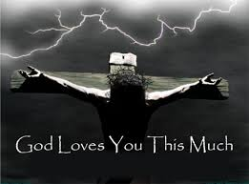
God Offers Salvation To The Humble
James 4:7-8, 10 – “Therefore submit to God. Resist the devil and he will flee from you. Draw near to God and He will draw near to you. Cleanse your hands, you sinners; and purify your hearts, you double-minded. . . Humble yourselves in the sight of the Lord, and He will lift you up”

Slide 27
Will You Come?
Proverbs 22:4 — “By humility and the fear of the LORD are riches and honor and life”

