Slide 1
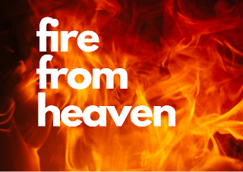
Horeb
Jonah
1 Kings 19
18
Elijah

Slide 2
He has indeed been zealous for the Lord of hosts but he is not as alone as he feels
God is powerfully producing the ends that He wants, despite Satan’s very real, hurtful blows
Elijah
In the midst of his personal pain, discouragement & self-pity, God asks, “What are you doing here?”

Slide 3
Is All It Takes!

Slide 4
Is All It Takes!
A much larger picture than meets the eye is happening by the power and will of our Sovereign King
Your faithful contribution, participation among God’s people is greatly significant

Slide 5
You!

Slide 6
Live in the shadow of the Almighty!
Hosea 14:7,8

