Slide 1
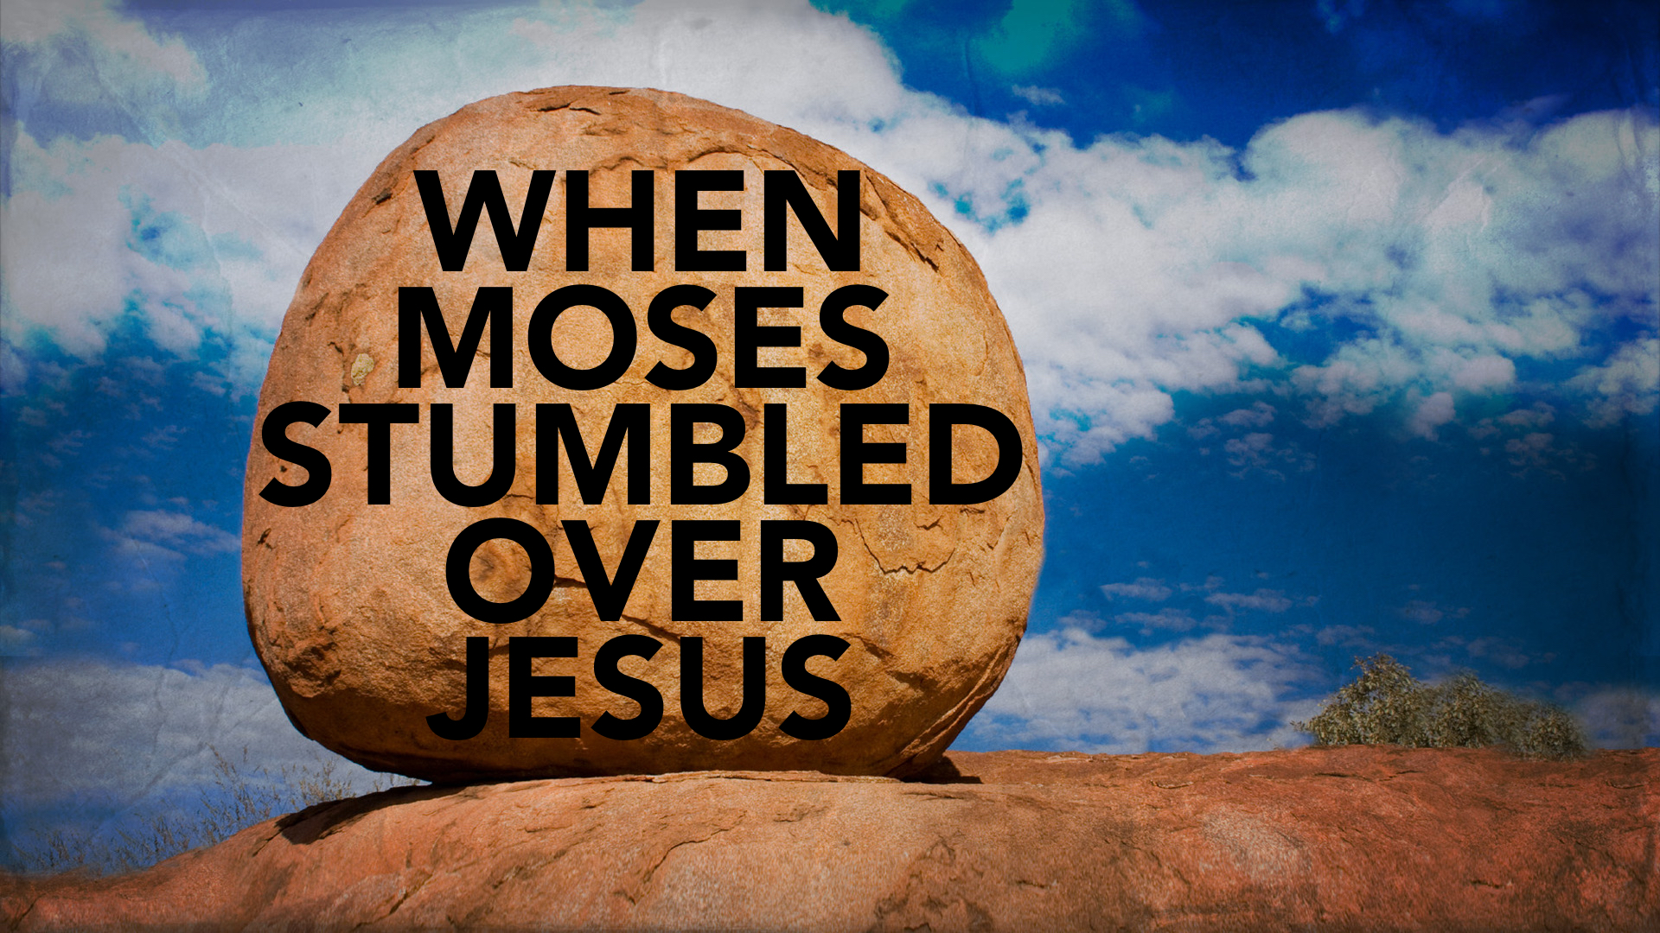

Slide 2
TRUSTING God and TREATING Him as Holy
Moses forgot about God’s PRESENCE.
Moses was careless with God’s PRECEPTS.
Moses forgot His PLACE.

Slide 3
So, Be CAREFUL…
Pay attention to the DETAILS in God’s commands.
If the godly can falter in their faith, UNBELIEF is easier than we think.
God’s definition of unbelief includes OBEDIENCE, not mere mental assent of God.

