Slide 1
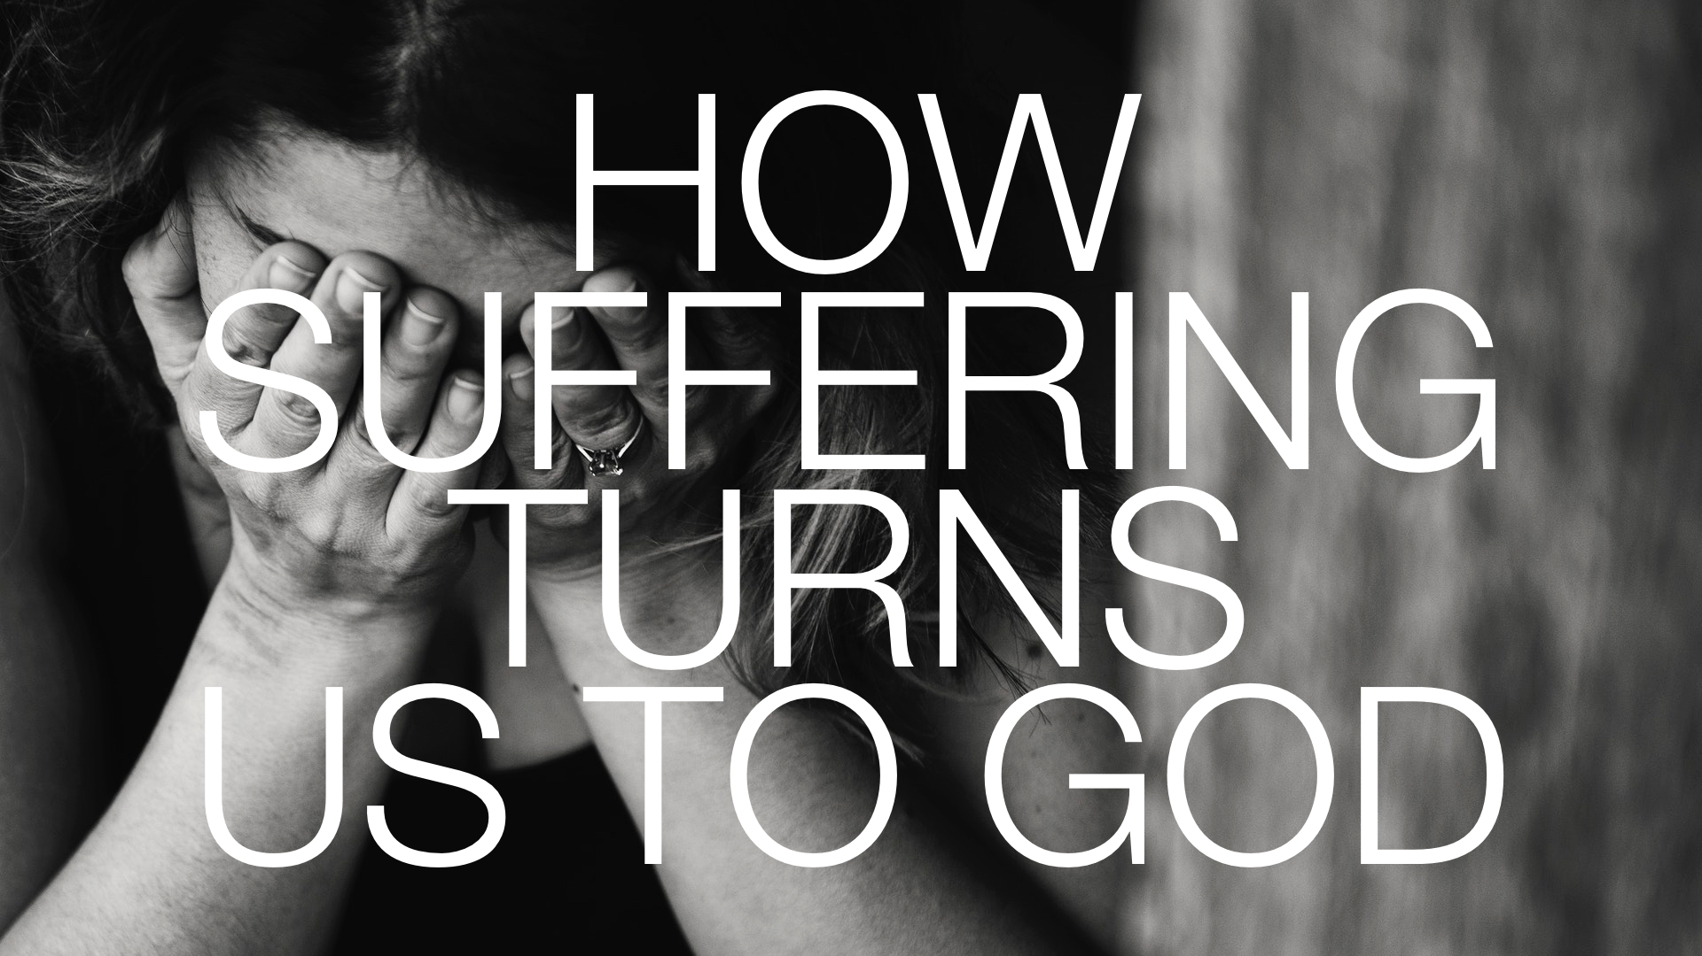

Slide 2
Do we have an EXAGGERATED perspective on suffering?
Sometimes we treat the INCONVENIENCES in our lives as the end of the world. But thinking right about suffering REDUCES frustrations and negative feelings so that we can PROPERLY focus on reality and God.

Slide 3
Do we CONTRIBUTE to the suffering of this world?
How HARD is your life right now because of your own DOING? If all practiced godliness, we would eliminate unnecessary suffering from this world. Thus, it is hypocritical to DEMAND God to remove suffering and yet refuse to be CORRECTED by Him.

Slide 4
Do we APPRECIATE the necessity of suffering?
We accept the general idea of suffering without complaint in almost every area of life because we see real RESULTS associated with suffering.

Slide 5
Do we APPRECIATE the necessity of suffering?
For example, a DENTIST causes pain to eliminate pain, or a coach puts his team through painful exercises to cause them to PERFORM better on the field.

Slide 6
Do we APPRECIATE the necessity of suffering?
No one calls this “UNLOVING” or denies the existence of doctors or coaches. Thus, not “all suffering is EVIL.”

Slide 7
Do we APPRECIATE the necessity of suffering?
And this is exactly what God does with all the suffering in the world; He SHAPES us into something better than we would be without the suffering. And in the process, we LEARN of His goodness, compassion, and mercy in a meaningful way.

