Slide 1
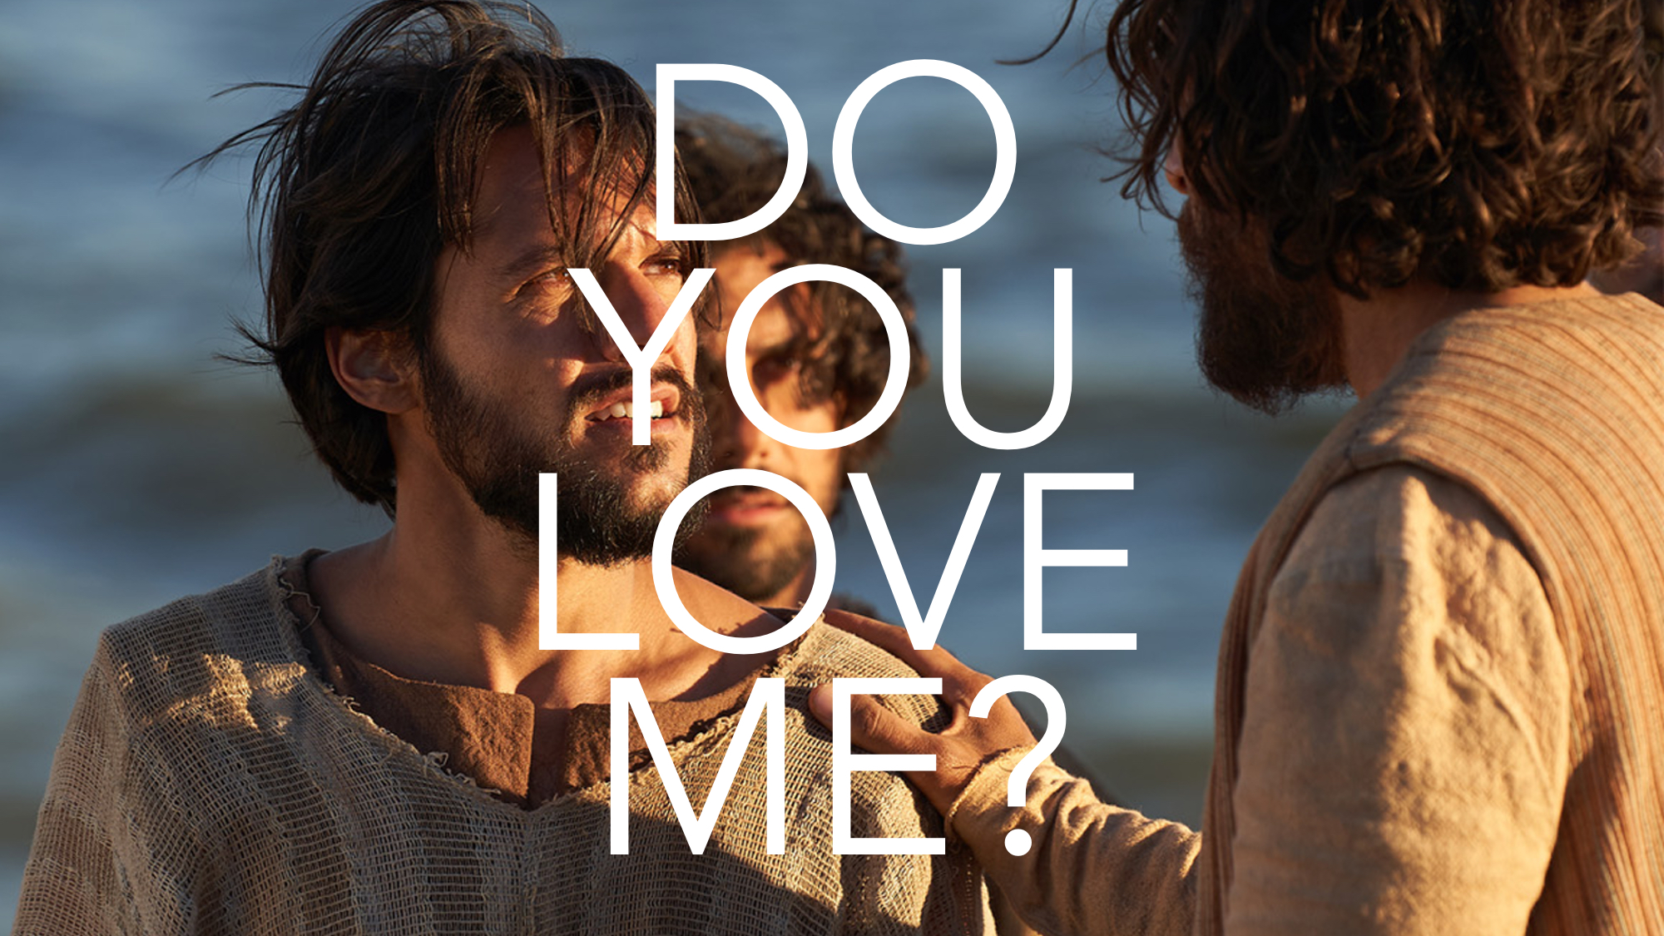

Slide 2
Obviously, the author and Jesus parallel the setting for Peter’s DENIAL and Peter’s RESTORATION.

Slide 3
Connections between the Two Events
Jesus knows all things.
They ate a meal together.
Jesus took off his garment after supper. Peter put on his garment after breakfast.
Jesus talks about His death. John talks about his resurrection.
Peter boasts. Peter is humbled.
Peter denies Jesus near a fire. Jesus restores Peter near a fire.
Peter kept at a distance. Peter followed Jesus closely.

Slide 4
True LOVE, REPENTANCE, and FORGIVENESS
Jesus’ forgiveness COMFORTS Peter’s guilt-ridden CONSCIENCE—where he once mourned for his sins, Jesus brought him PEACE.

Slide 5
True LOVE, REPENTANCE, and FORGIVENESS
Jesus’ forgiveness STRENGTHENS Peter’s DISCIPLESHIP—where he once DENIED Jesus, he would now PROCLAIM Jesus with confidence.

Slide 6
True LOVE, REPENTANCE, and FORGIVENESS
Jesus’ forgiveness CORRECTS Peter’s misguided ZEAL—where he once BOASTED with empty words, his death would bring GLORY to God rather than himself.

Slide 7
“Lord You Know EVERYTHING;
You Know That I LOVE You”
If we love Jesus, we will HATE our own life. And SACRIFICE everything for Him.
If we love Jesus, we will keep His COMMANDMENTS. And without COMPLAINT.
If we love Jesus, PROVE it. And don’t say you’ll DIE for Jesus when you don’t even LIVE for Jesus!

