Slide 1
Beehives & Churches
03/27/22

Slide 2
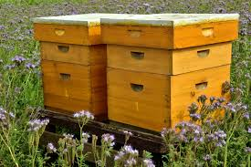
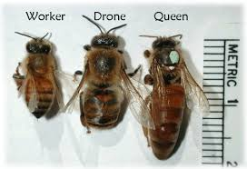
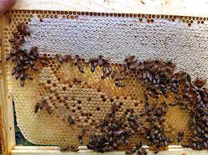
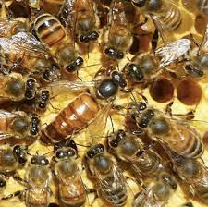
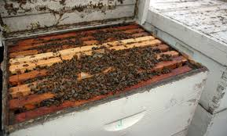
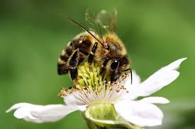

Slide 3
Types of Hives (& Churches)
Strong hives
Strong churches
Split/reproduce
Help prevent diseases
Produce honey
Survive winter stresses
Repeat cycle
Grow/expand
Help prevent diseases
Produce fruits
Survive worldly stresses
Repeat cycle

Slide 4
Types of Hives (& Churches)
Weak hives
Weak churches
Don’t split/reproduce
Susceptible to diseases
Don’t produce excess honey
Don’t survive winter stresses
Eventually die out
Don’t grow/expand
Susceptible to diseases
Don’t produce fruits
Don’t survive worldly stresses
Eventually die out

Slide 5
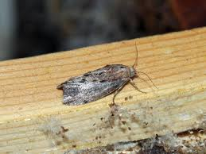
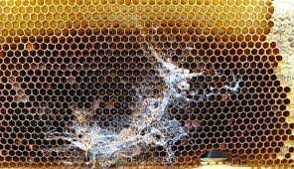
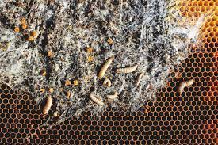
Moths
Large, very noticeable
Signs of neglect for a beekeeper

Slide 6
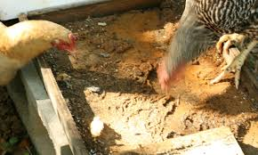
Kill the Moths (public sin)
Mark 3:28-30
1 Corinthians 5

Slide 7
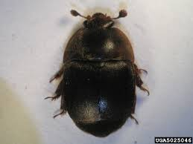
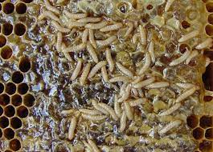
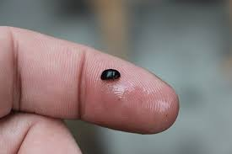
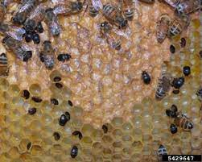
Beetles
Smaller, more noticeable with larger numbers
More common in weak hives

Slide 8
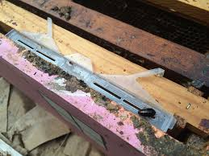
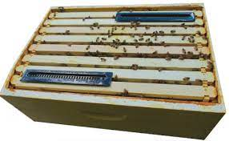
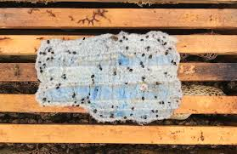
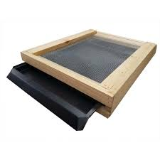
Trap the Beetles (continuous sin)
1 John 3:4-10
Hebrews 10:23-30

Slide 9
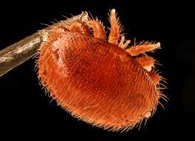
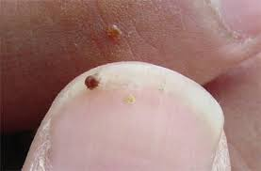
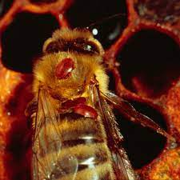
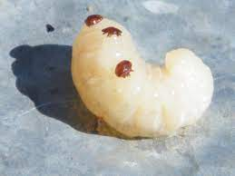
Varroa mites
Very small, attack young/old
Kill slowly over years

Slide 10
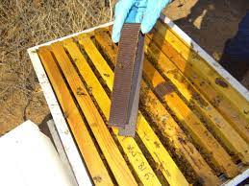
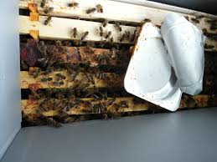
Treat the Mites (false teaching)
1 John 4:1
2 Timothy 4:3-4
Matthew 7:15-20
1 Timothy 6:3-5

Slide 11
Application – Which are you?

