Slide 1
perfection

Slide 2
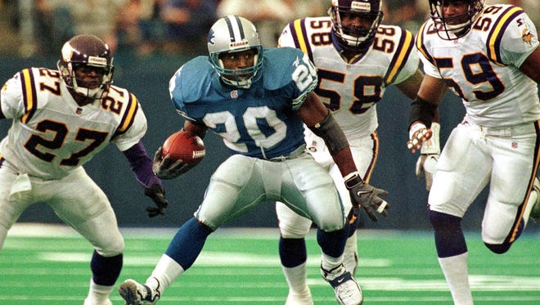
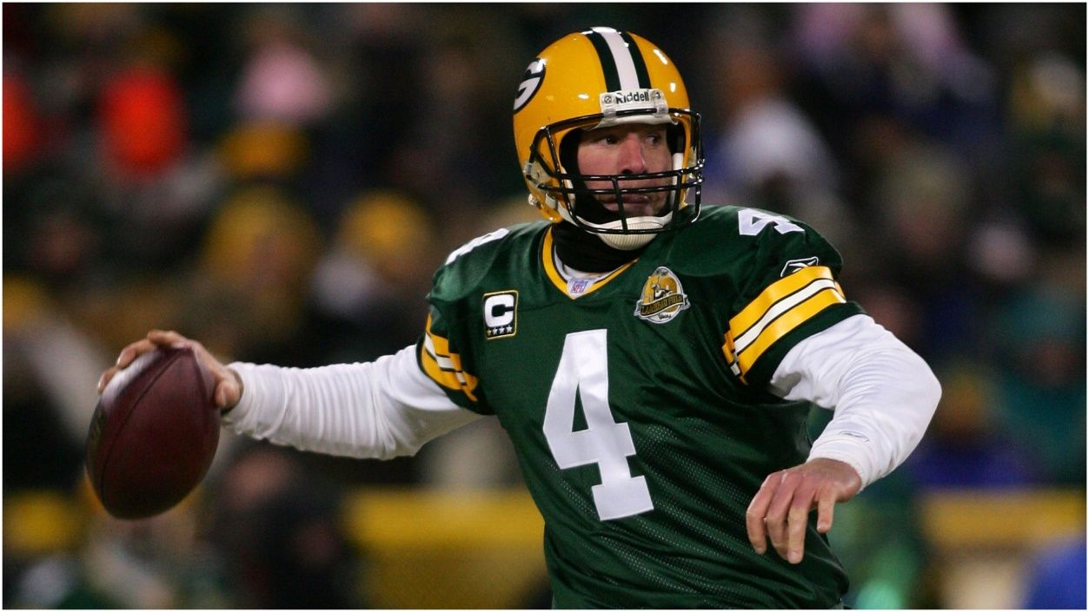
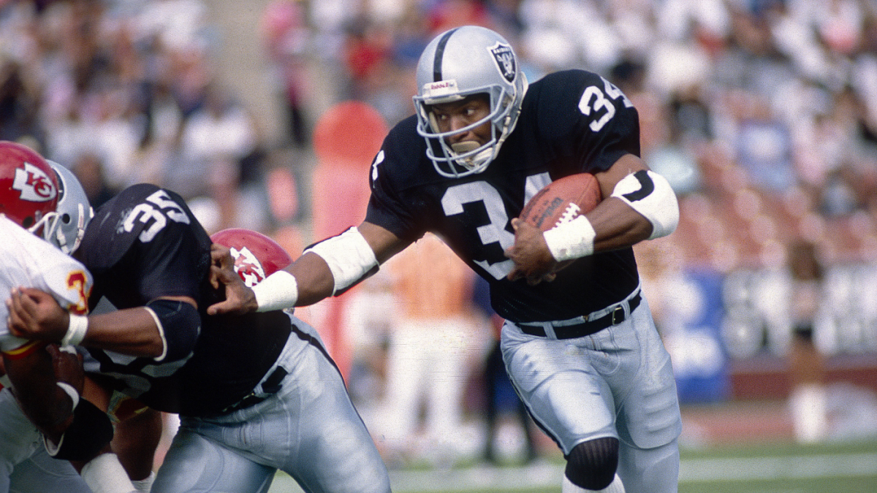
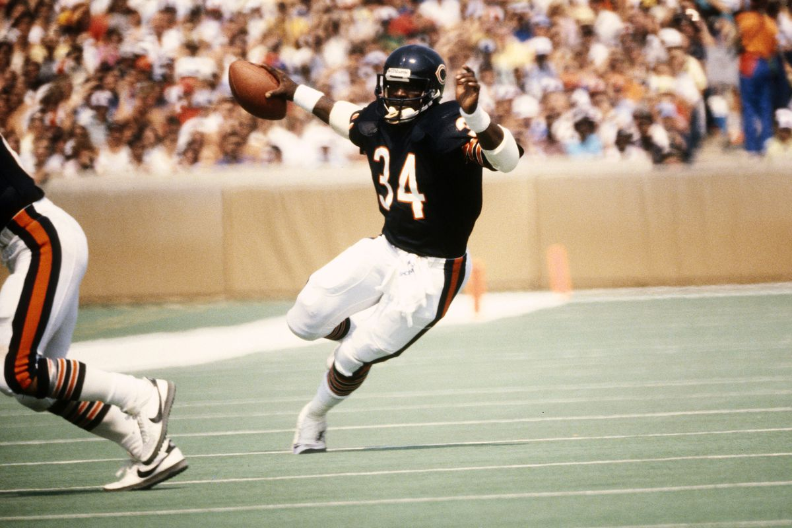
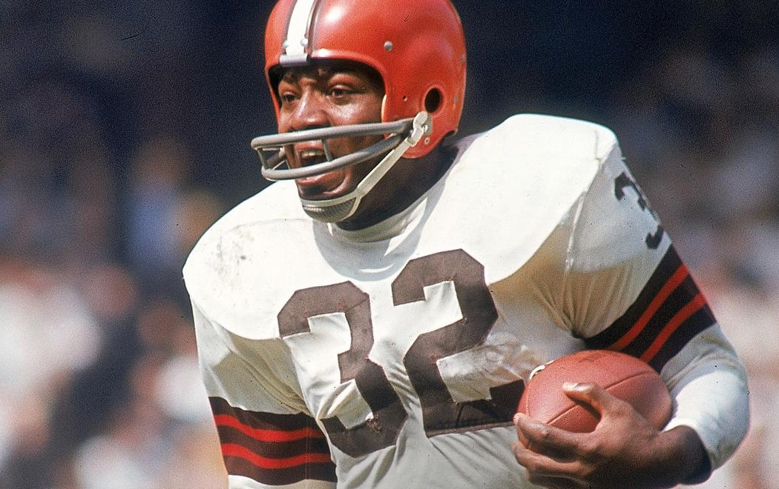

Slide 3
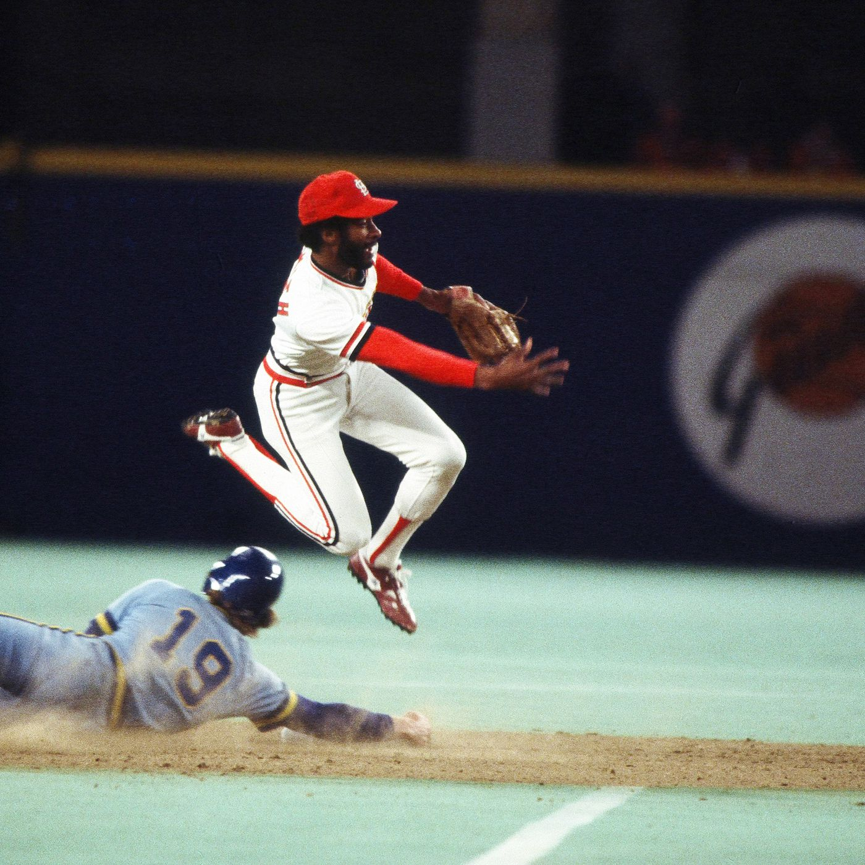
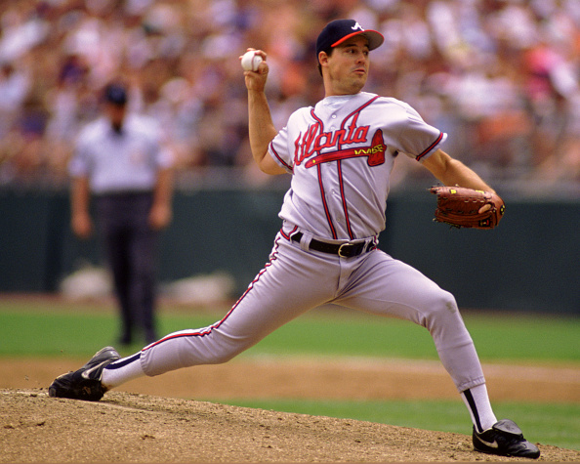
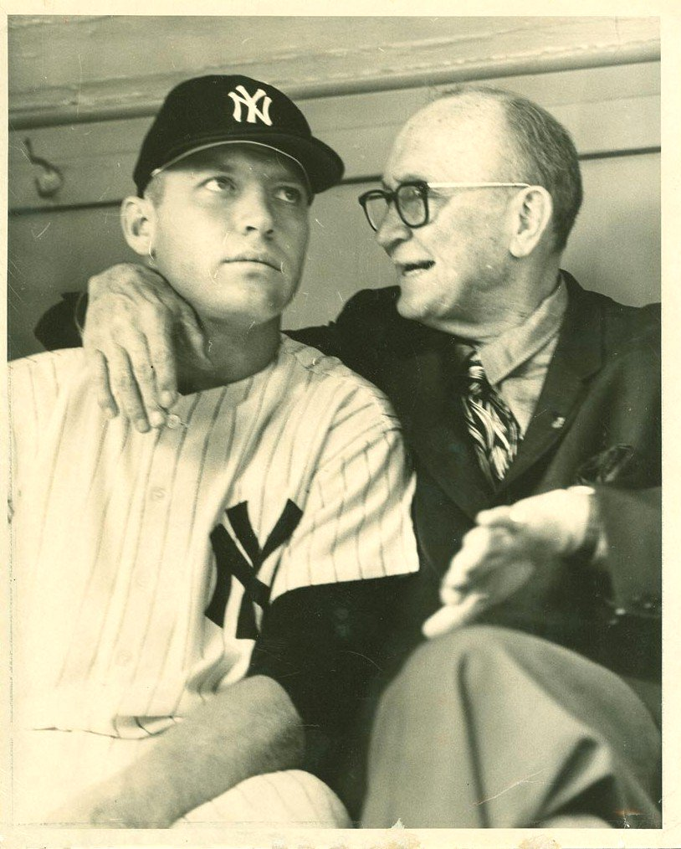
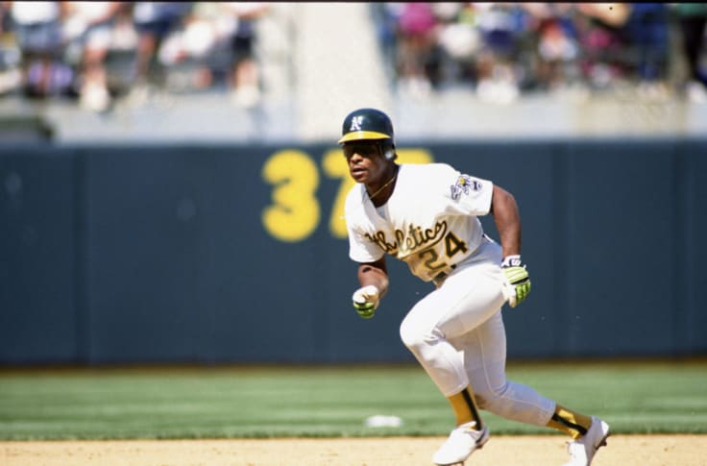
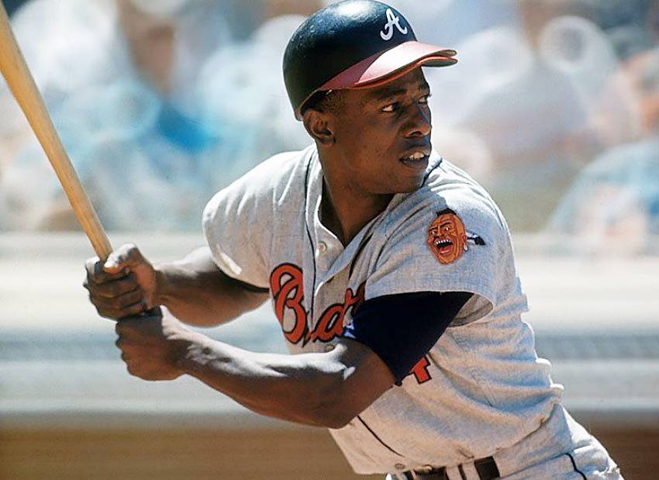
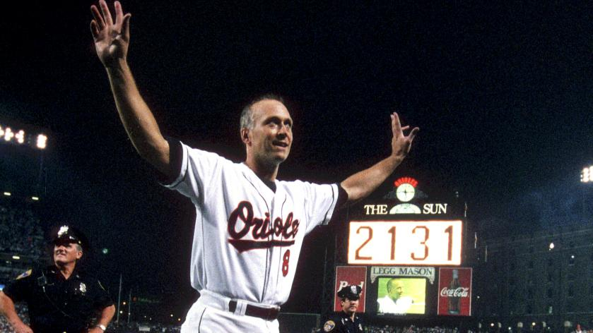

Slide 4
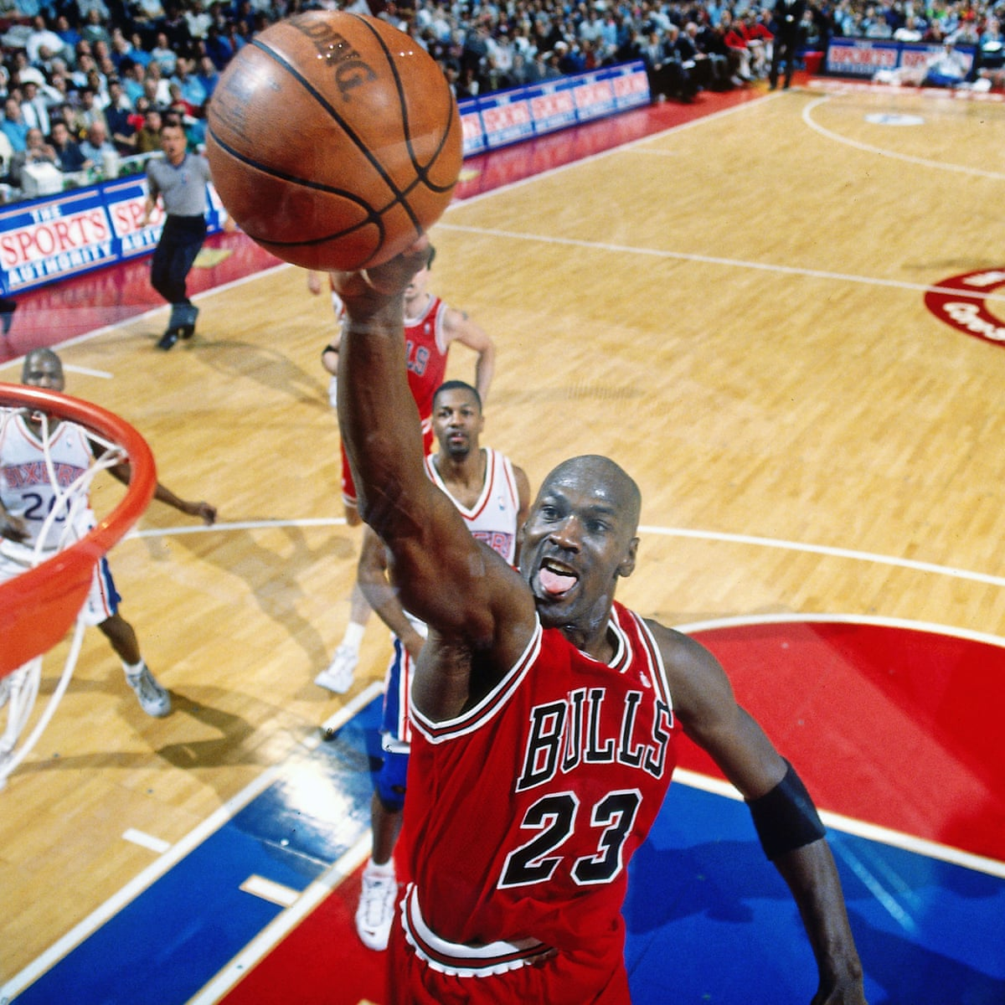

Slide 5
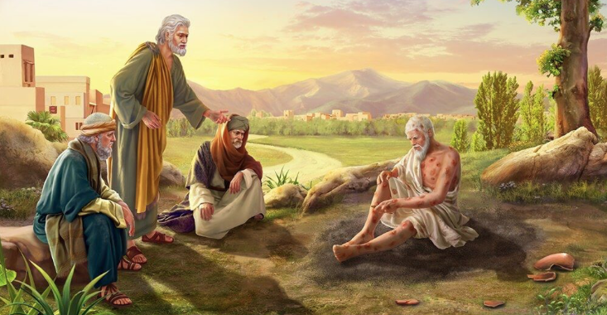
Faith of Job

Slide 6
Faith of Job
Job 1:1-4, 20-21
Job 2:9-10
Job 13:15, Job 19:25
Job 23:10, Job 27:3-4
Job 40:3-5, Job 42:1-6

Slide 7
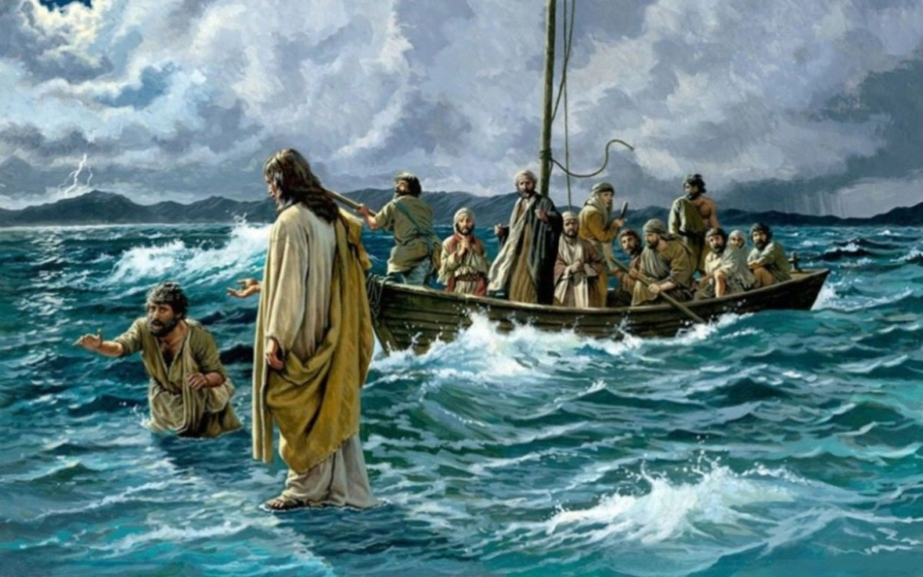
Boldness of Peter

Slide 8
Boldness of Peter
Matthew 14:25-33
Matthew 16:13-17
Acts 4:8-13
John 21:1-14

Slide 9
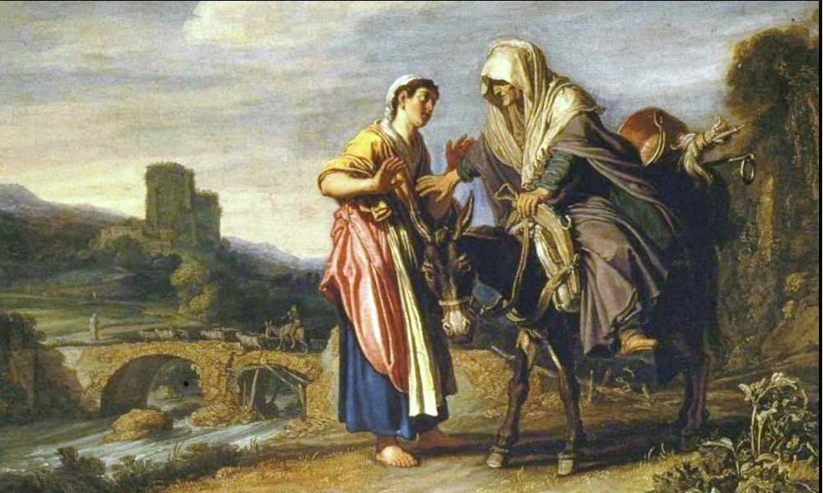
Commitment of Ruth

Slide 10
Commitment of Ruth
Ruth 1:12-18
Ruth 2:2, 11-12
Ruth 4:13, 16-17

Slide 11
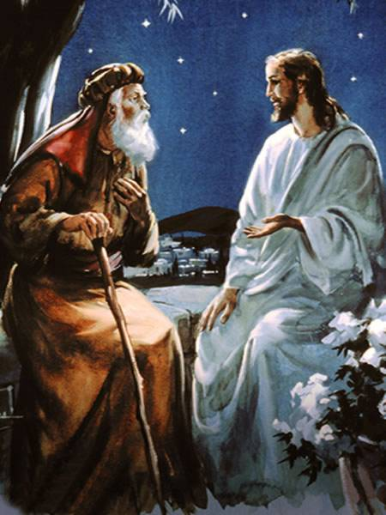
Courage of Nicodemus

Slide 12
Courage of Nicodemus
John 3:1-21
John 7:45-52
John 19:38-42

