Slide 1
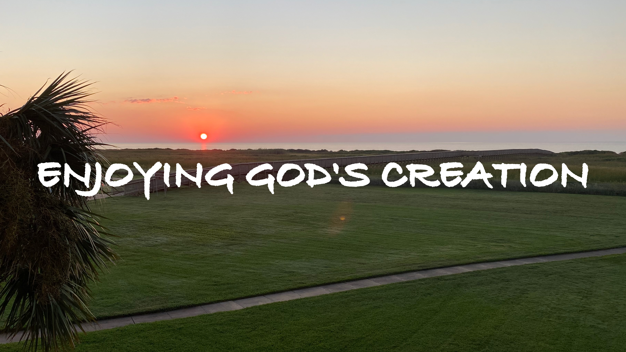

Slide 2
1 Timothy 4.1-5
It seems the false teachers were forbidding what God allowed because they believed it made one “HOLIER” to refrain from certain pleasures. They called “BAD” what God called “GOOD.” This error was a rejection of God’s authority and what God has given His creation to enjoy.

Slide 3
The Need for Balance
The holy lifestyle involves reverence to God and separation from the world through strict submission, self-control, and purity. These things are TRUE, but this is not all of the TRUTH. Pleasure is not necessarily WRONG, and enjoyment can be GODLY. In other words, holiness and pleasure are not mutually exclusive.

Slide 4
God Desires for Us to Enjoy Ourselves
God’s gift to humanity is the FRUIT of our labor. God is opposed to ASCETICISM, and therefore we must not DEPRIVE what He desires for His people. However, this is LIMITED—our main goal in life is not the pursuit of godly pleasures.

Slide 5
Whatever We Enjoy, It Ought to Overflow Into Praise and Thanksgiving
Only those who believe the truth recognize God as the SOURCE of all everlasting joy and pleasure. (Psalm 16.11) In other words, godly pleasures ought to bring us CLOSER to Him. If we SEPARATE God from enjoyment, we cannot truly enjoy life as He intended, and we are nothing more than the UNBELIEVER.

Slide 6
When Having Fun, Play by the Rules
Enjoy life but remember we will ANSWER for everything we do. Maintaining godly BOUNDARIES helps us to enjoy life with a good conscience.

