Slide 2
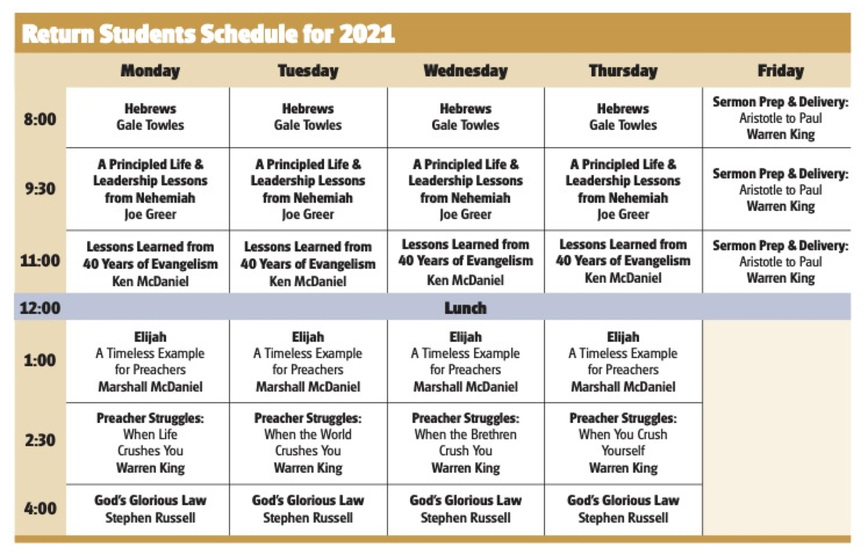

Slide 3
DAILY SCHEDULE
6:00 – Wake up
7:00 - 7:40 – Breakfast
7:40 - 8:00 – Singing/Devotion
8:00 - 12:00 – Lessons
12:00 - 1:00 – Lunch
1:00 - 5:00 – Lessons
5:00 – Dinner
6:30 – Questions and Answers
7:00 - 8:30 – Singing/Prayers/Devotions
8:30 – Desert/free time

Slide 5
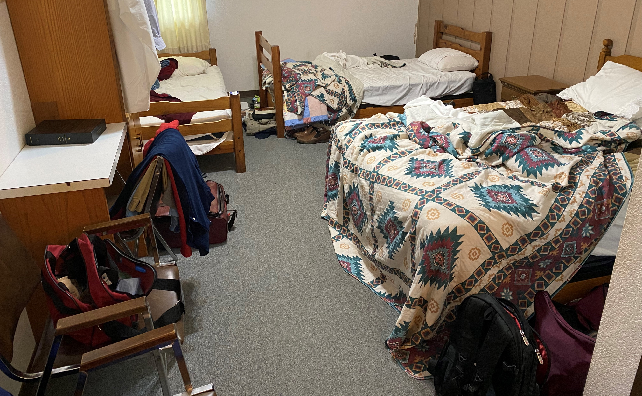

Slide 7
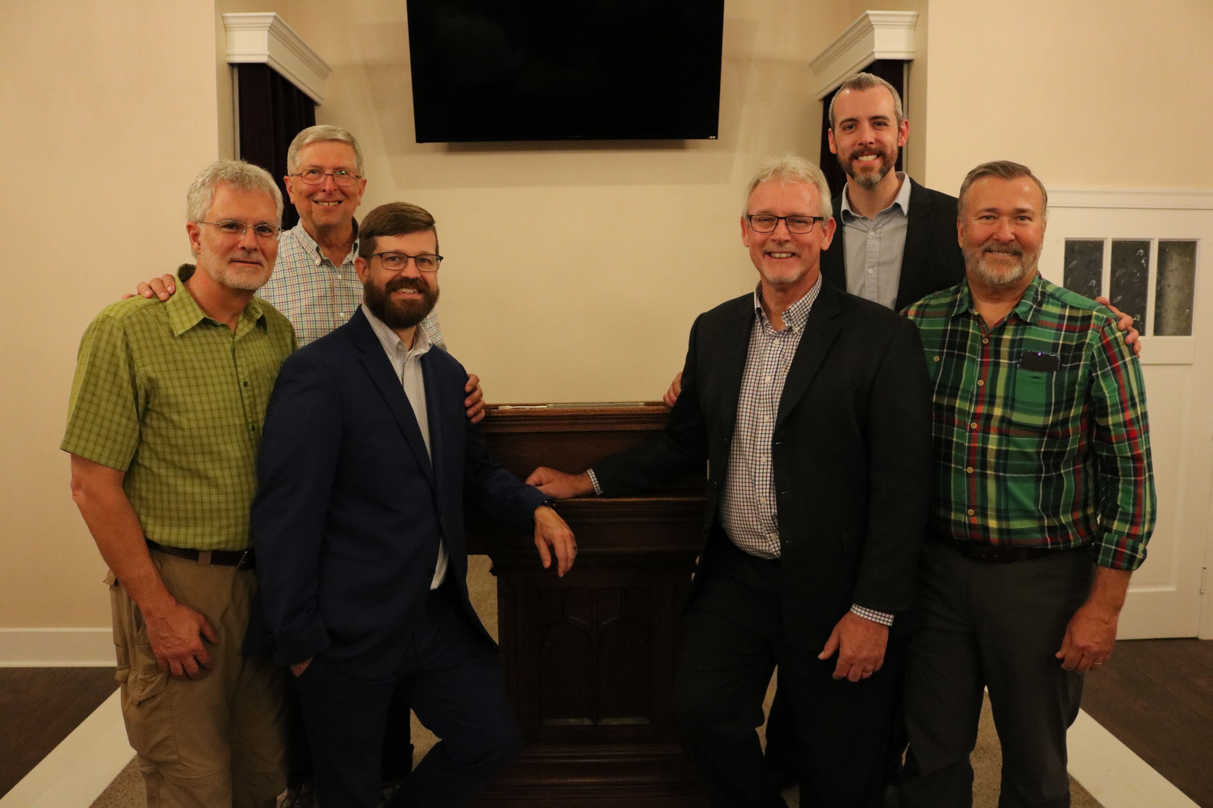

Slide 8
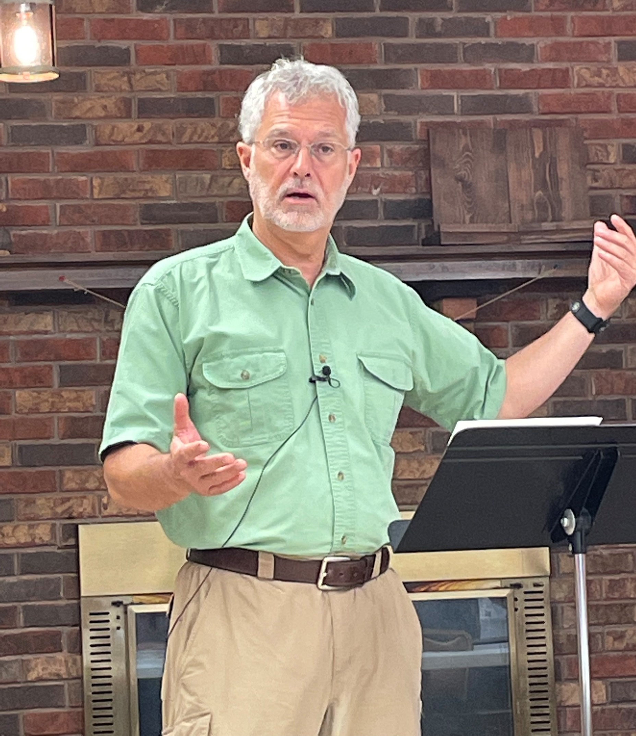
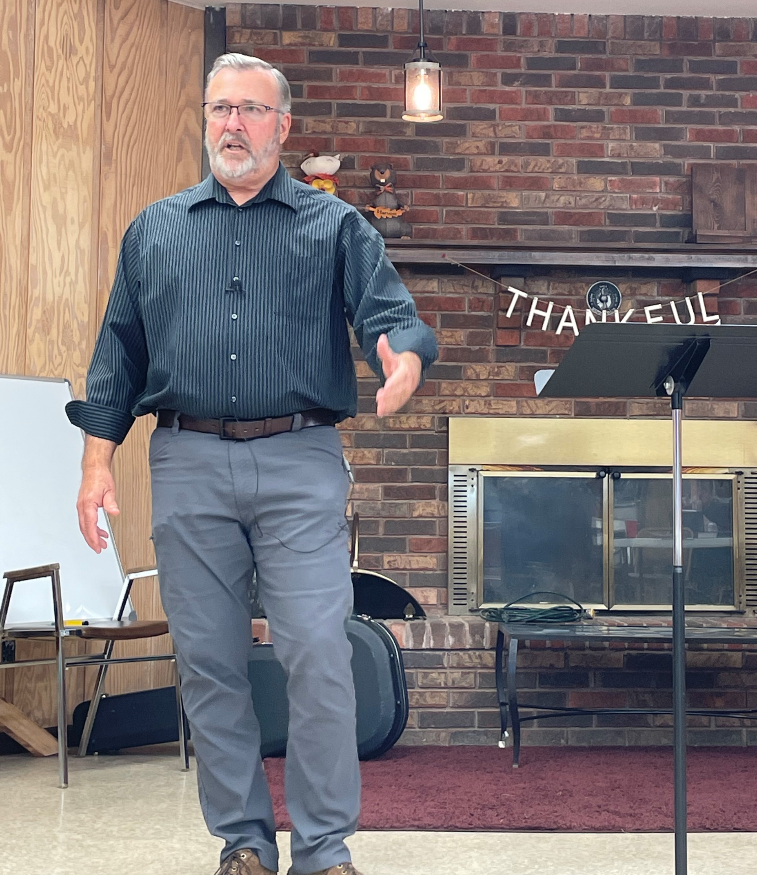

Slide 9
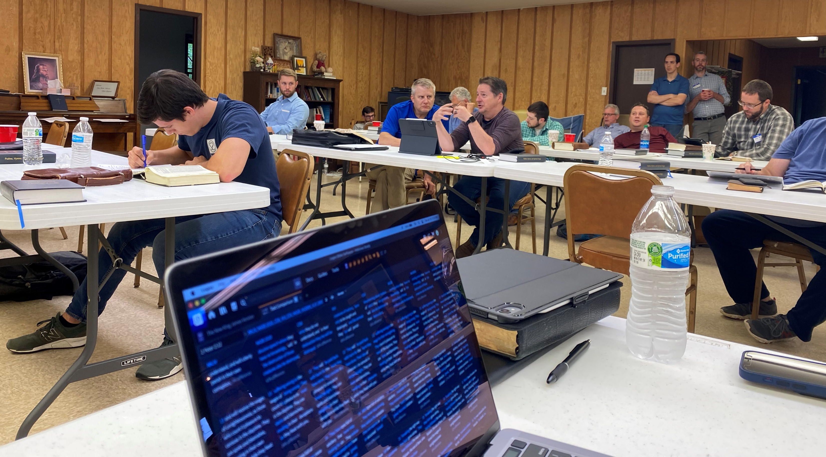

Slide 10
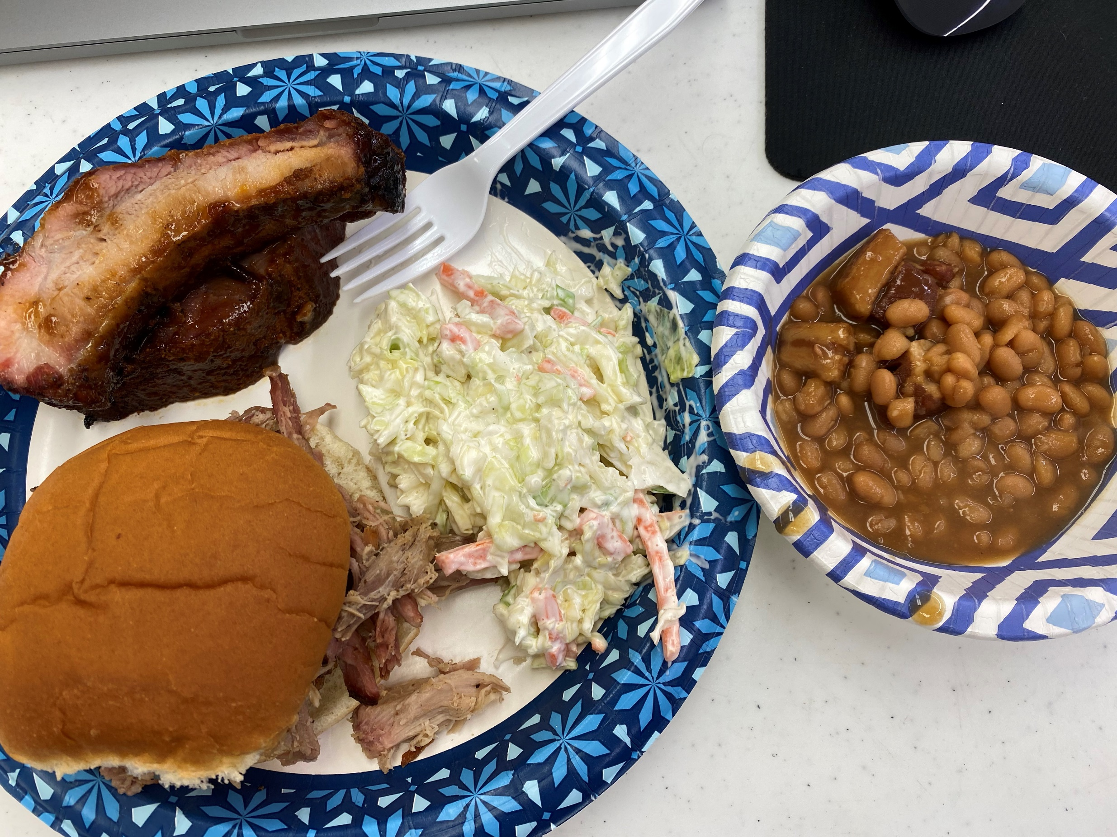

Slide 11
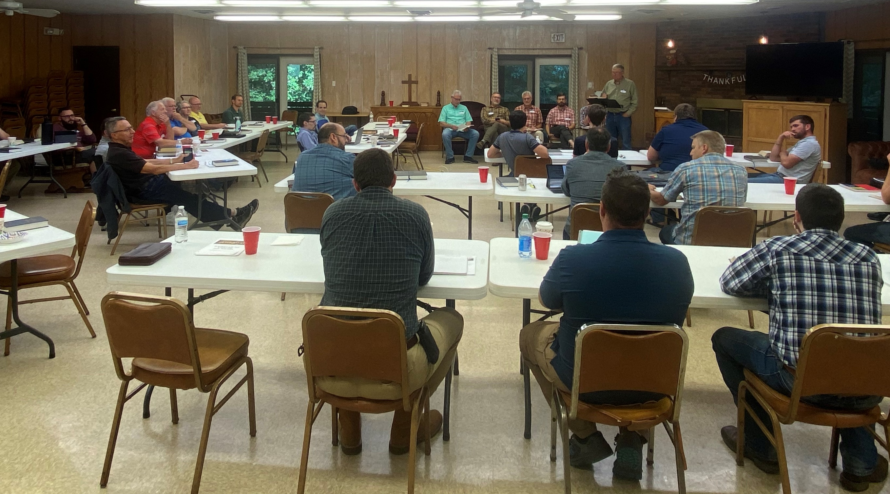

Slide 14
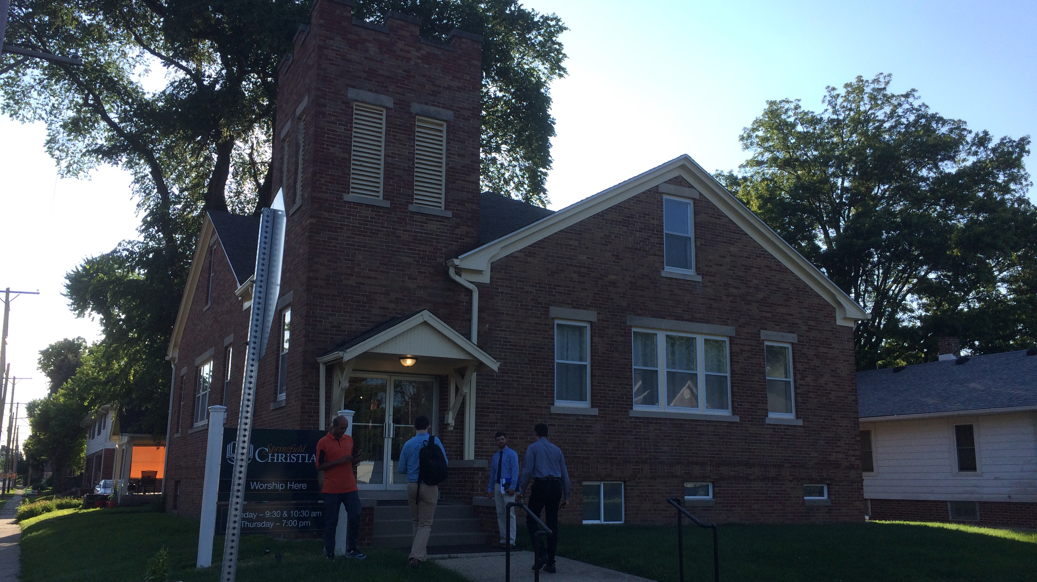

Slide 15
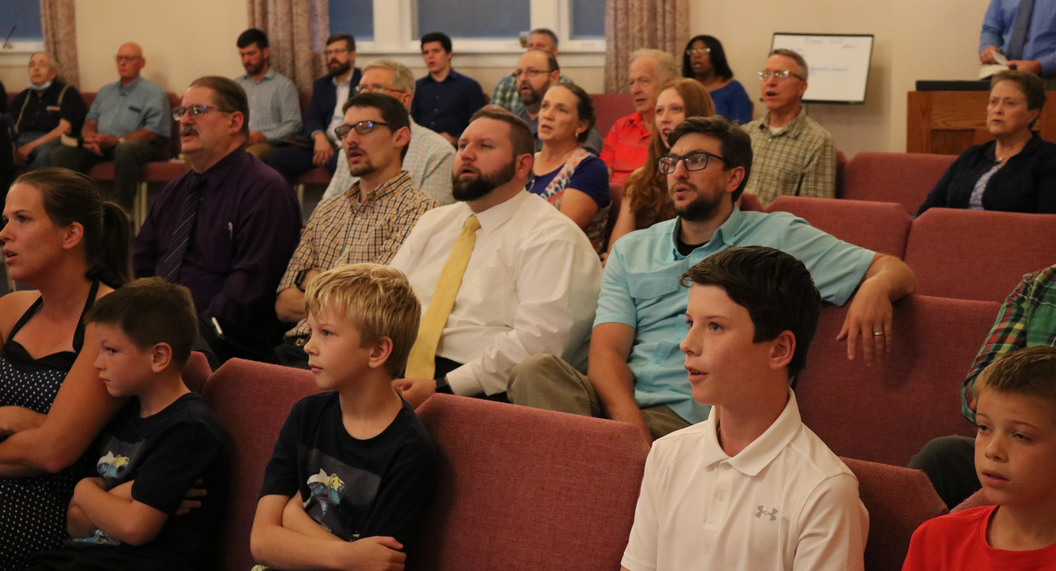

Slide 16
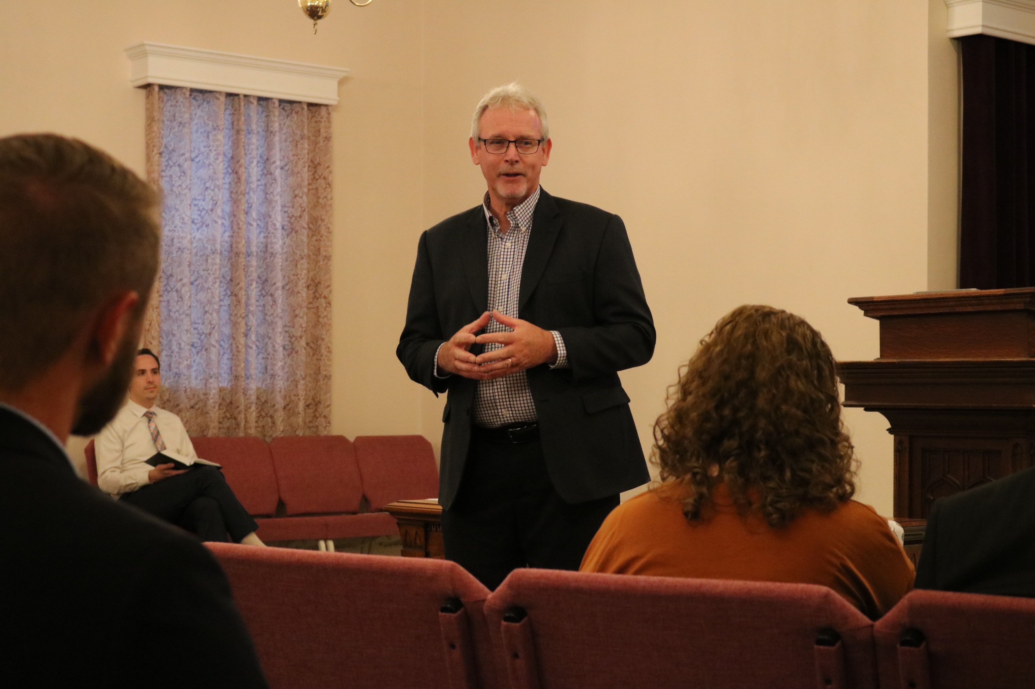

Slide 17
BENEFITS FOR ME
Strength to press on, Col. 1.21-23; 3.23
Shared struggles, Gal. 6.2; Rom. 12.15
Constructive criticism/sharpened, Prov. 12.15; 15.31-33; 27.17
Counsel from godly men, Prov. 11.14; 24.6
Friendships, Prov. 18.24

Slide 18
BENEFITS FOR THE CHURCH
Sound teaching, 2 Tim. 4.2-3; Titus 2.1
Encouragement, 1 Thess. 2.10-13

Slide 19
LESSONS LEARNED
Sam Bunyard preached about unity in local churches on Sunday.
Rick Liggin emphasized what we need in our preaching for the morning talks.
Q & A Session — the instructors answer doctrinal and work-related questions.

Slide 20
LESSONS LEARNED
Gale Towles taught an overview of Hebrews.
Joe Greer concentrated on effective leadership as he taught through Nehemiah.
Ken McDaniel focused on effective evangelism.

Slide 21
LESSONS LEARNED
Warren King discussed the struggles each preacher faces.
Marshall McDaniel taught a character study on the prophet Elijah.
Stephen Russell focused on the beauty of holiness and the glorious law of Moses.

Slide 22
