Slide 1
Necessary Inferences
7/12/21

Slide 2
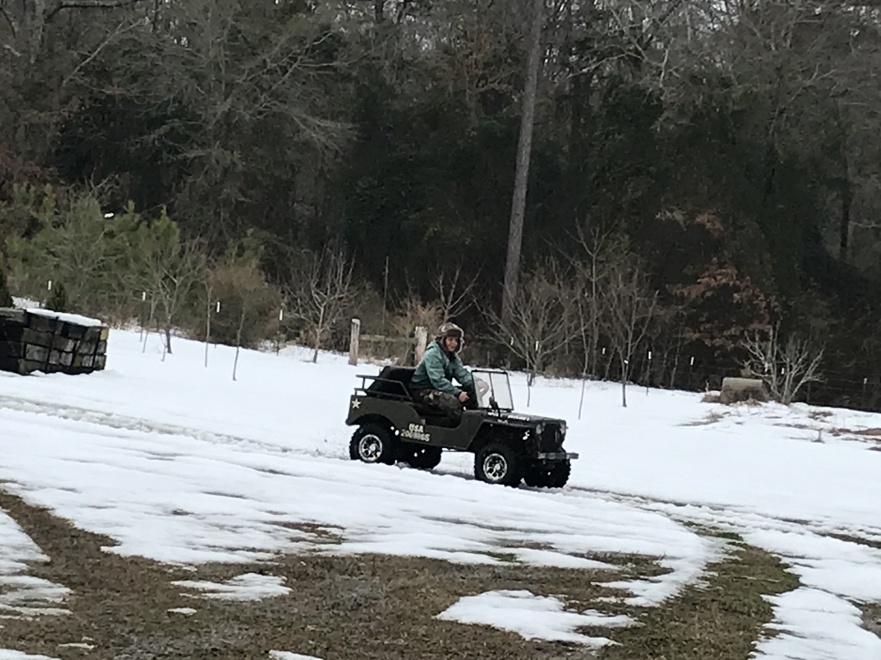

Slide 3
Everyone is useful
The young:
1 Timothy 4:12
Those with a past:
1 Timothy 1:15-16, Phil 3:13-15
The old:
Exodus 7:7, Genesis 17
The rejected/insignificant
Col 3:11, John 10:16, John 8:10-11, Romans 9:22-23
The rich/poor
The educated/uneducated
The holy/unholy
The dead
John 11

Slide 4
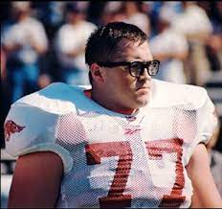
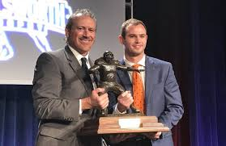

Slide 5
Get rid of your church hat
Peter
Luke 22:54-62, Matthew 26:69-75
Cephas
Galatians 2:11-16
Judas
Matthew 27:3-4

