Slide 1
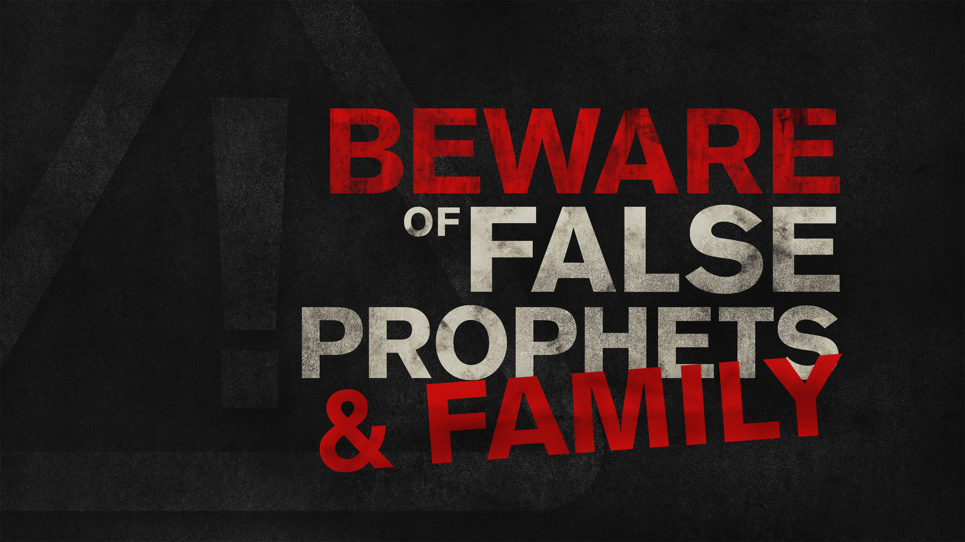

Slide 2
This strict COVENANT relationship with God required uncompromising faithfulness. If one COMPROMISED, God no longer had their COMPLETE allegiance. Neither CREDIBLE miracles nor intimate, familial relationships could interfere with their COMMUNION with God.

Slide 3
Stoning emphasized the SERIOUSNESS of the transgression. The transgressors SEDUCED others to serve false gods, denying God's SALVATION and SOVEREIGNTY.

Slide 4
Defending evil ENCOURAGES further corruption, but purging evil preserved their holiness and EXCLUSIVE worship of God. Throwing those stones caused them to EXPERIENCE the horror of sin.

Slide 5
Jesus said that a division would come that would mimic STONING our family members. Echoing Micah, Jesus would be the SOURCE of this division. STRIFE was inevitable because families would be at odds, SEVERED by SIN.

Slide 6
But there is hope. While Jesus would cause enmity within physical FAMILIES, saved ones would FORM a new family. FAITHFULNESS would now be found in the family of God. Take comfort in this!

Slide 7
When Family Is Leading Us Away from God…
We must LOVE God more, no matter the cost.
We must CHALLENGE the error without compromise.
We must EXPOSE the error, despite the humiliation.
We must DISFELLOWSHIP when necessary, despite the consequences.
We must WAIT for the salvation of the Lord.

Slide 8
Sometimes it’s not the “world” that pulls us away from God—it’s our own family!

