Slide 1
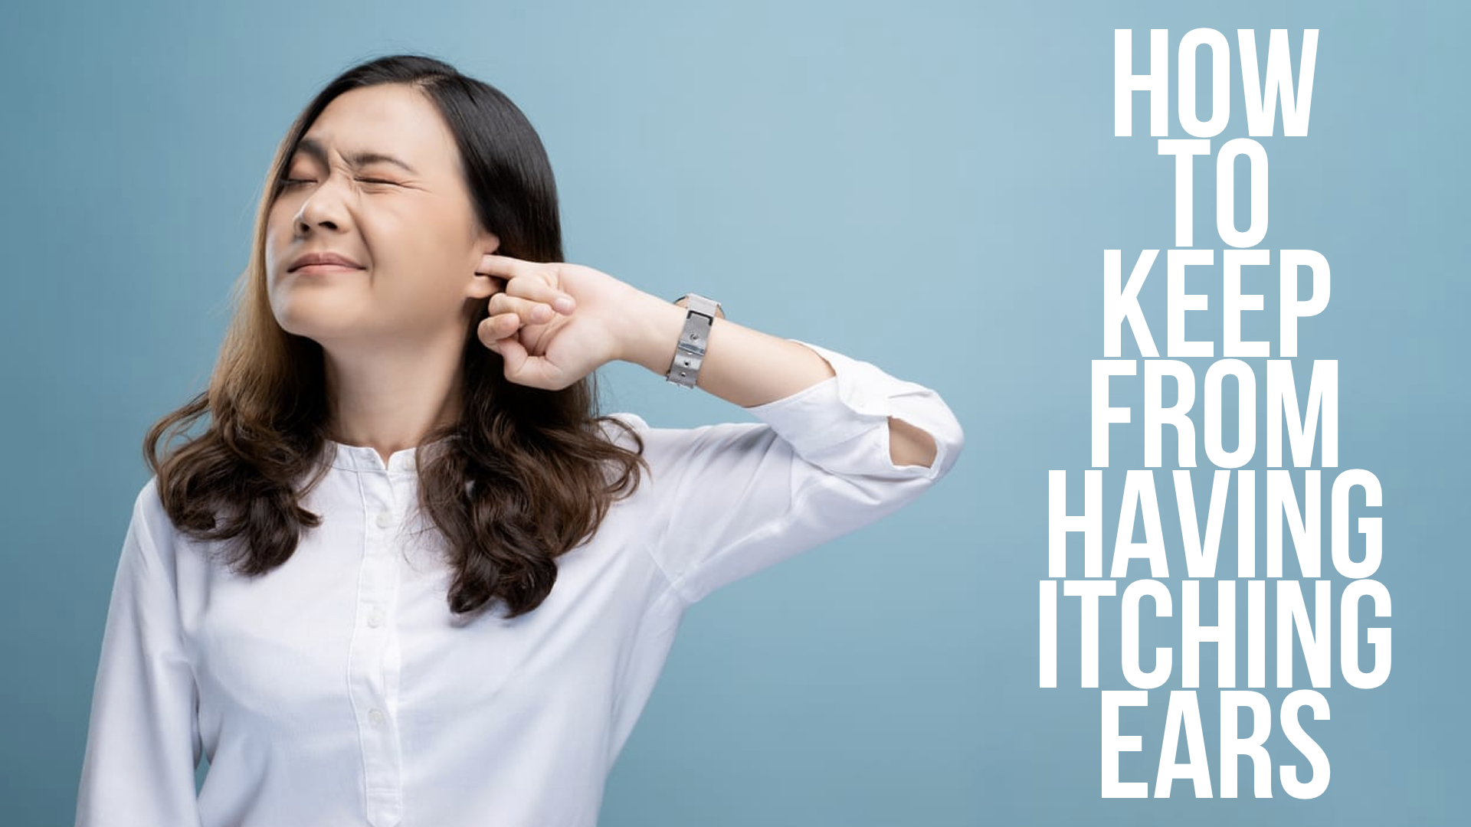

Slide 2
Ways to Keep From Having Itching Ears
Find pleasure in having a clean conscience, 1 Peter 3.21; Prov. 28.1; Psalm 119.9; 1 Peter 4.1-5
Find pleasure in being corrected when wrong, Prov. 9.8; John 8.31-32, 34; 3.16-21; Eph. 5.11; 1 John 1.5-9
Find pleasure in having certainty in an uncertain world, Eph. 4.14; Psalm 119.105; 119.43-45

