Slide 1
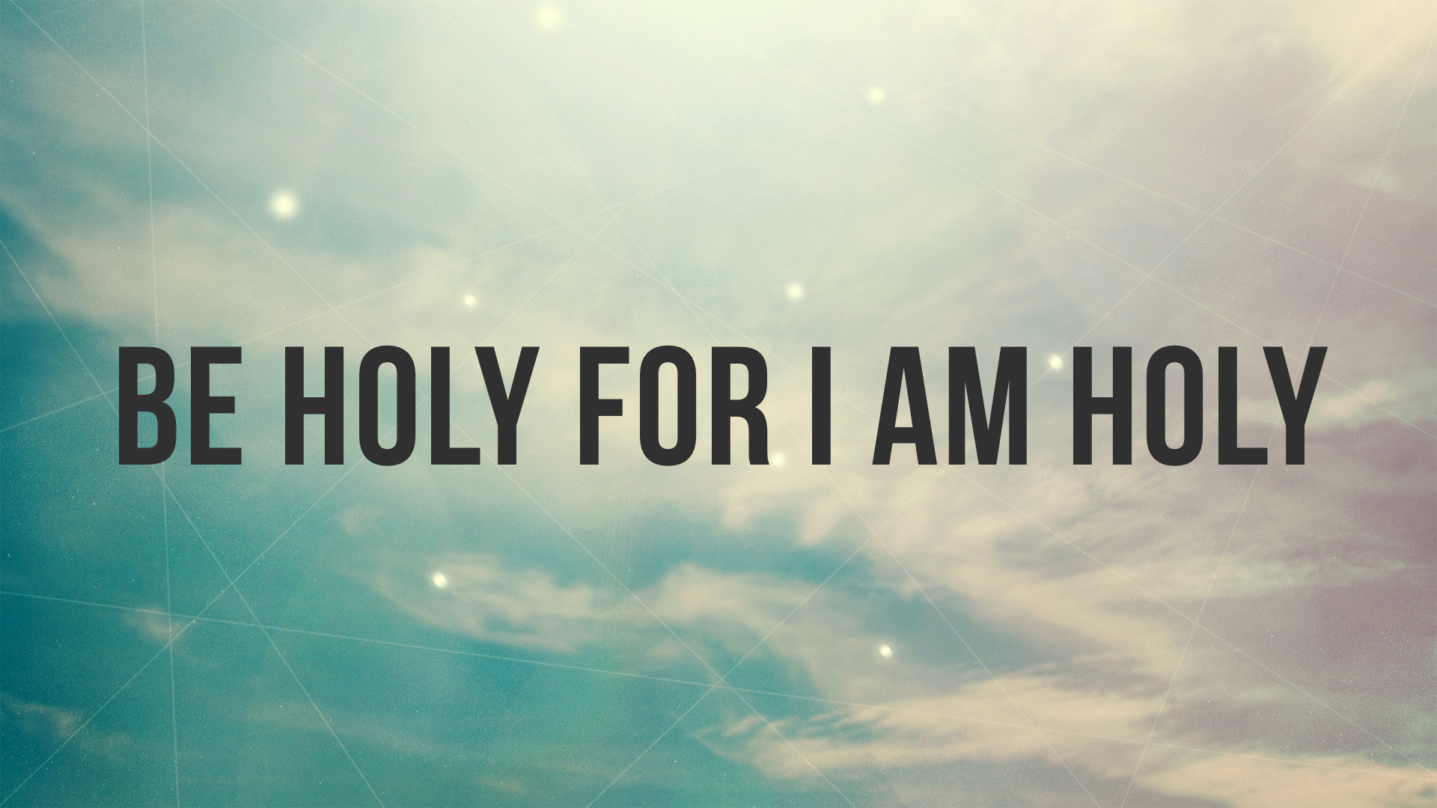

Slide 2
The High Call to Holiness
“the quality possessed by things and persons that could approach a divinity…. [pertaining] to being dedicated or consecrated to the service of God…. i.e. reserved for God and God’s service…. [It also carries the sense of being blameless or without fault]” (BDAG)

Slide 3
The High Call to Holiness
When we obey the truth (1 Peter 1.22) we are set apart from our “former” lusts/ignorance; that is, the world that is riddled with corruption (1 Peter 1.14; 2 Peter 1.3-4; 2.20-22).

Slide 4
“How Can I Be Holy Like God?”

Slide 5
Living the Holy Life
Love God’s children — our love for one another testifies of our conversion and sanctification, 1 Peter 1.22–23; 2.1; 1 John 5.1-2; Rom. 13.9
Long for God’s word — as our longing for the word increases, our desire to sin decreases, 1 Peter 2.1–2; Matt. 5.6
Live as God's servants — our devotion to God causes us to be free from sin (not free to sin), 1 Peter 2.16 (3.21; 4.2-4); 2 Peter 2.19; Gal. 5.13-14; John 8.31-36; Rom. 6.1-19

