Slide 1
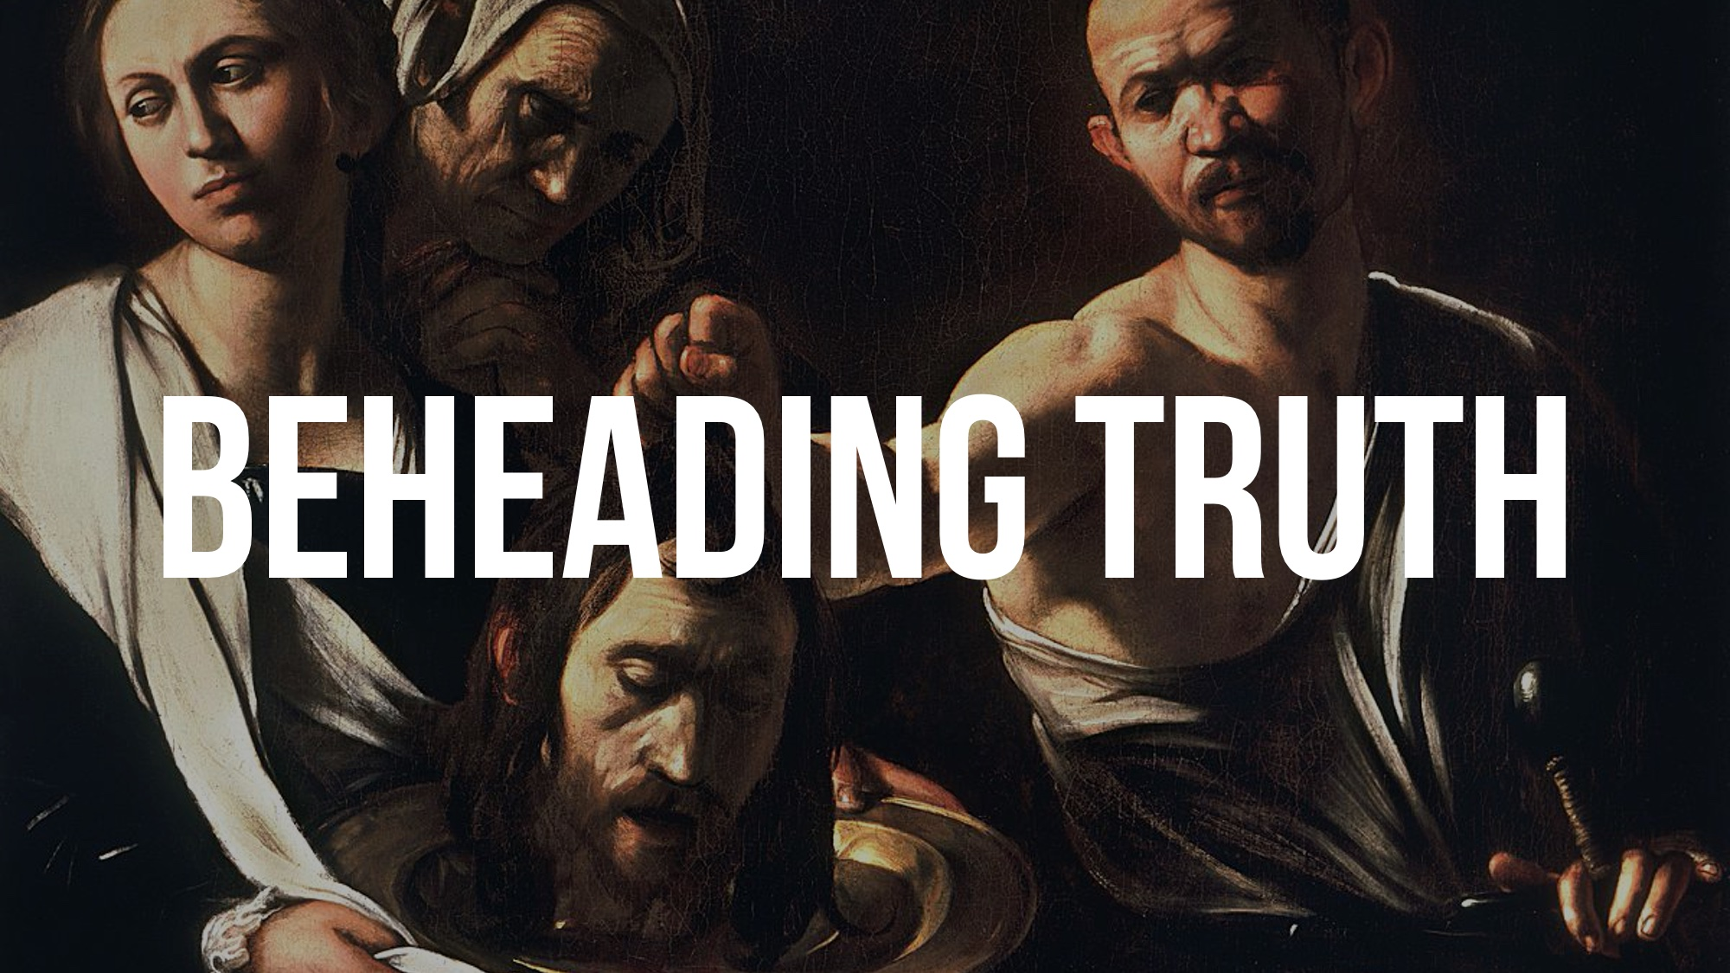

Slide 2
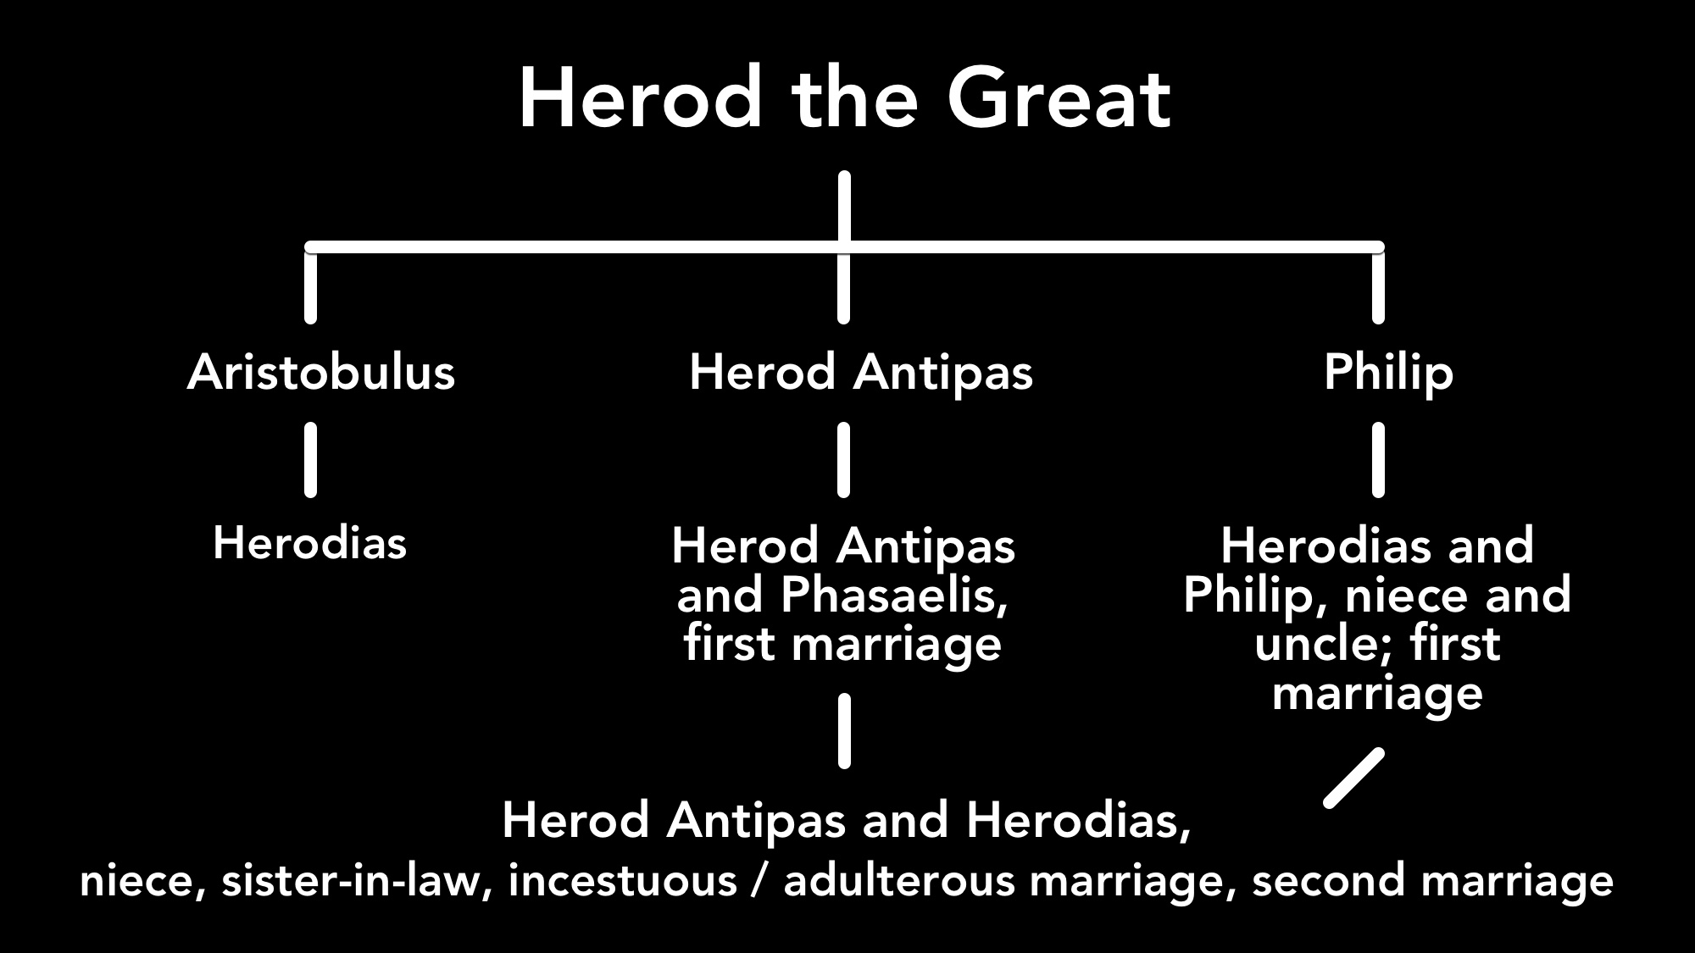

Slide 4
What John the Immerser Teaches Us…
If we are going to preach the truth, our lives must MATCH the truth, Mark 6.19-20; Matt. 5.16
If we are going to preach the truth, we cannot change the message to ACCOMMODATE the listener; even if it means we DIE for the truth,
Matt. 14.4; 2 Tim. 4.2-4; Eph. 4.15

Slide 5
What Herod Teaches Us…
PLEASURE kept him from obeying the truth, Matt. 14.4-6; 2 Thess. 2.10-12
PEER pressure from friends caused him to PROGRESS in his sin, Mark 6.20
The truth HAUNTED him — his foolishness TORMENTED his conscience, Mark 6.16

Slide 6
What Herodias Teaches Us…
Truth FRUSTRATES people — truth is often at ODDS with our desires, Mark 6.17-20; John 3.16-21
Truth is HARD to hear — truth is often SUPPRESSED to soothe our consciences, Rom. 1.18-32
If we PERSIST in frustration and suppression, we will want the truth destroyed by any means NECESSARY.

Slide 7
Do not BEHEAD the truth; SURRENDER to it, Prov. 23.23

