Slide 1
WHO DO YOU PLAY FOR?
1 Corinthians 1:10-17

Slide 2
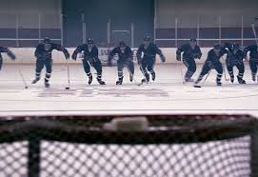
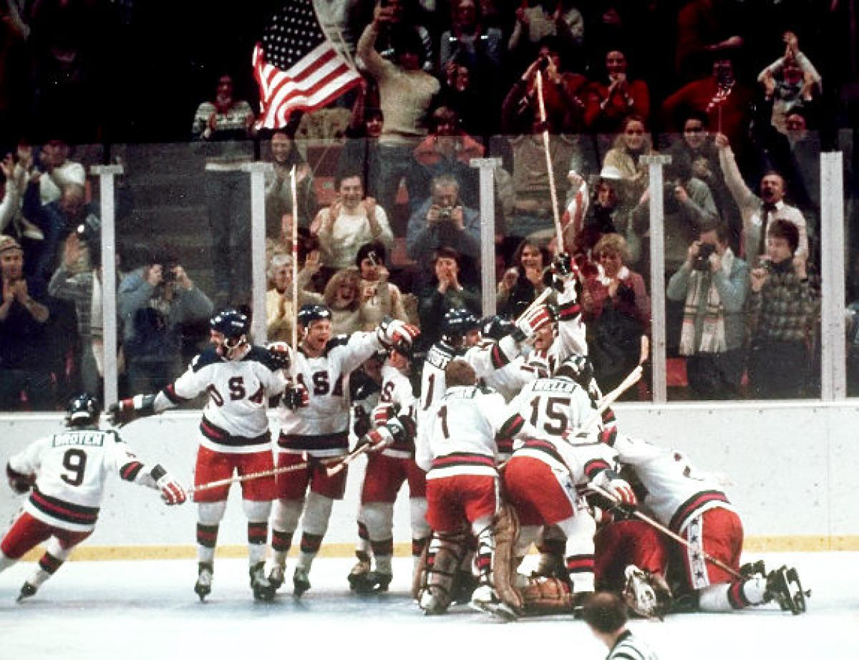

Slide 3
You play for the Almighty God
1 Cor 6:12-14
Rom 1:18-20
Col 1:15-20

Slide 4
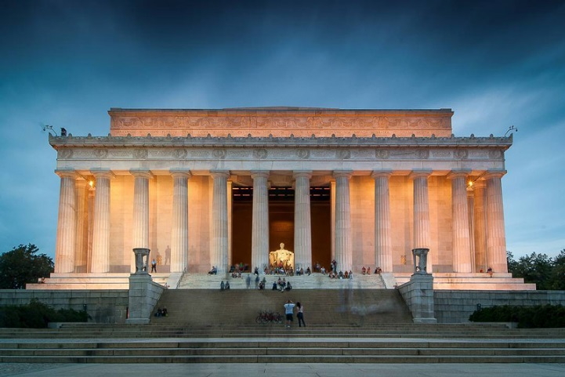
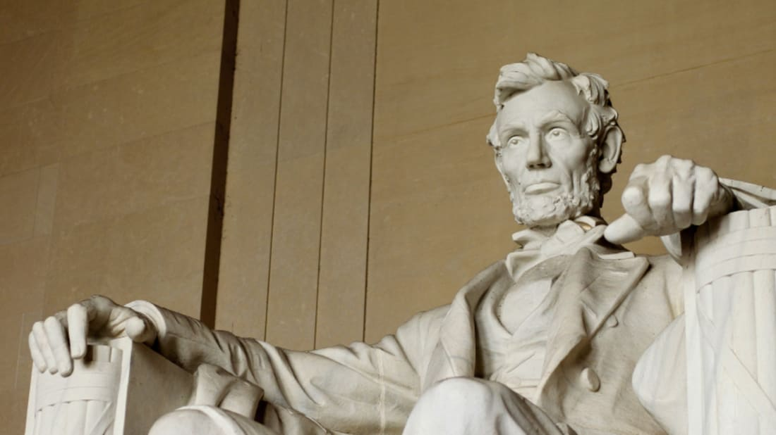
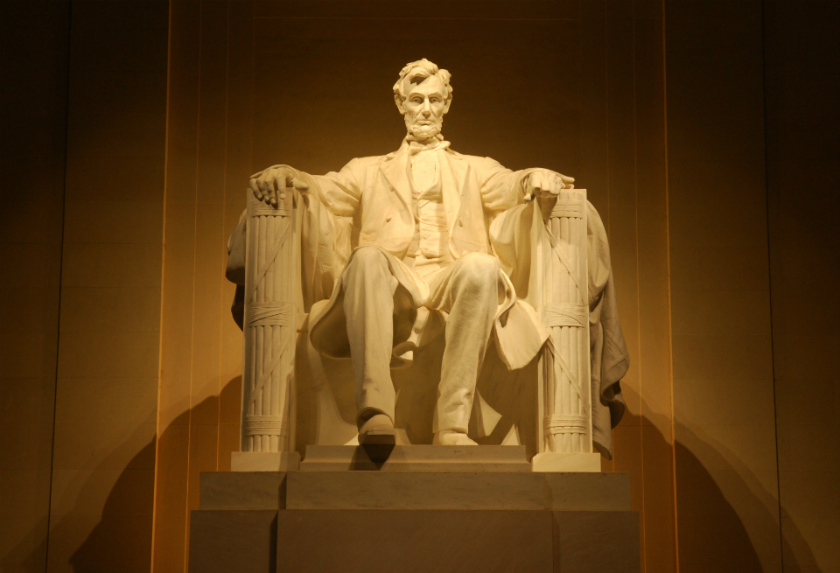

Slide 5
You play for the God of Justice
God is for US
Rom 12:17-19
2 Thes 1:5-8
Heb 10:30-31
God is for GOD
Matt 16:21-23
Luke 9:37-56

Slide 6
You play for the God of Mercy
Mercy for US
Eph 2:4-5
Mercy for THEM
John 8:1-20

