Slide 1
Gospel meeting – October 13-16, 2019 with Mark Roberts
Franklin Drive church of Christ  Texarkana, Arkansas www.txkchurch.com

Slide 3
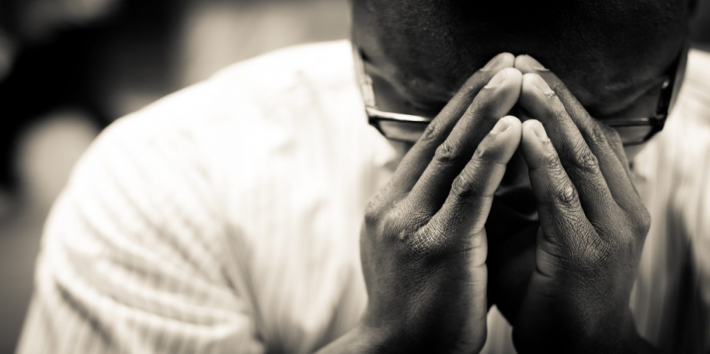
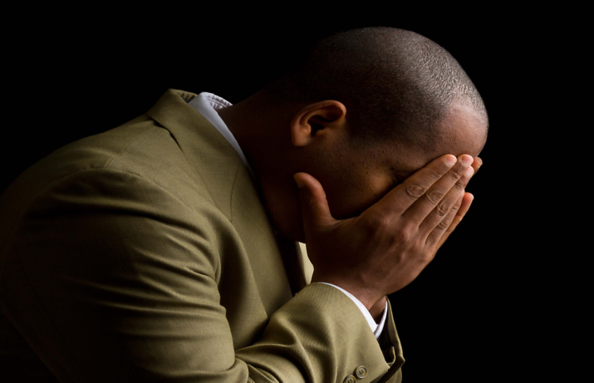
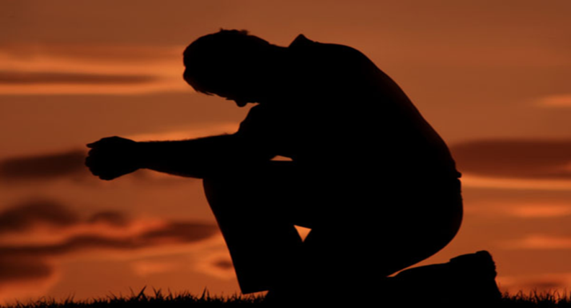
True Confession

Slide 4
True Confession
What is confession?
A declaration
An acknowledgement
“To say the same thing”

Slide 5
True Confession
The Keys to Confession
A daily discipline
Specific

Slide 6
True Confession
What happens when I confess?
I acknowledge God’s rule
I admit I am unworthy of grace
I affirm my hatred of sin
I am empowered to repent

Slide 7
True Confession

