Slide 1
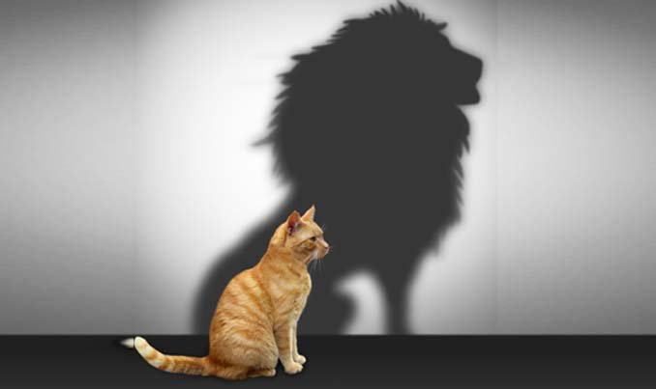
SELF
IMAGE

Slide 2
Millions, probably billions spent on personal care products and services:
Haircuts and styles – home hair products.
Skin and Beauty products – soaps, fragrances, lotions, makeup
Clothing
Jewelry and Accessories
Body Art
Most are necessities, but the huge variety and changes from year-to-year involve what we want our Self Image to be.

Slide 3
Who Am I?
Rancher Farmer Nurse Housewife Secretary Forester Student Retiree Receptionist ETC.
What Am I?
Father Mother Child Arkansan/Texan Fisherman Hunter Golfer Bowler
What Do Others Think Of Me?
Handsome Pretty Smart Dumb Homely Just OK Loner Young Old Fashionable Popular Talkative

Slide 4
But what about Jesus? What was His Self-Image?
Who Was He?
What Was He?
What Did Others Thing of Him?

Slide 5
Isaiah 53

Slide 6
1. God, through Isaiah, predicted WHO and WHAT Jesus would be.
2. The Gospels reveal that God was right in His predictions.
3. And partly because of WHO and WHAT Jesus was – along with the message He brought – people despised and rejected Him – both spiritually and physically.
1. Jesus know ahead of time – before coming to the earth – what God had predicted about Him.
2. Yet He came anyway – and fulfilled the predictions made by the Father.

Slide 7
But what was His own Self-Image?
1. We do not see Jesus spending time on His outward appearance.
2. We do not see Jesus shopping for fashionable and stylish clothing.
3. We do not see Jesus spending time making Himself popular.
4. We do not see Jesus trying to mold Himself into a particular image.
But Jesus had a VERY STRONG SELF-IMAGE!

Slide 8
Jesus
Who and What Am I?
The Bread of Life
The Light of the World
The Door to the Sheep
The Good Shepherd
The Son of God
The Resurrection
The Way
The Truth
The Life
The Vine
What Do Others Think of Me?
He was here to do His FATHER’S will – not please men!

Slide 9
Who/What Are We AS Christians?
The Salt of the Earth
The Light of the World
Children of God
Disciples of Christ
CHRISTIANS!
What Do Other’s Think About Us?
We should be here to do Our FATHER’s Will -not to please me!

Slide 10
If we are more concerned about our SELF Image:
How we look to yourself or others:
Than how we look to God:
We need to reexamine who we are and start imitating Jesus more.

