Slide 1
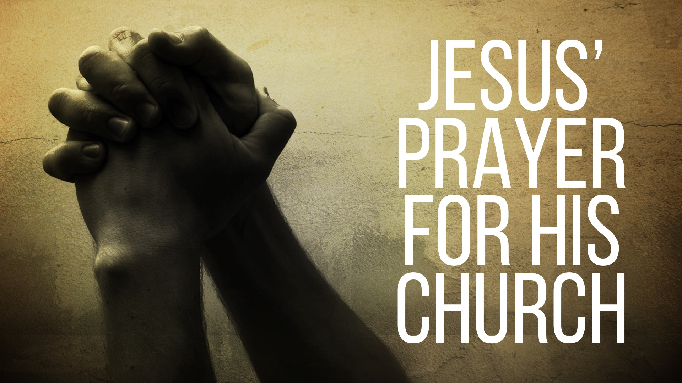

Slide 2
The reason Jesus came to the earth had ARRIVED – it was the hour of the CROSS.

Slide 3
What was on our Savior’s prayer list?

Slide 4
KNOW God, 3
To know God and Jesus goes beyond knowledge of FACTS about them. It means we FEAR and OBEY them, 8; John 14.21, 23; 1 John 2.3-6; 4.7-8; 5.20; Eccl. 12.13

Slide 5
FOLLOW God’s word, 8
By FAITH (20), when we follow God’s word we are set apart from the world because we live by a different and higher STANDARD (17) — therefore the world HATES us (14).

Slide 6
FURTHER God’s mission, 18
Our mission is to “show God’s glory to a world IGNORANT of God… to reveal His truth to a world in DARKNESS… to bring together a world DIVIDED by hatred and sin and bring them into the one body”. (Johnny Felker)

Slide 7
UNITE in God’s love, 20-23
Unity between believers demands that we use the same STANDARD (1 Cor. 1.10; Eph. 5.17), that we put forth EFFORT in maintaining right attitudes and doctrines (Eph. 4.1-6), that we stand for the truth TOGETHER (Phil. 1.27), and that we SHARE in God’s holiness — free of selfishness (Heb. 12.10; 2 Peter 1.3-11; Eph. 4.17-27). This is our greatest EVANGELISTIC means.

Slide 8
SEE God’s glory, 24
We see Jesus’ glory by faith, but one day we will see it with our own EYES, Acts 7.54-56; 1 John 3.1-2; Rom. 8.17-18

Slide 9
EXPERIENCE God’s joy, 13
We can be BLESSED with the joy that Jesus experienced in his glorification — TRUE and satisfying joy — when we know God, unite in His love, and serve one another.

Slide 10
Jesus prayed for you and me.
Is this prayer fulfilled in your life?

