Slide 1
Be Super

Slide 2
Be Super in Study
Study often
2 Timothy 3:16-17 - Deuteronomy 11:18-23
Study with others
Acts 2:42-47 - Proverbs 27:17
Study with a purpose
James 1:22 - Joshua 1:8-9

Slide 3
Be Super in Service
See a need, fill a need
Hebrews 13:16 - Philippians 2:4 - Luke 6:37-38 - 1 John 3:17-18
We all have a role
Romans 12:6-8 - 1 Peter 4:10-11

Slide 4
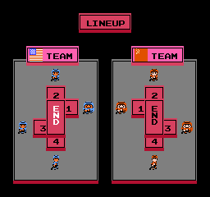
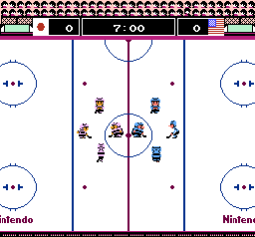

Slide 5
Be Super in Support
Support others to please them
Deuteronomy 15:7-11 - Romans 15:1-7
Support others to please God
Matthew 25:35-40 - Matthew 5:16 - Proverbs 19:17 - Luke 3:7-11

