Slide 1
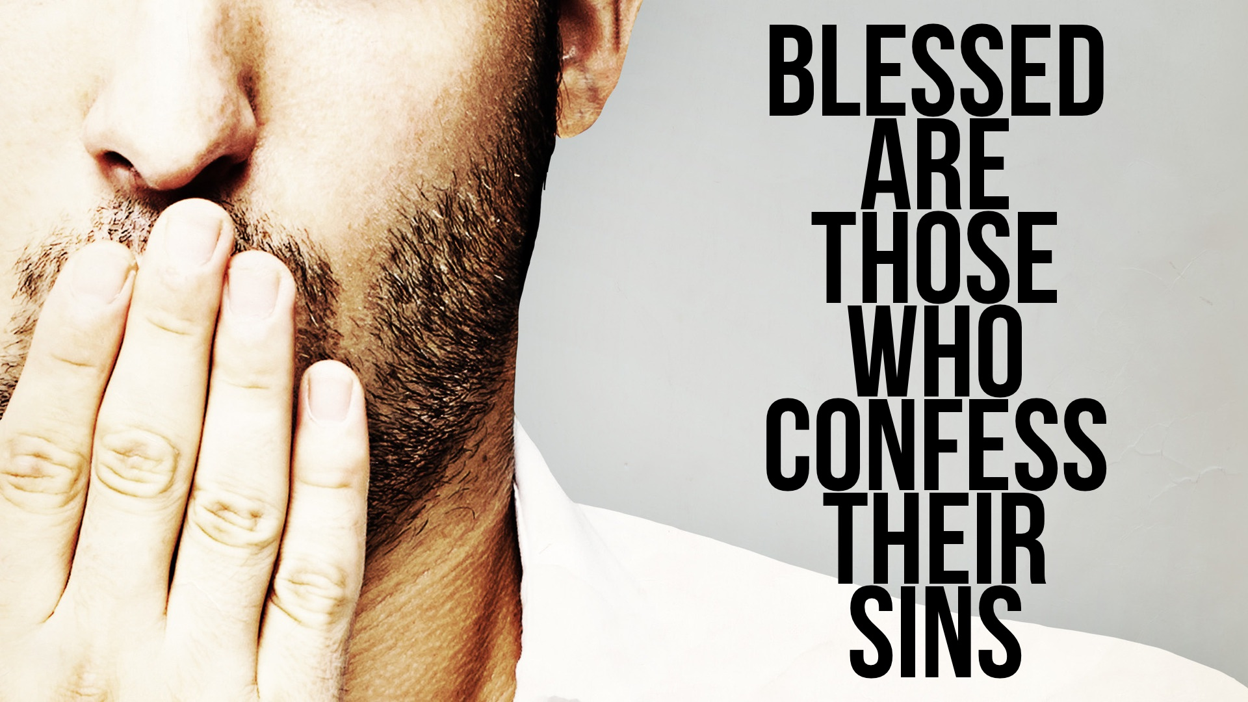

Slide 2
The BLESSINGS of Forgiveness, 1-2
When we sin against God, we have rebelled against Him (transgression), fallen short of his glory (sin), and perverted ourselves (iniquity) to our own destruction. God counts no sin against us when our sins are removed (forgiven).

Slide 3
The BURDEN of Sin, 3-6
If UNCONFESSED sin is in our life, we are SLAVES to that sin.
The pain we feel when we ignore sin in our lives is DESIGNED by God to urge us back to Him — his hand is heavy on us as he is DISCIPLINING us (Heb. 12.5-14).
When we confess our sins, we are simply acknowledging what God already knows and we are AGREEING with him that his law is right, and we are GUILTY of transgressing it. In other words, when we OWN our sins, that is when we are forgiven. (1 John 1.8-10; Prov. 28.13-14; Heb. 4.16)

Slide 4
The BENEFITS of Confessing Sin, 7-11
We are surrounded with God’s PROTECTION, 7
We are surrounded with God’s GUIDANCE, 8-9
We are surrounded with God’s LOVE, 10-11

Slide 5
Self-Examination
Who CONFESSES Their Sins and Is FORGIVEN? Those who are honest (2), those who are tired of the guilt and sorrow caused by sin (3, 10), those who refuse to cover their sins (5), those who are godly (6), those who trust God (7, 10), and those who upright in heart (11) – this is why David was a man after God’s own HEART!
Who REFUSES to Confess Their Sins and Is CONDEMNED? Those who are liars (2), those who are cowards (5), those who are stubborn (9), and those who are wicked (6a, 10).

