Slide 1
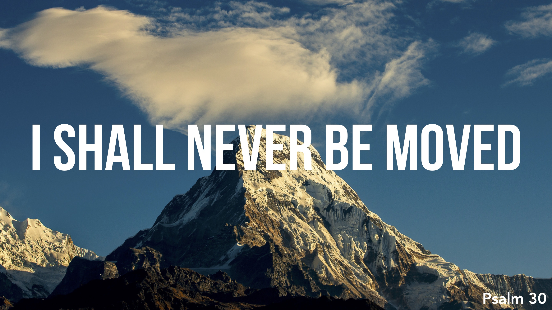

Slide 2
I Shall Never Be Moved – Arrogance and Self-Reliance
From death to life, 1-3
From God’s wrath to God’s grace, 4-5
From certainty to uncertainty, 6-7
From destruction to mercy, 8-10
From mourning to dancing, 11-12

