Slide 1
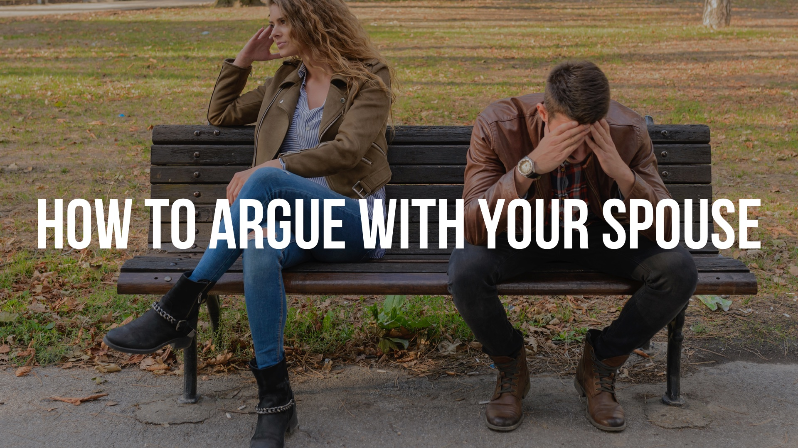

Slide 2
Every RELATIONSHIP involves two people with two different backgrounds, opinions, habits, and preferences – there will be CONFLICT.

Slide 3
Every RELATIONSHIP involves two people with two different backgrounds, opinions, habits, and preferences – there will be CONFLICT. While Christians are not to be QUARRELSOME, when conflict arises, Christians must react with God’s WISDOM. (Rom. 12.18; 2 Tim. 2.24-25; James 3.14-18)

Slide 4
Argue with the right PERSON at the right TIME about the right THING.
When you disagree, remember to be LOVING – not CRUEL.
When you disagree, remember to be WISE – not CARELESS.
When you disagree, remember to be PEACEABLE – not CONTENTIOUS.

Slide 5
Be PEACEABLE – not CONTENTIOUS
Avoid COMPETITIONS by SUBMITTING to one another.
Avoid SHOUTING matches by PRACTICING gentleness.
Avoid VERBAL punches by using EDIFYING words.
Avoid DIGGING up the past by FOCUSING on the present.

