Slide 1
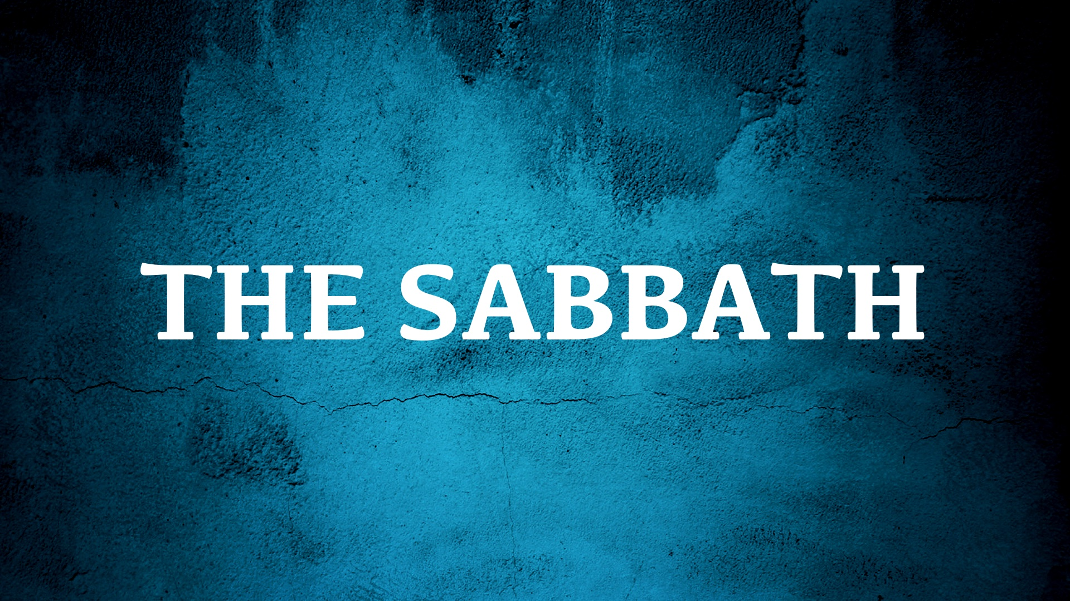

Slide 2
Sabbath – “to Rest or Cease from Labor”
The Sabbath was for the people of Israel only,
Deut. 5.1-6, 22; Exo. 16; 20; Neh. 13.13-22; 1 Kings 8.9, 21
The Sabbath was a weekly memorial and a sign,
Deut. 5.15; Exo. 31.13, 16-17; Ezek. 20.12, 20; Eph. 2.11-12
The Sabbath was strictly regulated to show its importance,
Deut. 5.12-14; Exo. 31.14-15; 20.10; 23.12; 35.2-3; 16.23; 34.21;
Num. 15.32-36; Amos 8.5; Lev. 24.8-9; Num. 28.9-10; Isaiah 56.2, 4, 6

Slide 3
If the Sabbath day is binding, then the instructions and punishment for defiling the Sabbath day is also binding.

Slide 4
The Sabbath and the New Covenant
The Old Covenant foretold a New Covenant – Jer. 31.31-32; Rom. 7.4, 6-7; Col. 2.13-17; Heb. 7.11-12
Per the Law of Christ, Christians assemble and worship on the first day of the week – Acts 2.1; 2.42; 20.7; 1 Cor. 16.1-2
What remains for Christians is eternal rest – Heb. 4.1-11

