Slide 2
Characteristics of the Lazy Person
A person who CAN work, but lacks the DESIRE to work – even refusing to work.

Slide 3
Characteristics of the Lazy Person
A person who CAN work, but lacks the DESIRE to work – even refusing to work. They love EXCESSIVE relaxation and AVOID effort and honest work.

Slide 4
Characteristics of the Lazy Person
A person who CAN work, but lacks the DESIRE to work – even refusing to work. They love EXCESSIVE relaxation and AVOID effort and honest work. They are selfish instead of SELFLESS.

Slide 5
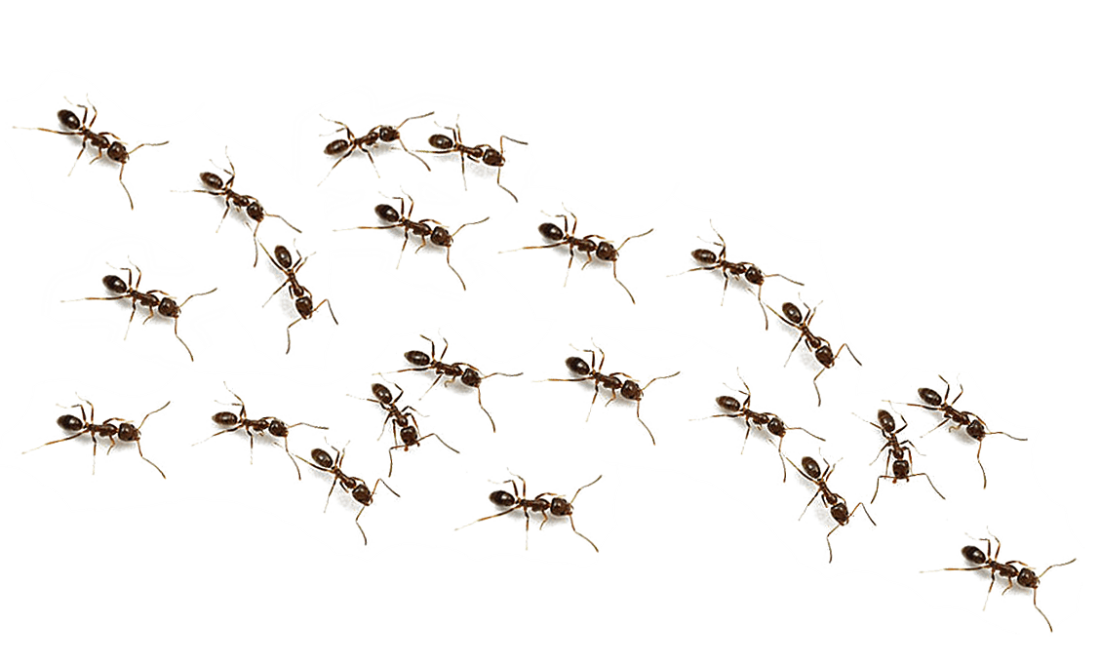
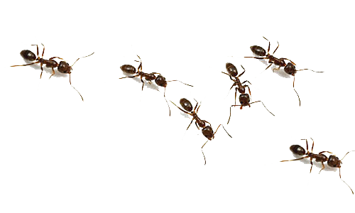
Why Go to the Ant?
Ants teach us to PERFORM DILIGENTLY.
Ants teach us to PLAN for the coming DAYS.
Ants teach us to PERSEVERE through DIFFICULTIES.
Ants teach us the PROFIT of being a DISCIPLINED person.

Slide 6
Laziness BREEDS more laziness – it is ADDICTIVE and IDOLATROUS.

Slide 7
The SPIRITUAL Sluggard
If we worked like we do for the Lord, would we lose our SECULAR JOB?
Do we offer EXCUSES for not doing the Lord’s work daily?
Do we say we want salvation but REFUSE to do what is necessary for it?

