Slide 1
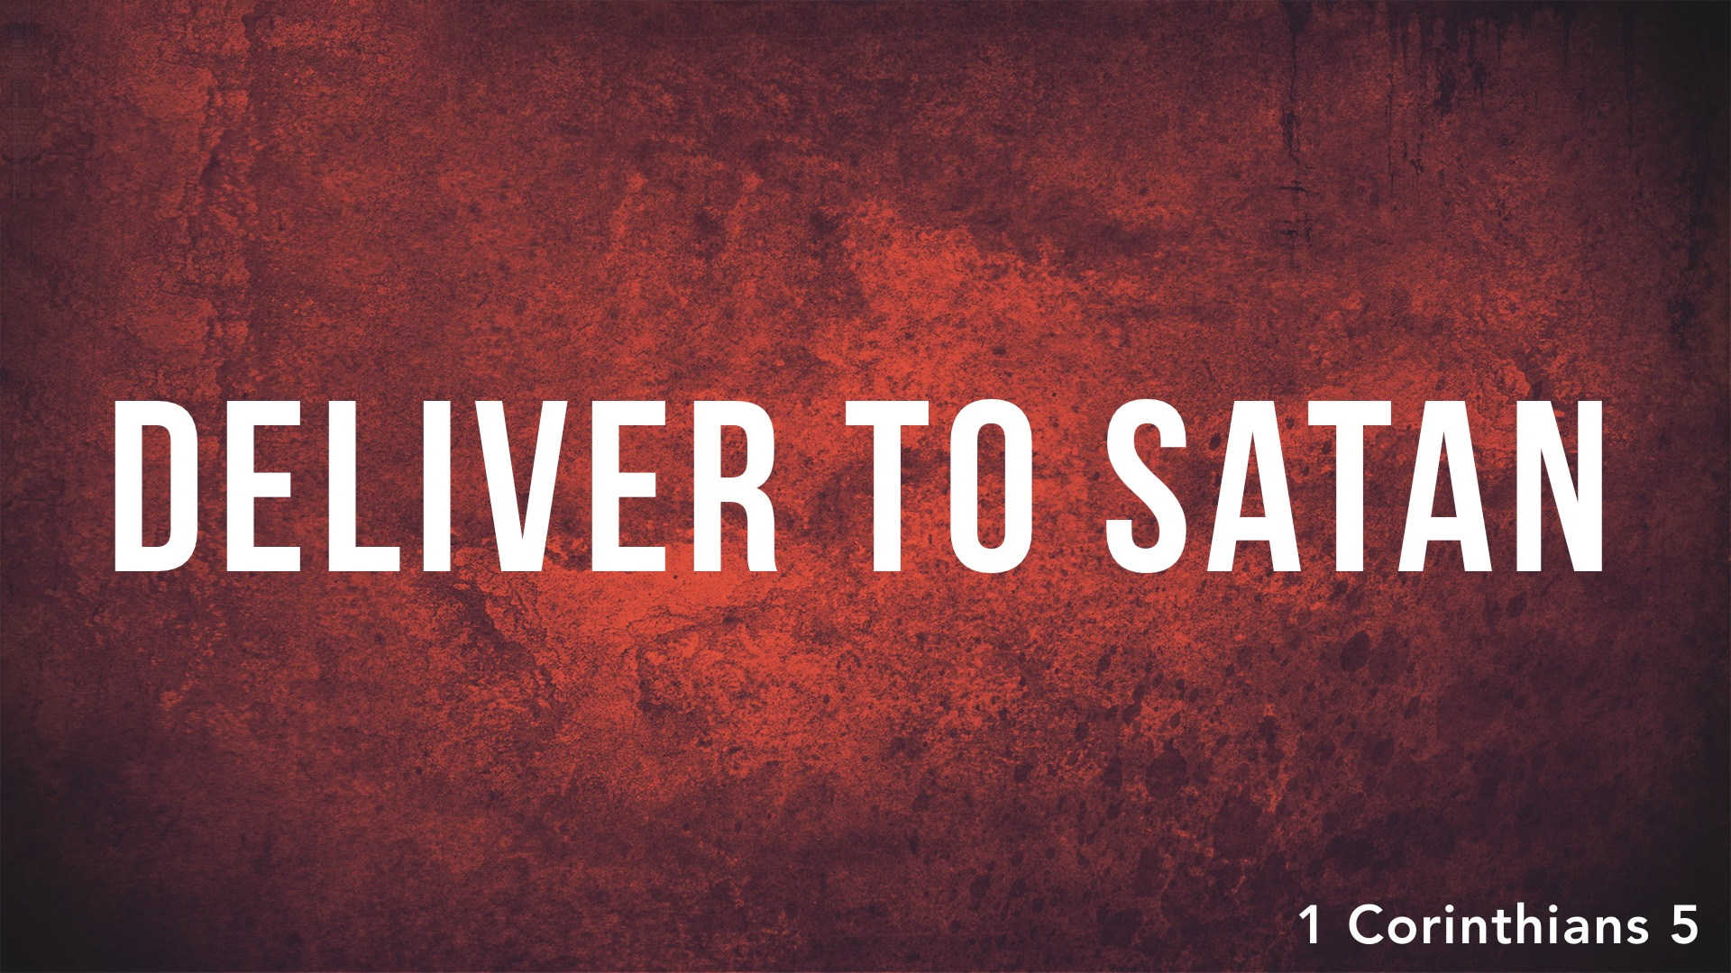

Slide 2
We must mourn the CONDITION of brethren in error and not LOOK the other way and PRETEND that nothing is wrong!

Slide 3
How Do We Destroy the Flesh?
  Why did we repent when we obeyed the gospel?

Slide 4
How Do We Destroy the Flesh?
  Why did we repent when we obeyed the gospel? Because we were not in FELLOWSHIP with God (Rom. 6.23; Eph. 2.12-13). We had to CEASE sin and CONTROL fleshly desires.

Slide 5
How Do We Destroy the Flesh?
  Why did we repent when we obeyed the gospel? Because we were not in FELLOWSHIP with God (Rom. 6.23; Eph. 2.12-13). We had to CEASE sin and CONTROL fleshly desires. The destruction of the flesh is simply a metaphor for putting away SIN through REPENTANCE (Rom. 8.7-8, 13; Gal. 5.16-25).

Slide 6
By delivering unruly brethren over to Satan, we are simply acknowledging REALITY – the transgressor is ALREADY with Satan. Thus, when the church ceases fellowship, it represents what God has already done in HEAVEN (and His DECISION on judgment day).

Slide 7
Our SPIRITUAL life is compared to the Feast of Unleavened Bread – Jesus' BLOOD purged us from all sin and as a new man/leaven, we must put the old man/leaven to death and serve God with PURITY of heart to live up to His SACRIFICE.

Slide 8
  Do not keep COMPANY with any person who professes Jesus as Lord who continues to INDULGE themselves in worldly pleasures or who cause stumbling and division through immorality and FALSE doctrines or who REFUSE to withdraw from others.
  (Matt. 18.15-17; Rom. 1.29-32; 1 Cor. 6.9-11; Gal. 5.19-21; 2 Thess. 3.6-15;
  Rev. 21.8; Rom. 16.17-18; 1 Tim. 1.19-20; 2 Tim. 2.16-18; Titus 3.10)

Slide 9
Why Does God Discipline Us through His Church?
To RESTORE erring brethren: Matt. 18.15-17
To cause erring brethren to be ASHAMED: 2 Thess. 3.14-15; Rom. 6.21
To teach the church to FEAR the Lord: Acts 5.5, 11; 1 Tim. 5.20
To show the ENORMITY of sin – it EXCLUDES one from the kingdom.
To PROTECT the purity of the church.
To show God and the world that we have NO PART with sin.

