Slide 1
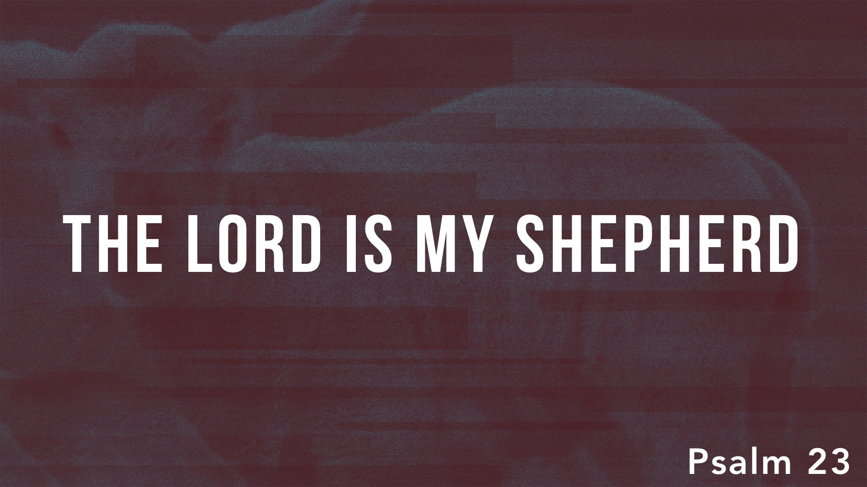

Slide 2
Psalm 23 and Jesus
John 10.7, 11, 14: “I am the good shepherd”
John 10.11, 15: “The good shepherd lays down his life for the sheep”
John 10.27-28: “My sheep hear my voice, and I know them, and they follow me. I give them eternal life, and they will never perish, and no one will snatch them out of my hand.”
Hebrews 13.20: “the great shepherd of the sheep”
1 Peter 2.25 – “the Shepherd and Overseer of your souls”
1 Peter 5.4: “the Chief Shepherd”

Slide 3
Is Jesus your Shepherd?

