Slide 1
Revelation 1
“John’s Vision of Christ
Commissioning Him to Write”
I. The Content & Nature of the Book (vv. 1-3)
II. Salutations to the Seven Churches (vv. 4-8)
III. John’s Vision of Christ (vv. 9-20)

Slide 2
Revelation 1
“John’s Vision of Christ
Commissioning Him to Write”
The Content & Nature of the Book (vv. 1-3)
Revelation of Christ which God gave him (v. 1)
Things that shortly take place (vv. 1, 3)
Signified (v. 1)

Slide 3
Revelation 1
“John’s Vision of Christ
Commissioning Him to Write”
The Content & Nature of the Book (vv. 1-3)
Salutations to the Seven Churches (vv. 4-8)
Grace & peace (v. 4)
From God & his Spirit (v. 4)
From Christ (vv. 5-8)

Slide 4
Revelation 1
Christ (vv. 5-8)
Faithful witness (v. 5)
Firstborn from the dead (v. 5)
Ruler over the kings of the earth (v. 5)
Loved us and washed us from sin (v. 5)
Made us kings and priests (v. 6)
To him be glory and dominion (v. 6)
Is coming in the clouds (v. 7)

Slide 5
Revelation 1
“John’s Vision of Christ
Commissioning Him to Write”
The Content & Nature of the Book (vv. 1-3)
Salutations to the Seven Churches (vv. 4-8)
John’s Vision of Christ (vv. 9-20)
A. Where John was – Patmos (v. 9)
B. Vision of Christ (vv. 10-18)
C. Commission to write (vv. 11, 19)
D. Explanation of vision (v. 20)

Slide 6
“John’s Vision of Christ
Commissioning Him to Write”
Key Verse
Revelation 1:11
Saying, "I am the Alpha and the Omega, the First and the Last," and, "What you see, write in a book and send it to the seven churches which are in Asia: to Ephesus, to Smyrna, to Pergamos, to Thyatira, to Sardis, to Philadelphia, and to Laodicea."

Slide 7
Revelation 1
“John’s Vision of Christ
Commissioning Him to Write”
The Content & Nature of the Book (vv. 1-3)
Salutations to the Seven Churches (vv. 4-8)
John’s Vision of Christ (vv. 9-20)

Slide 8
Revelation 1
What Is The Point?
“A living, holy, majestic, omniscient, authoritative, powerful Christ stands in the midst of the churches, holds their destiny in his hand and says: ‘Stop fearing, I was dead. I am alive forever. More than that, I hold in my hand the keys of death and the grave. You should not fear to go any place to which I hold the key.’”
- Ray Summers, Worthy is the Lamb, 105

Slide 9
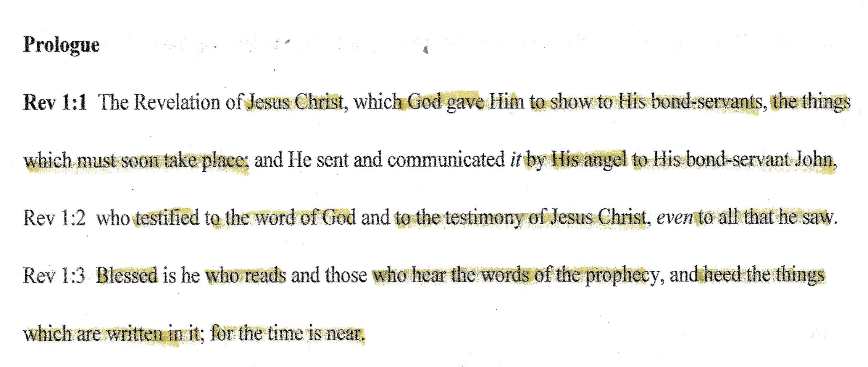

Slide 10
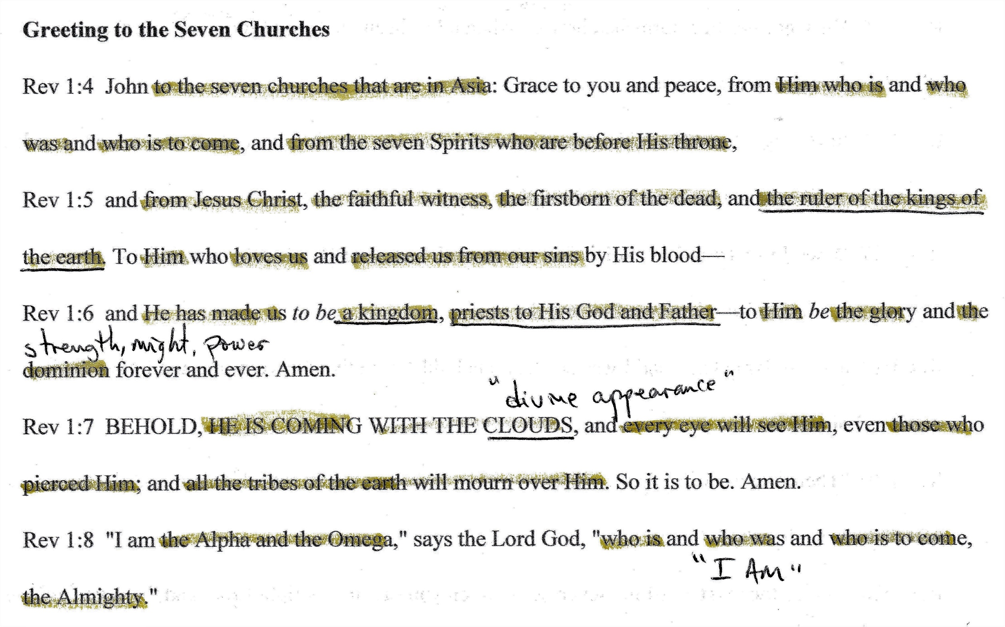

Slide 11
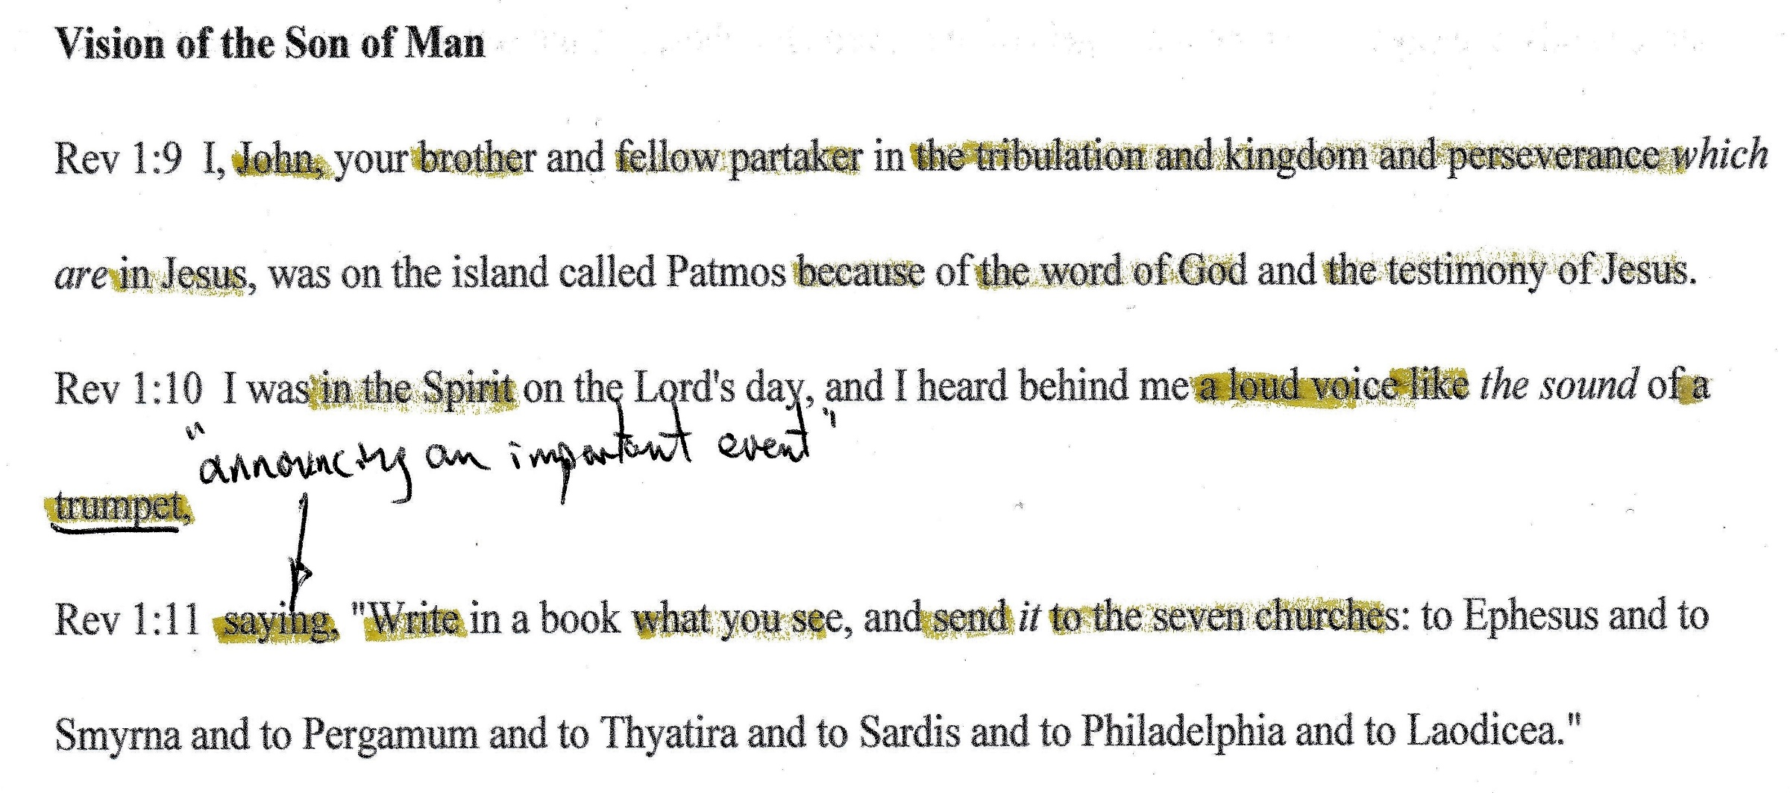

Slide 12
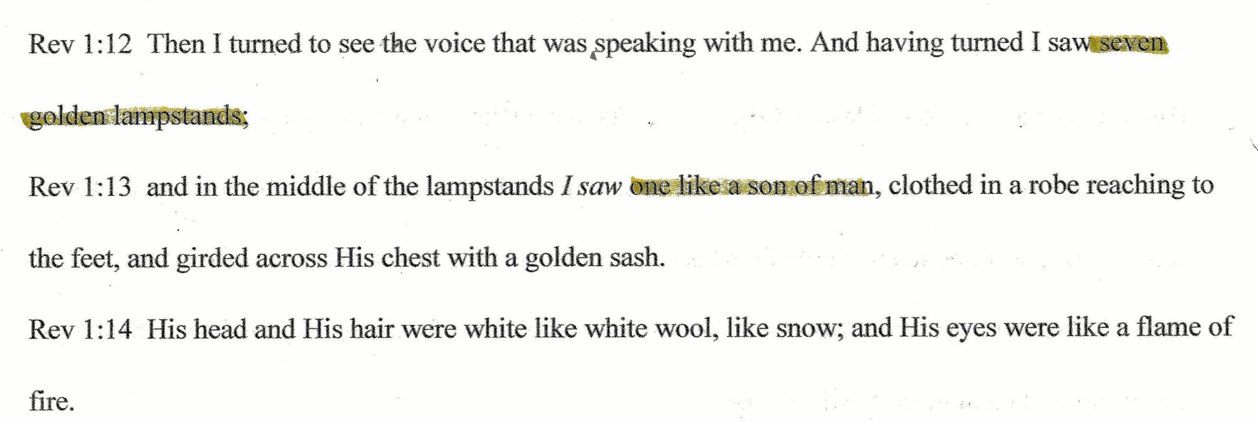

Slide 13
