Slide 1
Revelation

Slide 2
Revelation 1:1
The Revelation of Jesus Christ, which God gave him to show unto his servants, even the things which must shortly come to pass: and he sent and signified it by his angel unto his servant John;

Slide 3
Introducing Revelation
Early Date or Late Date?
The Date of the Book
Signs and Symbols. What and Who?
Confusion
What We Don’t Know About Revelation
“This Is That ...”: Acts 2:16
What We Do Know About Revelation
The Purpose of the Book
To Whom Was It Written?

Slide 4
Symbolic Objects in Revelation
Ark of the Covenant:
Babylon:
Beast:
Child: The Male Child
Children of Israel:
Clouds:

Slide 5
Color black:
Color pale (ashen): lit. pale green
Color red:
Color White:
Crystal Sea:
"Defiled with women":

Slide 6
Door:
Dragon:
Eagle:
Earthquake:
Fire:
Frog:
Gog and Magog:

Slide 7
Harlot: See Babylon
Horns:
Horse:
White: Conquest Red: War Black: Famine Pale: Death
Incense:
Isle or Islands:
Keys:

Slide 8
Lake of fire and brimstone:
Lamb:
Lightning, voices and thunders:
Lion:
Moon:
Mountains:
One hour:

Slide 9
Palm leaf:
Rainbow:
Sea:
Seal:
The Seals:
First: The white horse
Second: The red horse
Third: The black horse
Forth: The pale horse
Fifth: Souls under the alter
Sixth: Great earthquake, the sun blackened, the moon turned to blood
Seventh: Silence in heaven

Slide 10
Sickle:
Star or stars:
Throne:
Thunder:
Trumpet:
The Trumpets
First: Hail, fire, vegetation struck
Second: Great mountain burning; sea struck
Third: Great star fell from heaven; waters struck
Forth: Heaven struck (moon and stars)
Fifth: Locust
Sixth: The Euphrates struck
Seventh: Heaven

Slide 11
Waters:
Winds:
Winepress:
Woman:

Slide 12
The Seven Major OT Books Used in Revelation
Daniel
Ezekiel
Jeremiah
Isaiah
Zechariah
Exodus
Psalms

Slide 13
Places, Characters, and Objects
Jerusalem
The River Euphrates – war & destruction
Isa. 8:7; 27:12; 2 Chron. 35:20
Armageddon – Hill or City of Megiddo
Judges 5:19 – Battle between the judges and the kings of the Canaanites
2 Kings 23:29-30; 2 Chron. 35:22 – King Josiah dies in battle against the king of Egypt

Slide 14
Armageddon
Zec 12:10-14 "I will pour out on the house of David and on the inhabitants of Jerusalem, the Spirit of grace and of supplication, so that they will look on Me whom they have pierced; and they will mourn for Him, as one mourns for an only son, and they will weep bitterly over Him like the bitter weeping over a firstborn. "In that day there will be great mourning in Jerusalem, like the mourning of Hadadrimmon in the plain of Megiddo. "The land will mourn, every family by itself; the family of the house of David by itself and their wives by themselves; the family of the house of Nathan by itself and their wives by themselves; the family of the house of Levi by itself and their wives by themselves; the family of the Shimeites by itself and their wives by themselves; all the families that remain, every family by itself and their wives by themselves.

Slide 15
Objects That Are Named and Used From the
Old Testament
The Golden Lampstand
The Tabernacle and the Temple
The Altar
Balaam
Jezebel

Slide 16
Biblical Numbers
One - The Ultimate Unity
Two - Testimony and Witness
Three - Complete or Entire, often connected with Deity
Four - Every Direction, Everywhere
Seven - Finished, Perfect, an Oath
Ten - A complete set or a short time
Twelve - God’s people

Slide 17
Biblical Numbers
Twenty-four - God’s people under the Old and New Testaments
Forty - A complete, encompassing trial
One Hundred - A lot in quantity or a long time
666 - The Number of a Man
One Thousand - All in quantity or all the remain time
One Hundred Forty Four Thousand - All of God’s people

Slide 18
Part 1
Conflict and Judgment Within and Without the Church
Chapters 1-11
Chapter l. Christ Among the Lampstands
The Superscription, vv. 1-3
The Salutation, vv. 4-7
The Seal, v. 8
John's Charge to Write, vv. 9-11
The Vision: Christ's Majesty and Glory, vv. 12-16
The Charge to Write, vv. 17-20

Slide 19
Chapter 2. Letters to the Churches
Introduction to the Letters
Ephesus, vv. 1-7
Smyrna, vv. 8-11
Pergamum, vv. 12-17
Thyatira, vv. 18-29
Chapter 3. Letters to the Churches, Continued
Sardis, vv. 1-6
Philadelphia, vv. 7-13
Laodicea, vv. 14-22

Slide 20
Chapter 4. The Throne Scene
The Throne of God the Almighty
Chapter 5. The Lamb and the Book
Chapter 6. The Opening of the First Six Seals
The First Seal, vv. 1-2
The Second Seal, vv. 3-4
The Third Seal, vv. 5-6
The Fourth seal, vv. 7-8
The Fifth seal, vv. 9-11
The Sixth Seal, vv. 12-17

Slide 21
Chapter 7. An Interlude
Sealing the 144,000, vv. 1-8
The Victorious Multitude, vv. 9-17
Chapter 8. The Seventh Seal and the First Four Trumpets
The Seventh Seal: Prayer and Response, vv. 1-5
The First Four Trumpets, vv. 6-12
The Eagle: Herald of Woes, v. 13

Slide 22
Chapter 9. The Beginning of the Woes
The First woe, w. 1-12
The Second Woe, vv. 13-21
Chapter 10. The Angel and the Little Book
Chapter 11. The Vision Continues
The Measured Temple and the Two Witnesses, vv. 1-13
The Third Woe – The Seventh Trumpet, vv. 14-19

Slide 23
Part 2
War and Victory
Chapters 12-22
Chapter 12. The Woman and the Dragon
The Woman, the Dragon, the Man Child, vv. 1-6
The Great Spiritual War, vv. 7-12
Persecution of the Woman, vv. 13-17
Chapter 13. The Two Wild Beasts
The Beast Out of the Sea, vv. 1-10
The Beast Out of the Earth, vv. 11-18

Slide 24
Chapter 14. Righteous Judgment
The Lamb and the 144,000 on Mount Zion, vv. 1-5
Angels' Messages and a Voice of Warning from Heaven, vv. 6-13
Twofold Vision of Harvest and Vintage of the Earth, vv. 14-20
Chapter 15. The Seven Bowls of Wrath
The Seven Angels Introduced, vv. 1-8
Chapter 16. The Bowls of Wrath Poured Out
Bowls Involving Nature, vv. 1-9
Bowls Involving the Moral and Political, vv. 10-21

Slide 25
Chapter 17. The Infamy and Fall of Babylon
The Babylon Harlot Identified, vv. 1-6
Explanation of the Mystery of the Woman and the Beast, vv. 7-14
Further Identification of the Harlot, vv. 1 5-18
Chapter 18. The Fall of the Harlot
Heaven's Decree: "Fallen is Babylon," vv. 1-8
Lament of the Earthlings over Babylon, vv. 9-19
The Voice of Rejoicing, v. 20
The Silence of the Tomb, vv. 21-24

Slide 26
Chapter 19. Victory
Hallelujahs of Victory, vv. 1-10
The Warrior-King: Defeat of the Two Beasts, vv. 11-21
A. The Warrior-King Revealed, vv. 11-16
B. The Angel's call to "The Great Supper of god," vv. 17-18
C. The Decisive Battle and Defeat of Evil, vv. 19-21
Chapter 20. The Thousand Years and the Final Judgment
The Thousand Years, vv. 1-10
The Final Judgment, vv. 11-15

Slide 27
Chapter 21. The Eternal Glory
"All Things New," vv. 1-8
The New Jerusalem, vv. 9-27

Slide 28
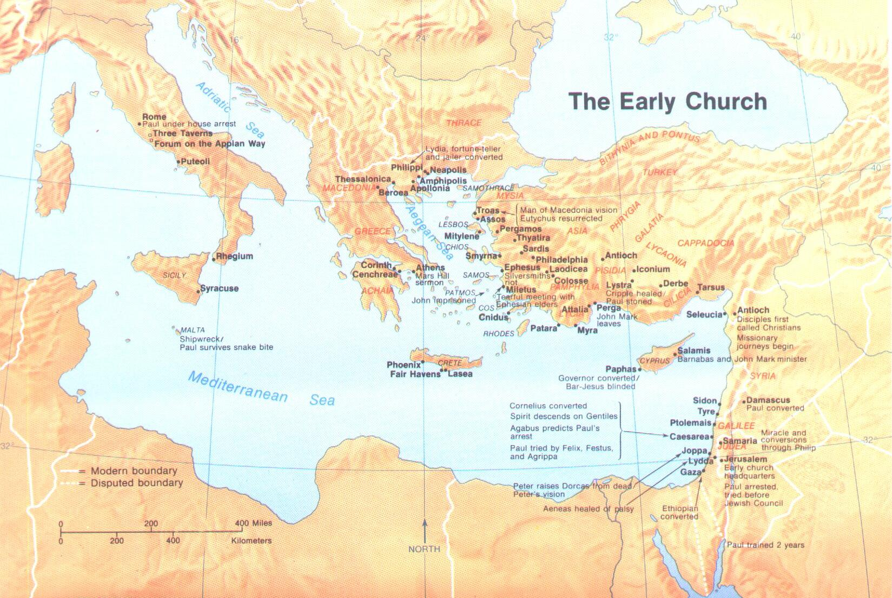
Letters To The
The Seven Churches of Asia

Slide 29
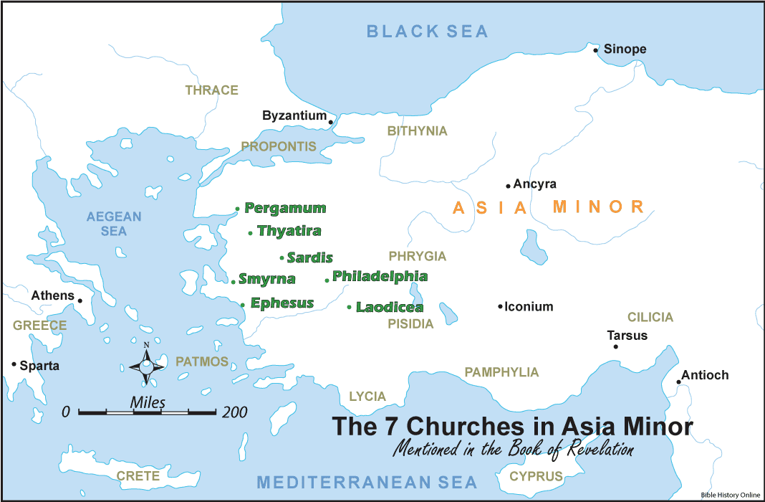

Slide 30
Chapter l. Christ Among the Lampstands
The Superscription, vv. 1-3
The Salutation, vv. 4-7
The Seal, v. 8
John's Charge to Write, vv. 9-11
The Vision: Christ's Majesty and Glory, vv. 12-16
The Charge to Write, vv. 17-20

Slide 31
Chapter 2. Letters to the Churches
Introduction to the Letters
Ephesus, vv. 1-7
Jesus ...
The One who hold the seven stars
The One who walks among the lampstands
I know ...
Deeds, toil, perseverance
Cannot tolerate evil men
Test false apostles
Perseverance and endurance and not grown weary

Slide 32
Chapter 2. Letters to the Churches
Introduction to the Letters
Ephesus, vv. 1-7
I have this against you ...
Left your first love
Remember ...
You have fallen
Repent
Do first deeds
I am coming
I will remove your lampstand
Repent
You do have ...
Hate the deeds of the Nicolaitans

Slide 33
Chapter 2. Letters to the Churches
Introduction to the Letters
Ephesus, vv. 1-7
Listen ...
Hear the Spirit
Overcome
Reward ...
Grant to eat of the tree of life

Slide 34
Chapter 2. Letters to the Churches
Smyrna, vv. 8-11
Jesus ...
The first and last
Was dead and has come to life
I know ...
Tribulation, poverty, blaspheme
Do not ...
Fear persecution

Slide 35
Chapter 2. Letters to the Churches
Smyrna, vv. 8-11
Be faithful ...
Until death
Reward ...
Give the crown of life
Not hurt by the second death
Listen ...
Hear the Spirit
Overcome

Slide 36
Chapter 2. Letters to the Churches
Pergamum, vv. 12-17
Jesus ...
Has the sharp sword
I know ...
Where you live (Where Satan’s throne is)
You hold fast my name
Did not deny My faith, My witness, my faithful one
I have this against you ...
Some teach Balaam
Teach the Nicolaitans

Slide 37
Chapter 2. Letters to the Churches
Pergamum, vv. 12-17
Repent ...
I will come quickly
Make war with you
Listen ...
Hear the Spirit
Overcome
Reward ...
Give the hidden manna
Give a white stone
Give a new name

Slide 38
Chapter 2. Letters to the Churches
Thyatira, vv. 18-29
Jesus ...
The Son of God
Eyes like a flame of fire
Feet like burnished bronze
I know ...
Your deeds, love, faith, service, perseverance
Later deeds greater than first
I have this against you ...
You tolerate Jezebel – teach and lead servants astray - immorality

Slide 39
Chapter 2. Letters to the Churches
Thyatira, vv. 18-29
Beware …
Repent
Reward according to deeds
I say to the innocent ...
I place no other burden on you
Hold fast
Overcome ...
Keep My deeds to the completion

Slide 40
Chapter 2. Letters to the Churches
Thyatira, vv. 18-29
Reward ...
Give authority over the nations
Give the morning star
Listen ...
Hear the Spirit

Slide 41
Chapter 3. Letters to the Churches, Continued
Sardis, vv. 1-6
Jesus ...
Has the seven Spirits of God and the seven stars
I know ...
Your deeds
A name alive, but you are dead
Wake up …
Strengthen what remains

Slide 42
Chapter 3. Letters to the Churches, Continued
Sardis, vv. 1-6
Be watchful ...
No deeds completed
Finish what you started
Remember ...
What you received and heard
Keep them
Repent
I will come as a thief
A few remain pure

Slide 43
Chapter 3. Letters to the Churches, Continued
Sardis, vv. 1-6
Reward ...
Walk with Jesus in white
Overcome ...
Be clothed in white
Not erase your name from the book of life
I will confess your name
Listen ...
Hear the Spirit

Slide 44
Chapter 3. Letters to the Churches, Continued
Philadelphia, vv. 7-13
Jesus ...
Holy and true
Has the key of David
Open and shuts
I know ...
Your deeds
Given you an open door
You have a little power
Kept My word – with perseverance
Give you of the synagogue of Satan
Not denied My name

Slide 45
Chapter 3. Letters to the Churches, Continued
Philadelphia, vv. 7-13
I will also ...
Keep you from the hour of tribulation
I am coming ...
Quickly
Hold fast what you have

Slide 46
Chapter 3. Letters to the Churches, Continued
Philadelphia, vv. 7-13
Overcome ...
Reward ...
Make a pillar in the temple
Write on you the name of God
Listen ...
Hear the Spirit

Slide 47
Chapter 3. Letters to the Churches, Continued
Laodicea, vv. 14-22
Jesus ...
The Amen
The faithful and true witness
The Beginning of creation
I know ...
Your deeds
Neither hot or cold - lukewarm
Say you are rich – but are poor
You are wretched, miserable, poor, blind, naked

Slide 48
Chapter 3. Letters to the Churches, Continued
Laodicea, vv. 14-22
Warning ...
Buy Me gold, white garments and eye salve
Clothe yourselves
Apply eye salve
Be zealous
Repent
I will ...
Love, reprove, discipline

Slide 49
Chapter 3. Letters to the Churches, Continued
Laodicea, vv. 14-22
I stand at the door ...
I knock
Hear My voice
Open the door
I will come in and dwell
Overcome ...
Reward ...

