Slide 1
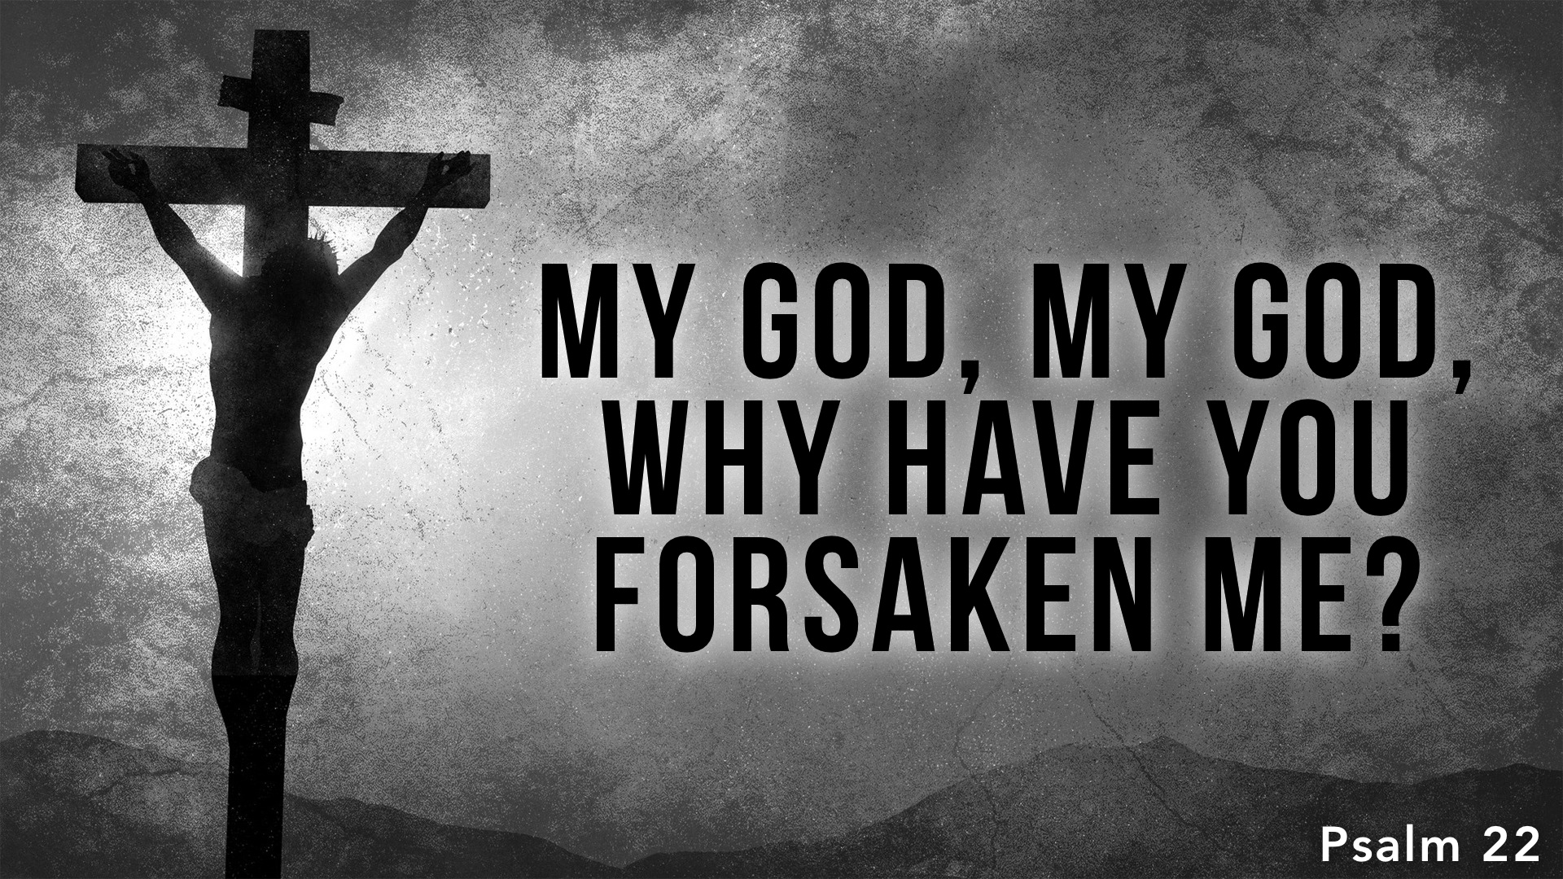

Slide 2
Psalm 22 Outline
1-2: Complaint – God isn’t answering me!
3-5: Appeal to the past – Our fathers’ trust and deliverance.
6-8: Complaint – My trust means mockery!
9-10: Appeal to the past – You’ve helped me before.
11-18: Complaint – But there’s no one to help now!
19-21: Request – Be not far off!
22-24: Public Praise – God does not forsake the afflicted.
25-31: God’s rule over the nations; the message proclaimed.

Slide 3
His Initial Feelings Did Not Match Reality
“For he has not despised or abhorred the affliction of the afflicted, and he has not hidden his face from him, but has heard, when he cried to him.” (24)

Slide 4
David’s Confidence Throughout the Psalm
He called him “my God” – he maintained faith: 1
He considered God as holy and worthy of praise: 3
He relied on the past’s deliverance, his devotion to God, and God’s faithfulness: 3-5, 9-10
He used his suffering to proclaim His greatness: 22-31

Slide 5
Application to the Messiah | Prophecy
Psalm 22.1
Matthew 27.46; Mark 15.34
My God, my God, why have you forsaken me?
Jesus cried out with a loud voice, saying, “Eli, Eli, lema sabachthani?” that is, “My God, my God, why have you forsaken me?”

Slide 6
Application to the Messiah | Prophecy
Psalm 22.6
Isaiah 53.3-4; Matt. 26.67-68; 27.20-23; Luke 23.11, 21-23
But I am a worm and not a man,scorned by mankind and despised by the people.
He was despised and rejected by men… Then they spit in his face and struck him. And some slapped him … They all said, “Let him be crucified!” … treated him with contempt and mocked him

Slide 7
Application to the Messiah | Prophecy
Psalm 22.7
Matt. 27.29, 39-40; Mark 15.20, 29; Luke 23.11, 35-39
All who see me mock me; they make mouths at me; they wag their heads;
mocked him, saying, “Hail, King of the Jews!”… those who passed by derided him, wagging their heads… the people stood by, watching, but the rulers scoffed at him, saying, “He saved others; let him save himself…”

Slide 8
Application to the Messiah | Prophecy
Psalm 22.8
Matt. 27.41-44; Mark 15.31-32
“He trusts in the LORD; let him deliver him; let him rescue him, for he delights in him!”
mocked him, saying, “He saved others; he cannot save himself. He is the King of Israel; let him come down now from the cross, and we will believe in him. He trusts in God; let God deliver him now…

Slide 9
Application to the Messiah | Prophecy
Psalm 22.11
Matt. 26.56, 72; John 16.32
Be not far from me, for trouble is near, and there is none to help.
Then all the disciples left him and fled… again he denied it with an oath: “I do not know the man…” you will be scattered, each to his own home, and will leave me alone.

Slide 10
Application to the Messiah | Prophecy
Psalm 22.12-13
Matt. 27.1, 24-25; Acts 4.27
Many bulls encompass me; strong bulls of Bashan surround me; they open wide their mouths at me, like a ravening and roaring lion.
the people took counsel against Jesus to put him to death… a riot was beginning… all the people answered, “His blood be on us and on our children!”… were gathered together against… Jesus

Slide 11
Application to the Messiah | Prophecy
Psalm 22.15
Matt. 27.48; John 19.28-29
my strength is dried up like a potsherd, and my tongue sticks to my jaws; you lay me in the dust of death.
knowing that all was now finished, said (to fulfill the Scripture), “I thirst.” (cf. Psalm 69.21)

Slide 12
Application to the Messiah | Prophecy
Psalm 22.15
Matt. 27.50; John 19.30
my strength is dried up like a potsherd, and my tongue sticks to my jaws; you lay me in the dust of death.
When Jesus had received the sour wine, he said, “It is finished,” and he bowed his head and gave up his spirit.

Slide 13
Application to the Messiah | Prophecy
Psalm 22.16
Matt. 26.57; Mark 15.16-20; Luke 22.63-71; 23.4-5, 10-11, 23, 36; John 20.25
For dogs encompass me; a company of evildoers encircles me; they have pierced my hands and feet
[authorities] gathered… soldiers… called together the whole battalion… [the people] were urgent, demanding with loud cries that he should be crucified…

Slide 14
Application to the Messiah | Prophecy
Psalm 22.17
Matt. 27.36, Luke 23.35
I can count all my bones—they stare and gloat over me;
the people stood by, watching…

Slide 15
Application to the Messiah | Prophecy
Psalm 22.18
Matt. 27.35; Mark 15.24; Luke 23.34; John 19.23-24
they divide my garments among them, and for my clothing they cast lots.
…they took his garments and divided them… his tunic… “Let us not tear it, but cast lots for it...” This was to fulfill the Scripture which says, “They divided my garments among them, and for my clothing they cast lots.”

Slide 16
Application to the Messiah | Prophecy
Psalm 22.22
Heb. 2.12
I will tell of your name to my brothers; in the midst of the congregation I will praise you:
“I will tell of your name to my brothers; in the midst of the congregation I will sing your praise.”

Slide 17
Application to the Messiah | Prophecy
Psalm 22.24
Heb. 5.7
For he has not despised or abhorred the affliction of the afflicted, and he has not hidden his face from him, but has heard, when he cried to him.
In the days of his flesh, Jesus offered up prayers and supplications, with loud cries and tears, to him who was able to save him from death, and he was heard because of his reverence

Slide 18
Application to the Messiah | Prophecy
Psalm 22.31
John 19.30
they shall come and proclaim his righteousness to a people yet unborn, that he has done it.
When Jesus had received the sour wine, he said, “It is finished,” and he bowed his head and gave up his spirit.

Slide 19
Matthew 27.46 was not to describe the actual relationship between Jesus and the Father, but to describe how it appeared to the onlookers and to show that Psalm 22 was being fulfilled before their eyes (Acts 13.27).

Slide 20
Expression of trust in God – quotes from a Psalm that ultimately points to deliverance from death (resurrection).

