Slide 1
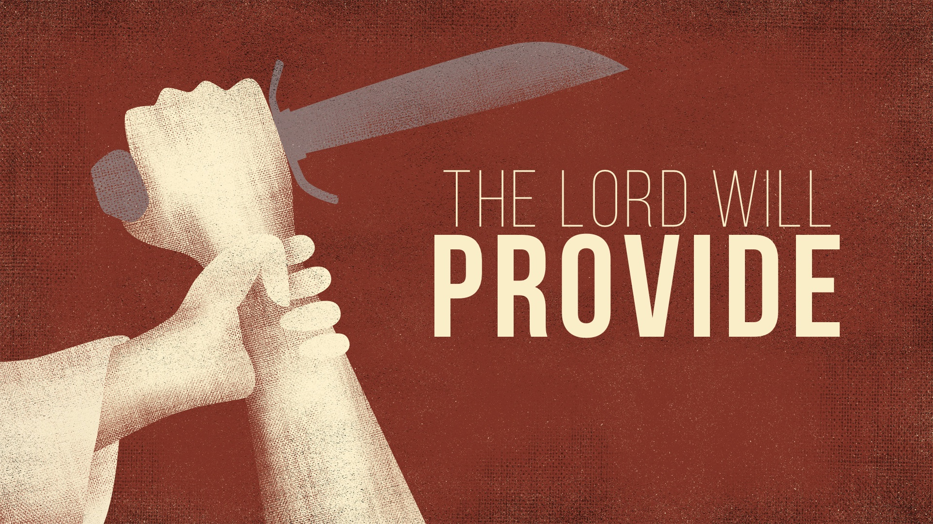

Slide 2
Isaac Is a Picture of JESUS
BOTH have impossible pregnancies with divine intervention, descendants of Abraham, named before their birth, born at the right time, left their homeland and rode a donkey to their death, three days journey and three days in the tomb, carried their own wood and placed on wood, offered as a sacrifice on the same mountain, released from death and raised from death, etc.

Slide 3
Why Did God Command the Sacrifice of Isaac?
God ORCHESTRATED an event in Abraham’s life to FORESHADOW what He always PLANNED to endure – His Son's sacrifice to fulfill His PROMISE to Abraham and his descendants. And He did so, not SPARING His own son: Rom. 8.32

Slide 4
Why Did Abraham Obey God?
Despite the difficulty, Abraham SURRENDERED everything because he TRUSTED God and loved Him with all his heart and ABOVE his own beloved son

Slide 5
Why Did Abraham Obey God?
Despite the difficulty, Abraham SURRENDERED everything because he TRUSTED God and loved Him with all his heart and ABOVE his own beloved son – faith is not something you are WILLING to do, it is something you DO. He had it to do and he did it: Heb. 11.17-19; James 2.20-24

Slide 6
Do We Trust God like Abraham?
If we truly trust God, then whatever He commands – no matter the DIFFICULTY or whether we UNDERSTAND it – we will obey

Slide 7
Do We Trust God like Abraham?
If we truly trust God, then whatever He commands – no matter the DIFFICULTY or whether we UNDERSTAND it – we will obey; and, we will put NOTHING before our LOYALTY to Him: Rom. 4.3, 11-12, 16-25

Slide 8
Do We Trust God like Abraham?
Those who are children of God by faith are those who INHERIT the BLESSINGS promised to Abraham: Gal. 3.8-9, 22, 26-29

