Slide 1
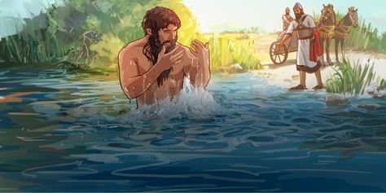
Naaman’s Baptism
2 Kings 5:1-27

Slide 2
Naaman:
1. Captain of the army of Aram/Syria
2. A great man
3. Highly respected
4. Jehovah had granted victory to Syria through Naaman
5. A valiant warrior
6. But he was a leper

Slide 3
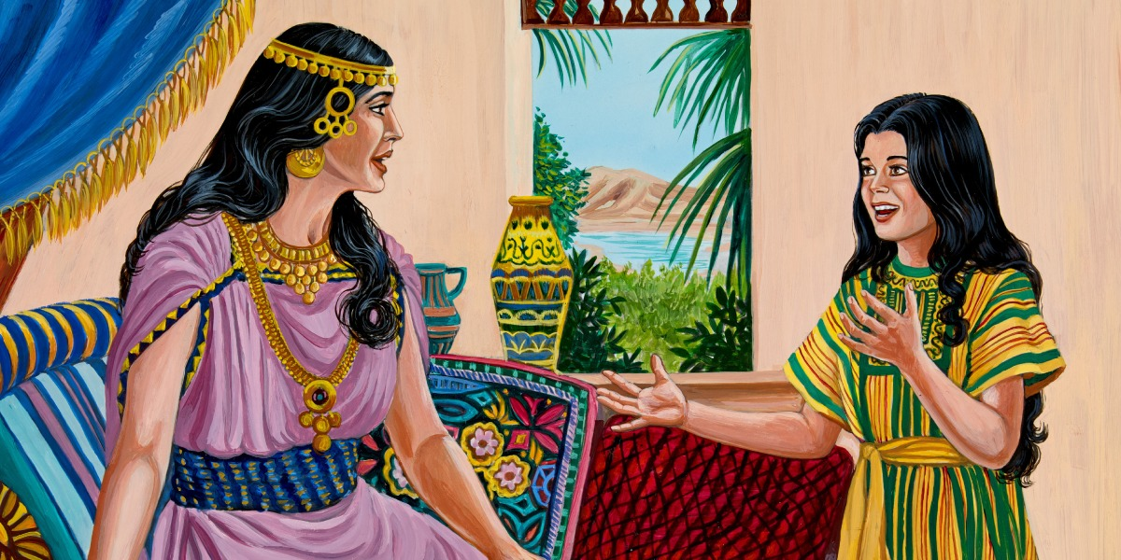
A captive Israelite girl
She was Naaman’s wife’s servant
She had faith and belief in Elisha back in Samaria to cure Naaman
(Compare her to Esther)
The king of Syria (Ben-Hadad) sent a letter and gifts with Naaman to the King of Israel (Jehoram)

Slide 4
Joram:
Read the letter and tore his clothes
Thought it was a trap to start a quarrel with Israel
(Either didn’t recognize Elisha – Didn’t think of him – or didn’t recognize/admit himself that there was a prophet in the land)

Slide 5
Elisha:
Heard about Naaman and the king
Tore his own clothes
Chastised the king for tearing his clothes
Sent word to the king to send him to Elisha
Let Naaman come to me to know that there is a prophet (a representative of Jehovah) in the land

Slide 6
Naaman came to Elisha but only saw and received the message from his servant, Gehazi.
“Go wash in the Jordan seven times and be cleansed.”

Slide 7
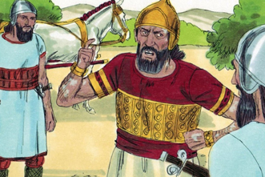
Naaman:
1. Was furious and left
2. Thought Elisha should have welcomed him
3. He should have stood and called to Jehovah, his God
4. Should have waved his hand and cured him
5. My rivers are better than the Jordan
6. (I want to do it my way!)

Slide 8
Naaman’s Servants:
1. If Elisha had commanded a great thing, you would have done it
2. He told you a simple thing instead

Slide 9
Naaman:
Obeyed
Washed – “wash”
Dipped – “dip or plunge”

Slide 10
RESULTS
Glory to Jehovah, the God of Israel
Healing of Naaman
Faith in Naaman, his wife, the king of Syria and Naaman’s servants

Slide 11
LESSONS
1. There is a prophet in the land – JESUS
2. should point people to Jesus for their healing
3. Naaman wanted it his way:
a. Ritual
b. Cleaner water
c. Alternative healing
d. Elisha said THIS – Naaman wanted THAT

Slide 12
CONCLUSIONS:
1. We can have it our way, but we won’t be cleansed
2. If Jesus commanded something great, we might do it (worldwide campaigns, brotherhood-wide cooperation, etc.)
3. Baptism is simple
4. JESUS SAID, BE BAPTIZED!

