Slide 1
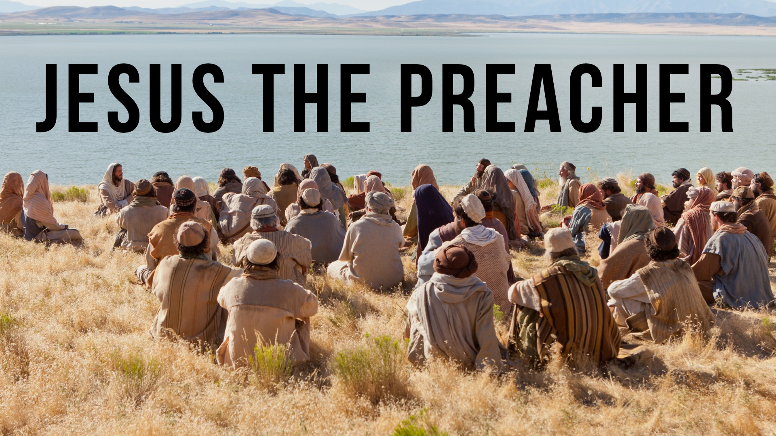

Slide 2
Jesus the Preacher
His preaching was instructive.
His preaching was urgent and demanding.
His preaching was authoritative.
His preaching was compassionate.
His preaching was passionately firm when necessary.

Slide 3
When we apply these things to our teaching, we will be blessed by God.

