Slide 1
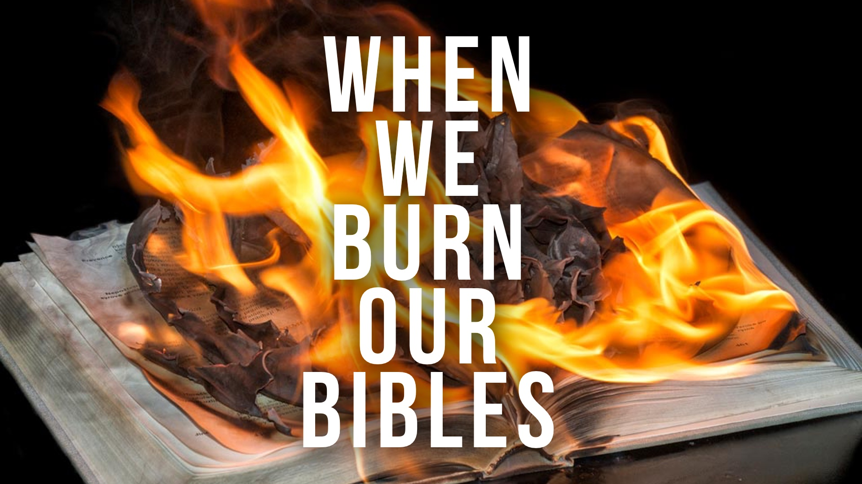

Slide 2
God’s word was sent forth to expose UNGODLINESS, produce godly SORROW, and demand godly LIVING: Jer. 36.2-3, 7

Slide 3
The Irony of the Situation
Jehoiakim did not refuse to listen; he listened exclusively to publicly repudiate (29) the FIERY and INDES-TRUCTIBLE (27-28, 32) message by destroying it in FIRE (23). But he did so to own DESTRUCTION (30-31).

Slide 4
The Spirit of Jehoiakim | when we burn our bibles
  When we IGNORE God’s word…
  When we DISAGREE with God’s word…
  When we become ANGRY with those who speak the truth…

Slide 5
The Spirit of Jehoiakim | when we burn our bibles
  When we are no longer bothered by God’s WARNINGS…
  When we refuse to obey DIFFICULT commands…
  When we JUSTIFY our wicked lifestyle, and refuse to repent of sin…

Slide 6
The Spirit of Jehoiakim | when we burn our bibles
  When we CHANGE God’s word to fit our lifestyle…
  When we ADD TO or take from God’s word…
  When we follow man’s TRADITIONS rather than God’s commandments…

Slide 7
  CUT and BURN!

Slide 8
What Will You Do with God’s Word?
  We have the spirit of Jehoiakim when we “tear our BIBLES” (Jer. 36.23-24) and the spirit of Josiah when we tear our HEARTS (2 Kings 22.11-13, 19).
Notes:
Text: Jeremiah 36
God’s word was sent forth to expose ____________________, produce godly _________________, and demand godly _______________: Jer. 36.2-3, 7
The Irony of the Situation
Jehoiakim did not refuse to listen; he listened exclusively to publicly repudiate (29) the ___________ and ____________________________ (27-28, 32) message by destroying it in ________ (23). But he did so to own __________________________ (30-31).
The Spirit of Jehoiakim | when we burn our bibles
When we _____________ God’s word, cut and burn!
When we _____________ with God’s word, cut and burn!
When we become _______________ with those who speak the truth, cut and burn!
When we are no longer bother by God’s _______________, cut and burn!
When we refuse to obey ____________________ commands, cut and burn!
When we ________________ our wicked lifestyle, and refuse to repent of sin, cut and burn!
When we _______________ God’s word to fit our lifestyle, cut and burn!
When we ________________ or take from God’s word, cut and burn!
When we follow man’s ____________________ rather than God’s commandments, cut and burn!
What Will You Do with God’s Word?
We have the spirit of Jehoiakim when we “tear our ______________” (Jer. 36.23-24) and the spirit of Josiah when we tear our _____________ (2 Kings 22.11-13, 19).

