Slide 1
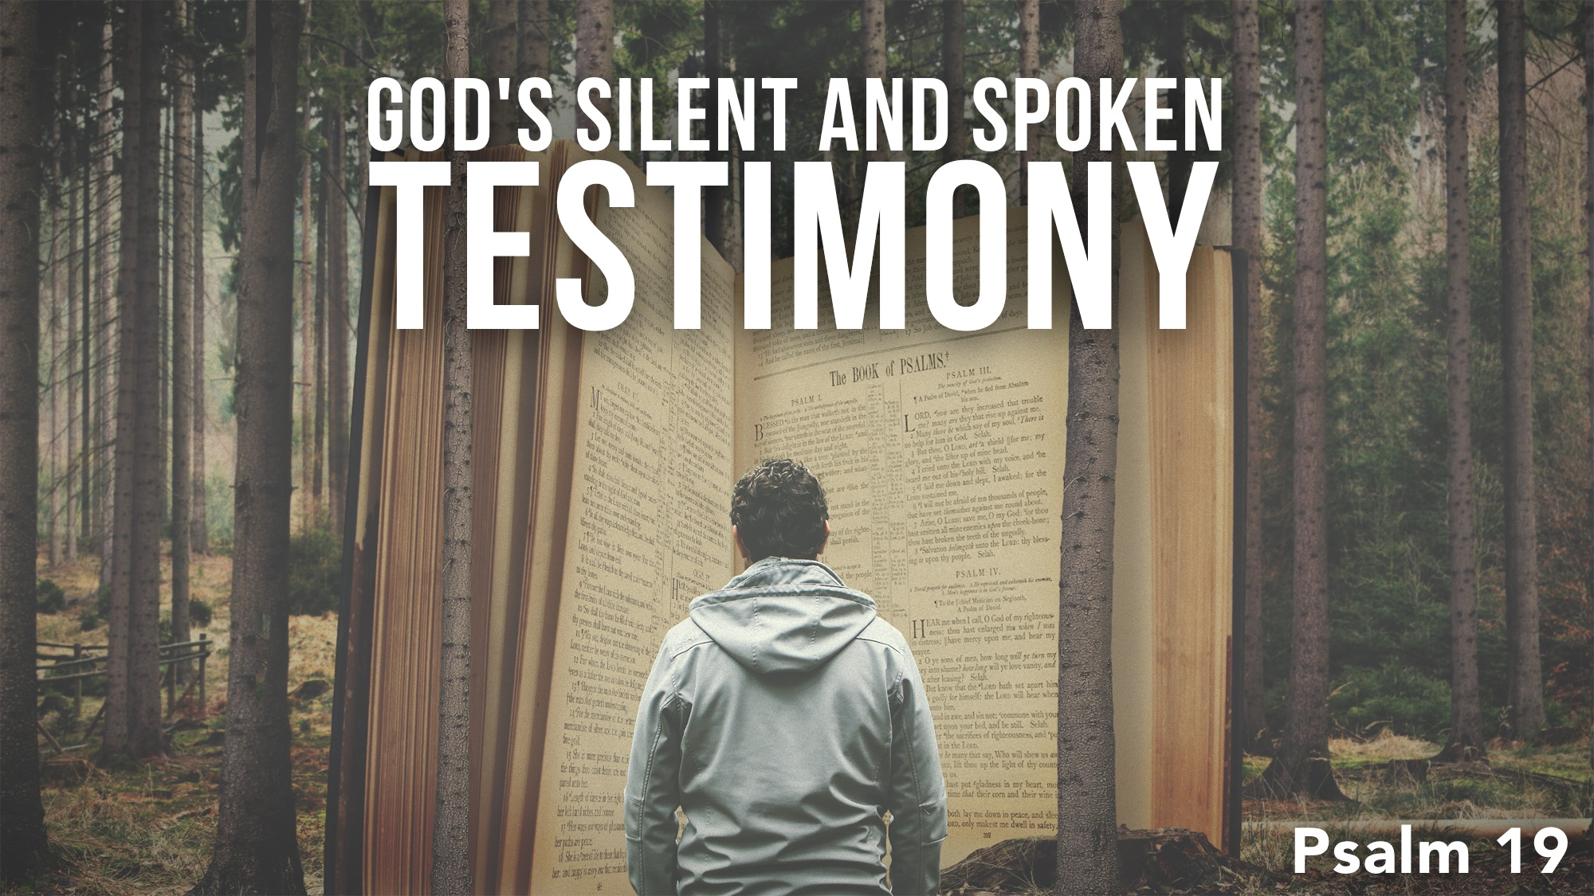

Slide 2
God Speaks through Creation: 1-6
No man is needed to declare God’s glory through creation – creation speaks for itself!
“Day to day” and “night to night” and the sun and its circuit reveal order, consistency, a set pattern with perfect accuracy – the world turns and operates as it was designed to do.

Slide 3
God Speaks through His Word: 7-11
  Six descriptions for God’s word: Law, testimony, precepts, commandment, fear, rules
  Six qualities of God’s word: perfect, sure, right, pure, clean, true
  Six benefits of God’s word: It revives the soul, it makes wise the simple, it gives joy to the heart, it enlightens the eyes, it endures forever, it is righteous altogether

Slide 4
Our Response to God’s Testimony: 12-14
God’s testimony leads us to obedience, prayer, and ridding ourselves of sin to be right with God almighty – this takes humility.
David understood that he could not continue in sin and maintain fellowship with God; he examined his heart by looking into the perfect law: cf. James 1.23-25

Slide 5
While God’s creation provides for the body, God’s revelation provides for the soul. God’s creation already sustains you. Let God sustain your soul by your faith.

