Slide 1

Notes:
Sermon notes adapted from Perry Hall.

Slide 2
What Characterized Paul’s Past?
He was FORMERLY a BLASPHEMER and PERSECUTOR:
Acts 8.1-3; 9.1-2, 13-14, 26

Slide 3
Despite Our Past, Jesus LOVES Us
For God so loved the world, that he gave his only Son, that whoever believes in him should not perish but have eternal life. For God did not send his Son into the world to condemn the world, but in order that the world might be saved through him. John 3.16-17

Slide 4
Despite Our Past, Jesus SAVES Us
Now the law [of Moses] came in to increase the trespass, but where sin increased, grace abounded all the more, so that, as sin reigned in death, grace also might reign through righteousness leading to eternal life through Jesus Christ our Lord. Romans 5.20-21

Slide 5
Despite Our Past, Jesus SAVES Us
No MATTER the sin or the NUMBER of sins we have committed, God’s grace has us COVERED. His grace TRUMPS sin every time; sin is no MATCH for God’s grace!

Slide 6
Despite Our Past, Jesus USES Us
If a man who MURDERED God’s people can be loved, forgiven and used for God’s service, so can we – we are not a HOPELESS case!

Slide 7
Despite Our Past, Jesus USES Us
God’s view of us – the POTENTIAL he sees in us – is more POWERFUL than our own past: Acts 26.16-18

Slide 8
Despite Our Past, We GLORIFY Jesus

Slide 9
Despite Our Past, We GLORIFY Jesus
Use your past as EVIDENCE of God’s grace:
Gal. 1.13-16, 22-24; Col 1.21-23

Slide 10
Despite Our Past, We GLORIFY Jesus
Use your past to TEACH God’s grace:
Titus 2.11-14; Acts 22.3-16; 26.9-11; Phil. 3.3-14;
Rom. 1.14-17; 1 Cor. 15.9-10; Eph. 3.7-9

Slide 11
Despite Our Past, We GLORIFY Jesus
When we find our former life OFFENSIVE, we will use our past to stay AWAY from our past: 1 Peter 4.2-3

Slide 12
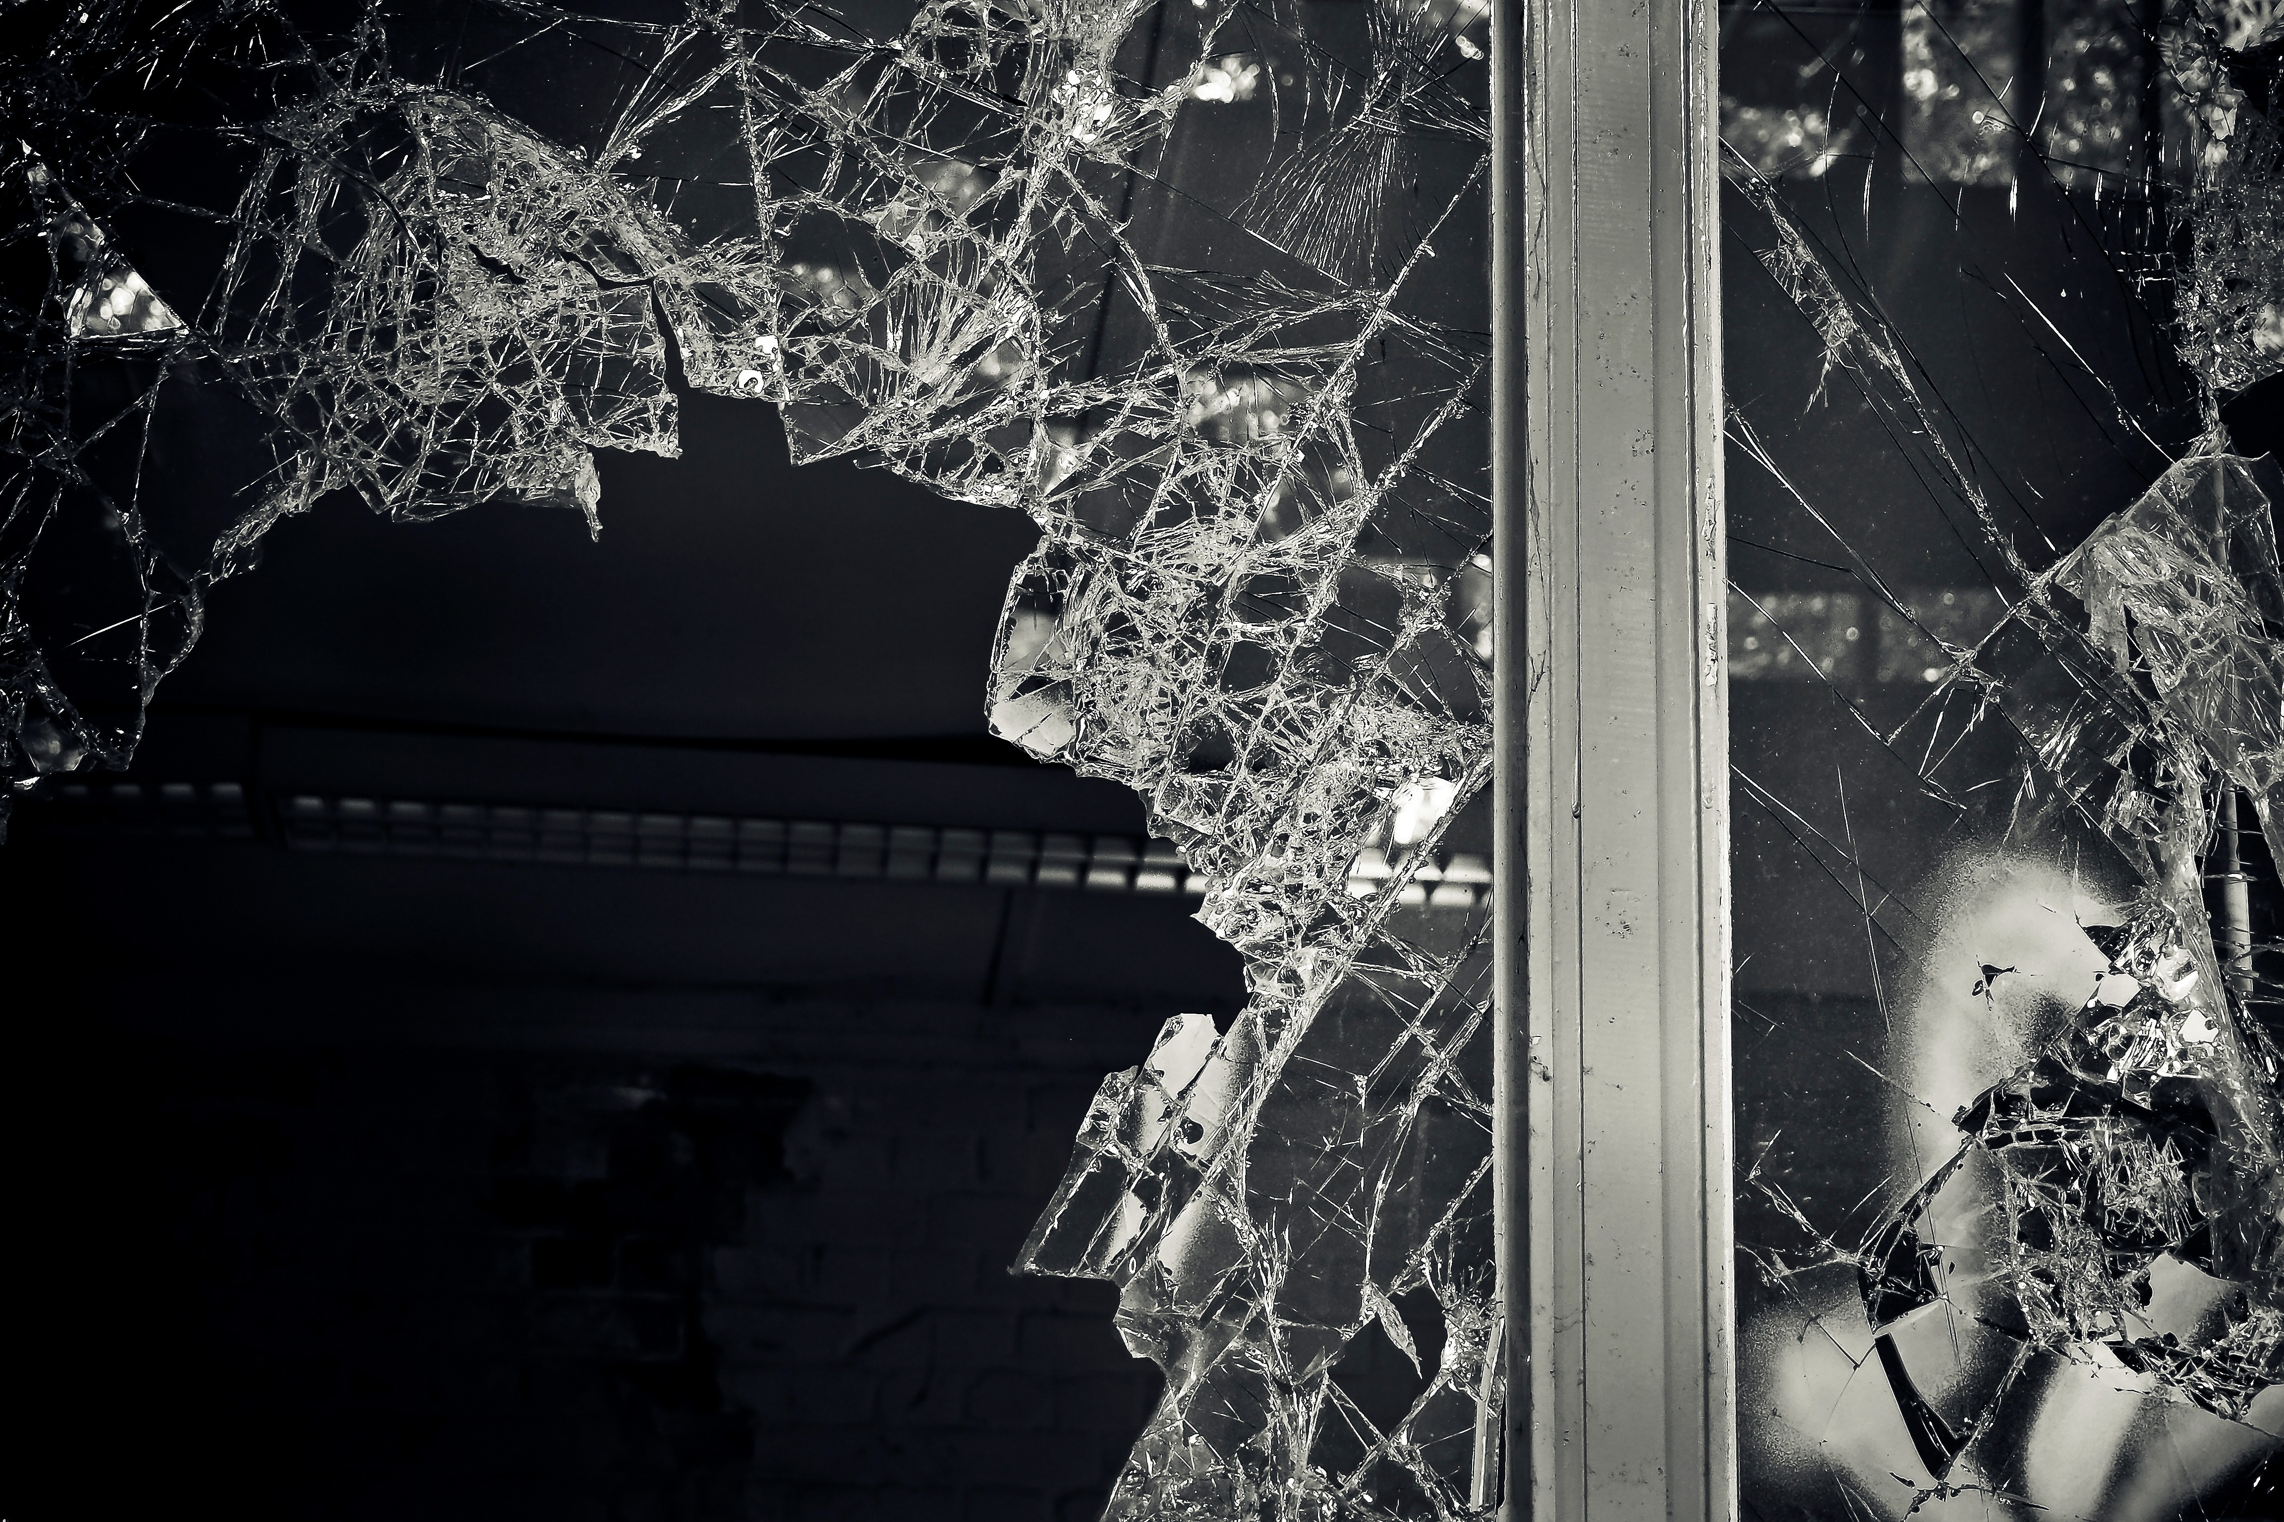
Paul’s story glorifies
God’s grace.
Your story can glorify God’s grace too.

