Slide 1
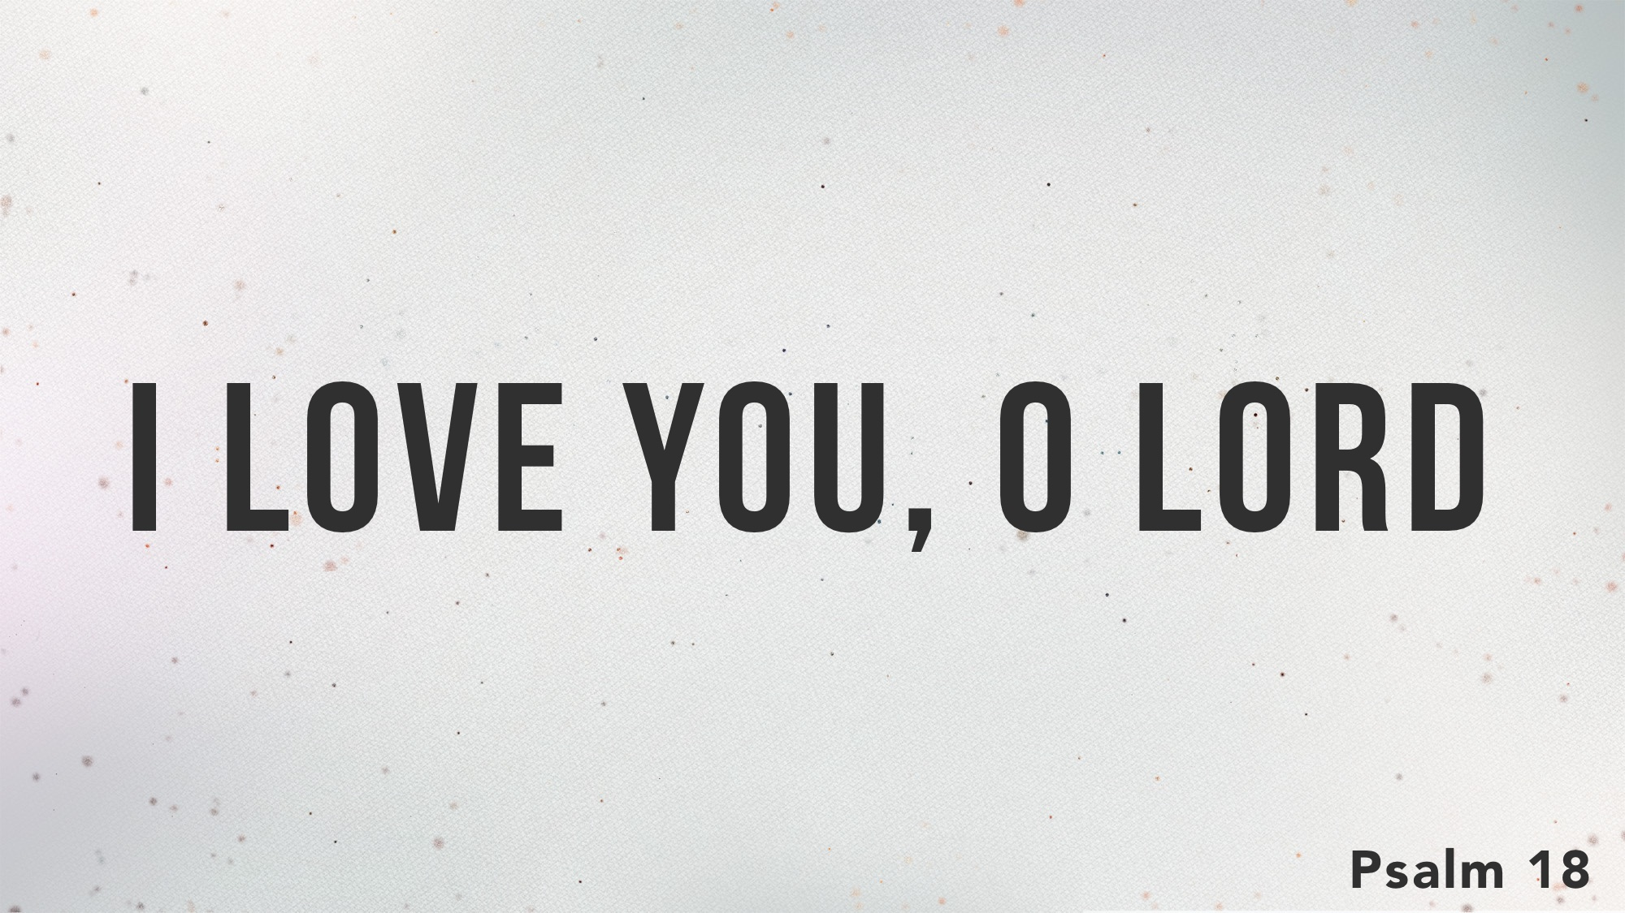

Slide 2
Psalm 18 Outline
1-2: David used several personal descriptions of God.
3-6: David cried out to God for deliverance from his enemies.
7-15: David praises heaven’s response.
16-19: David praises God for rescuing Him.
20-24: David was rescued because he was living right.
25-30: David used his story to show how this can true for everyone.
31-48: David praised God for supporting and delivering him, and exalting his reign.
49-50: David spread God’s fame everywhere.

Slide 3
Why Was David Victorious?
  Four things characterized his life:
  He loved God: 1
  He trusted in God: 2
  He called upon God: 3
  He praised God for his accomplishments: 4ff

