Slide 1
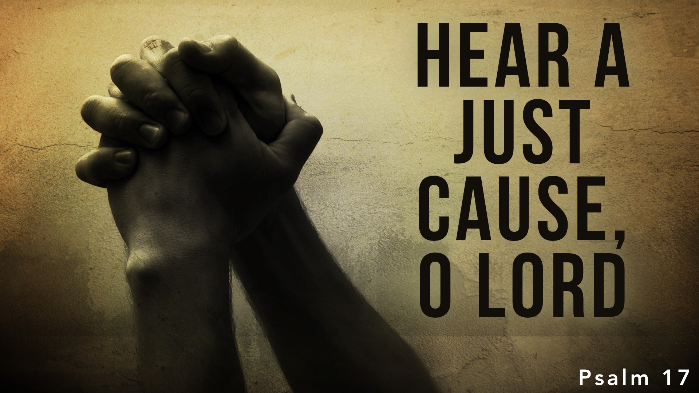

Slide 2
Examine Me: 1-5
David’s cause and conduct was just.
He determined to be on the right path – careful not to stumble: Matt. 7.13-14; Heb. 2.1; Psalm 119.10-11; Prov. 2.10-13; Job 31.1; Psalm 101.3; 119.15; 2 Cor. 13.5; 1 John 2.3-6
He wanted vindication from God – notice he does not vindicate himself: Rom. 12.17-21; 2 Thess. 1.5-9

Slide 3
Nestled Under God’s Wing: 6-9
David calls on God in prayer because God will answer him, regardless of when – that’s true faith: cf. Heb. 11.13-16
His aim was God’s favor – to remain the apple of His eye, hidden in the shadow of His wings, protected as something precious and valuable: 2 Cor. 5.9; Matt. 23.27-39; Deut. 32.10-12; Prov. 7.2

Slide 4
The Arrogance of the Sinner: 10-14
They were prosperous and satisfied – with no need for God – self-confident: cf. Deut. 32.15; James 4.16
They surrounded him on every side with the intentions to destroy and devour him – like a lion who fixes his eyes on his prey.
They are satisfied with their portion – blessings from God, though they do not acknowledge them from God. Matt. 5.45b; Job 21.7-15

Slide 5
David’s Patience: 15
David believed in the resurrection: cf. Psalm 16.9-11
He was satisfied with spiritual things – seeing God: cf. Matt. 5.8; Phil. 3.20-21; 1 John 3.2-3

