Slide 1
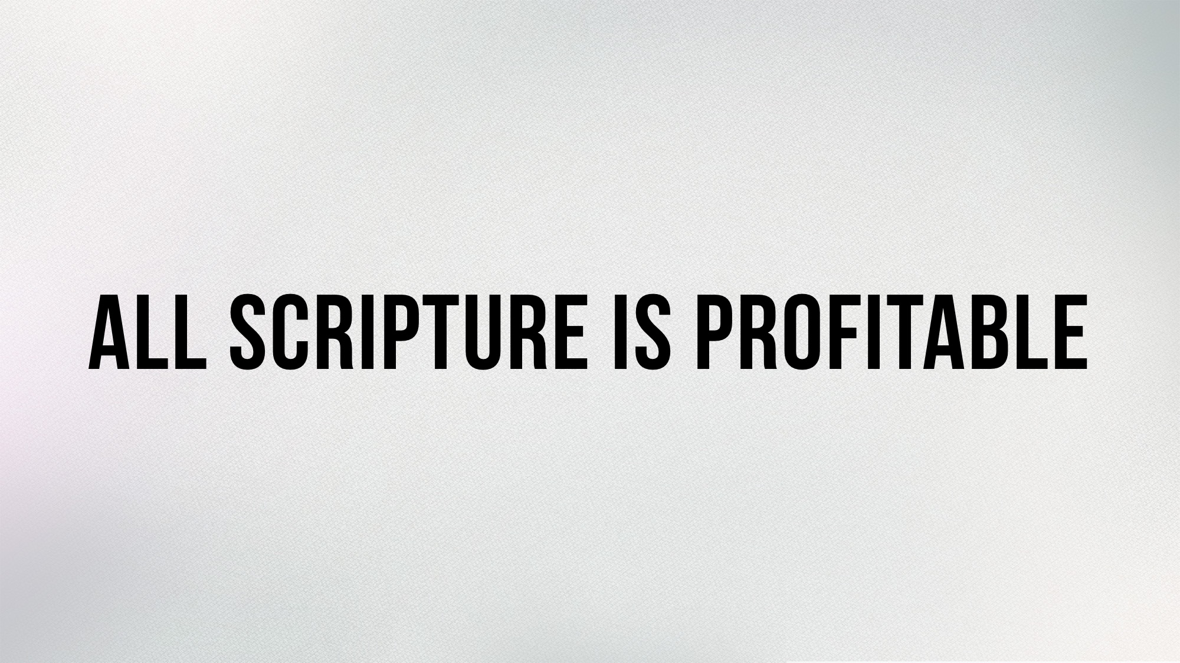

Slide 2
What is the value of the Old Testament?

Slide 3
The O.T. Was Preserved to Makes Us Wise
But as for you, continue in what you have learned and have firmly believed, knowing from whom you learned it and how from childhood you have been acquainted with the sacred writings, which are able to make you wise for salvation through faith in Christ Jesus. 2 Tim. 3.14-15

Slide 4
The O.T. Was Persevered for the Man of God
All Scripture is breathed out by God and profitable for teaching, for reproof, for correction, and for training in righteousness, that the man of God may be complete, equipped for every good work. 2 Tim. 3.16-17

Slide 5
The O.T. Was Preserved to Warn Us
Now these things took place as examples for us, that we might not desire evil as they did... Now these things happened to them as an example, but they were written down for our instruction… 1 Cor. 10.6, 11

Slide 6
The O.T. Was Preserved to Give Us Hope
For whatever was written in former days was written for our instruction, that through endurance and through the encouragement of the Scriptures we might have hope. Rom. 15.4

Slide 7
The Bible Demands That We Know the O.T.
To be wise, continue to study the O.T.
No part of the O.T. is worthless – it is all profitable.
The O.T. is always relevant – time or culture has not changed God’s attitude toward holiness.
The whole O.T. strengthens us in our afflictions by providing comfort and hope.

