Slide 1
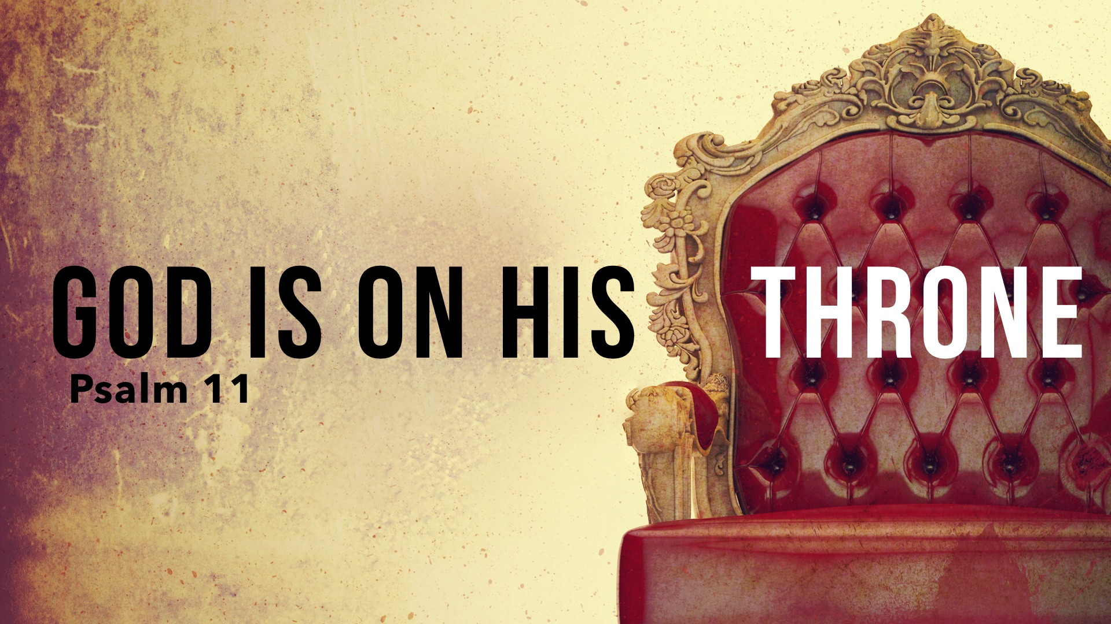

Slide 2
How Can You Say That? 1-3
“I will trust in the Lord”

Slide 3
How Can You Say That? 1-3
“I will trust in the Lord” – by refusing to listen to counsel, David magnifies God’s power.
Truth/Righteousness has stability and security; what if it is weakened or destroyed, what can the righteous do?

Slide 4
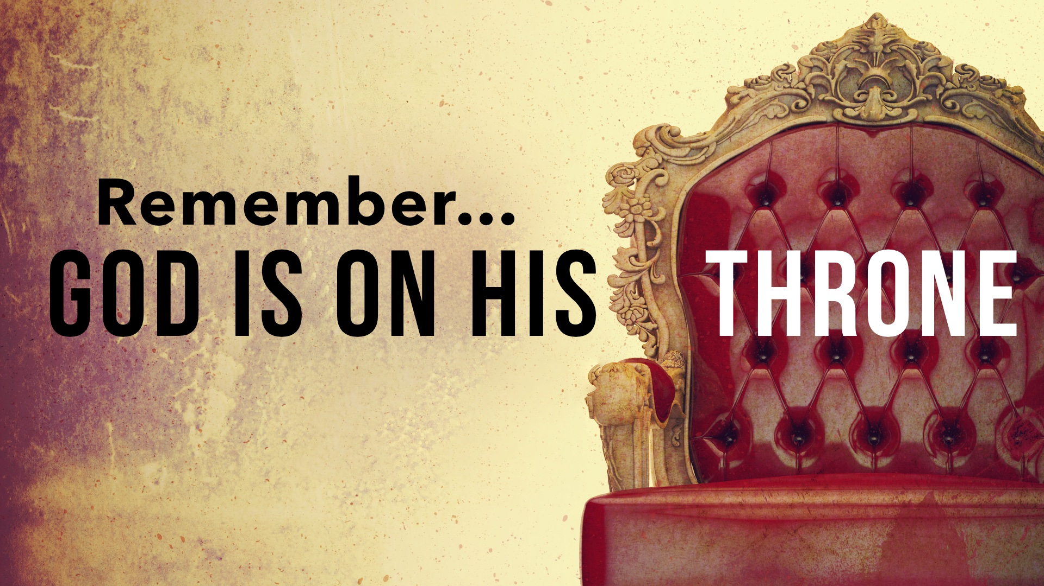
David takes refuge – not in the mountains – but in a righteous God who reigns from heaven.

Slide 5
God Is on His Throne: 4-7
David is not afraid

Slide 6
God Is on His Throne: 4-7
David is not afraid – what is there to fear if God reigns?

Slide 7
God Is on His Throne: 4-7
David is not afraid – what is there to fear if God reigns?
God is on His throne examining us

Slide 8
God Is on His Throne: 4-7
David is not afraid – what is there to fear if God reigns?
God is on His throne examining us – when one is tested, his true character, his trust in God, and his convictions are revealed: cf. 1 Peter 1.6-9

Slide 9
God Is on His Throne: 4-7
David is not afraid – what is there to fear if God reigns?
God is on His throne examining us – when one is tested, his true character, his trust in God, and his convictions are revealed: cf. 1 Peter 1.6-9
God hates the wicked and loves the righteous

Slide 10
God Is on His Throne: 4-7
David is not afraid – what is there to fear if God reigns?
God is on His throne examining us – when one is tested, his true character, his trust in God, and his convictions are revealed: cf. 1 Peter 1.6-9
God hates the wicked and loves the righteous – another reason to have courage in a wicked world.

