Slide 1
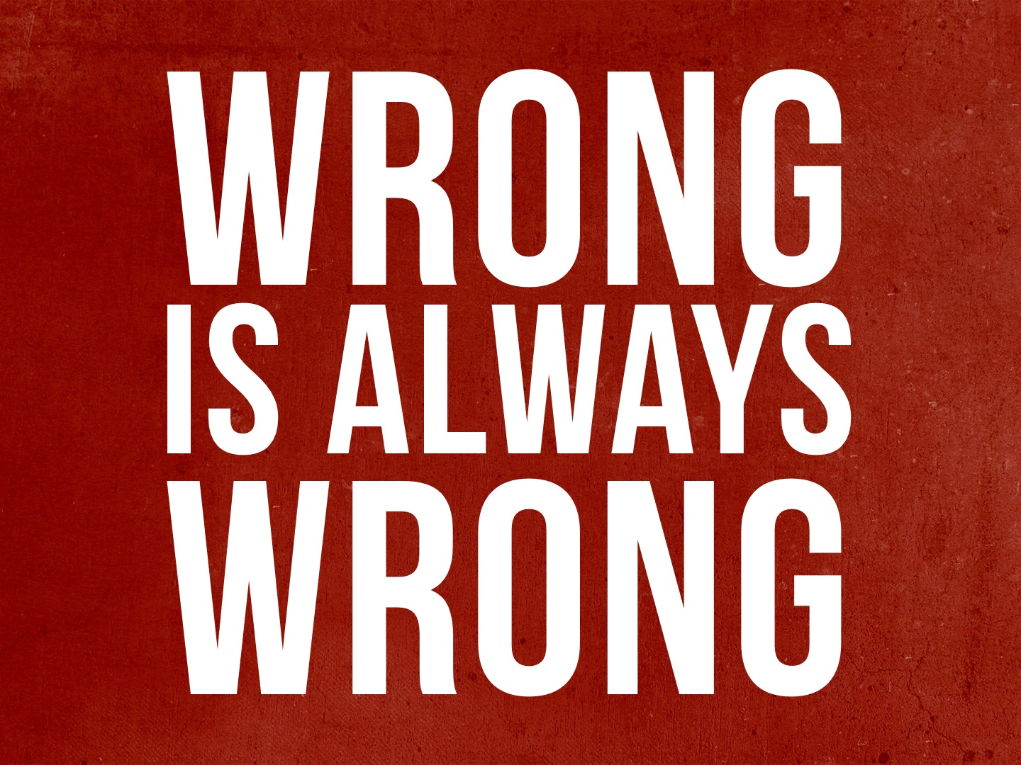

Slide 2
For the wrongdoer will be paid back for the wrong he has done, and there is no partiality. Col. 3.25

Slide 3
No Matter Who Does It
The rich & powerful: Job 34.19
Jews or Gentiles: Rom. 2.6-12; 3.23
My family: Gal. 1.14; Matt. 10.34-37
The majority: Exo. 23.2; Matt. 7.13-14
Apostles, angels, preachers, elders: Gal. 1.8; 2.11-14

Slide 4
Even If It Is Legal or
Acceptable to Society
Same-sex marriages, abortion, social drinking, immodest dress, pornography, gambling, divorce for any cause, fornication, etc.
Consent between two parties does not make it right – adultery, fornication, gambling, etc.
Man does not set the standard: John 12.48
Man will always try to make “wrong” legal and “right” unlawful!

Slide 5
Even If Someone Else
“Causes” Us to Do It
Adam shifted blame to Eve: Gen. 3.12-13
Self-justification blames others: 1 Sam. 15.13-15
Personal choice and responsibility: Ezekiel 18.4, 20; Col. 3.25

Slide 6
Even If It Doesn’t Hurt Anyone Else
Every sin man commits will hurt him spiritually, and possibly physically.
One sin brought Jesus Christ to this world.

Slide 7
Even If We Don’t Get Caught
We might be able to fool others, but we cannot fool God. He sees all that we do, day and night: Prov. 15.3; Num. 32.23; Psalm 139.7-12; Heb. 4.12-13
Judgment is coming: 2 Cor. 5.10; Eccl. 12.13-14

Slide 8
Even Though God Wants Us to Be Happy
It is true that God wants us to be happy: Psalm 40.16, 144.15, etc. cf. Philippians
It is also true that God does not want us living in sin!
Sin may make you happy at first, but later it will make you miserable: cf. Heb. 11.23-26

Slide 9
Even If We Are Blessed by God
God rains on the just and the unjust: Matt. 5.45; Acts 17.25b
God blesses us to motivate us to repent: Rom. 2.4
For those who are blessed and do not turn to God, their end will be destruction: Psalm 73.17
Just because one prospers does not mean he is right with God!

Slide 10
Even If We Were Wronged
Bless those who persecute you: Matt. 5.44
Overcome evil with good: Rom. 12.14-21
Retaliation is wrong, even if someone wrongs us: 1 Peter 2.21-23

Slide 11
Even If Tradition Says It Is Okay
Just because we’ve always done it, doesn’t make it right!
Even if something is 2,000 years old, it doesn’t make it right.
We void the commandments of God when we hold to the traditions of men: Matt. 15.1-14; Mark 7.1-13

Slide 12
Even If It Is Done for a Good Cause or Seems Like the Right Thing to Do
Sometimes we reason that we should do evil things for a good cause - “The end justifies the means”
We cannot do evil for good motives: Rom. 3.8; cf. 1 Sam. 15.22; Matt. 7.21-23

Slide 13
Even If It Is Done for a Good Cause or Seems Like the Right Thing to Do
Sometimes we reason that we should do evil things because it seems like the right thing to do. Prov. 16.25; Jer. 10.23
  Abraham’s deceit: Gen. 12.13
  Uzzah: 2 Sam. 6.6-7
  Saul sacrificing at Gilgal: 1 Sam. 13.8-13
  Caiaphas thought it right to kill Jesus: John 11.49-50

Slide 14
Even If It Is Done for a Good Cause or Seems Like the Right Thing to Do
Situation ethics are not God’s standard – even if it is convenient to sin to have a good outcome.
Would you lie about your faith to protect your life? Matt. 10.33; Rev. 2.10; 21.8
Regardless of what good might be accomplished, if God says it is a sin, it is sin!

Slide 15
Even If It Is Done in Ignorance
Murderers of Jesus: Acts 3.17, 19
God has determined that ignorance is no excuse: Acts 17.30

Slide 16
Even If It Is Done in Ignorance
God does not want us to be ignorant (without knowledge): 1 Tim. 2.4; cf. 1 Cor. 12.1; 1 Thess. 4.13; Eph. 5.17; 2 Peter 3.18
Because though done in ignorance, it is still a violation of God’s will.
“I did not know” will not be valid excuse on judgment day!

Slide 17
Even If Our Favorite Politician Does It
How many times have we overlooked the sins of the politician we want to win, but we hold the person we do not want to win to a higher standard?
Sin is still sin regardless of who is running for senator, president, etc.

Slide 18
Even If Others Are Doing Worse
We may categorize sin, but God does not! To God, sin is sin!
Looking to others and seeing if they are worse than us is not a wise comparison; we become the standard: Luke 18.11
We will be judged by our own works, not by what someone else has or has not done that makes us “look better”!

Slide 19
Even If It Does Not Bother Our Consciences
What if our conscience no longer bothers us? Is it a good guide then?
We can do wrong with a clear conscience, if we have been improperly taught: Acts 7.58; 8.1, 3; 9.1-2; 23.1; 26.9-11; Gal. 1.13-14; Prov. 14.12

Slide 20
Even If It Does Not Bother Our Consciences
Even if we have been taught properly, we can continually violate our conscience until it ceases to function properly: Eph. 4.19; 1 Tim. 4.2; Heb. 3.13
Let the truth be our guide and standard in all-religious matters: John 12.48; 17.17; Col. 3.17; Heb. 5.14

Slide 21
Even If We Change Its Name or Definition
“It is not homosexuality; it is an alternate life style.”
“Love wins!”
“It is not murder; it is a woman's choice.”
“Pornography is not obscene; it is art.”
Isaiah 5.20; Prov. 17.15

Slide 22
Even If We are Religious
We can be religious, but religiously wrong.
We can have “a zeal for God, but not according to knowledge” and create our own form of righteousness instead of submitting to God's righteousness: Rom. 10.2-3
“Surely a person who believes in God and is a good person is right with God!” Matt. 7.21; 15.8-9

Slide 23
Even If It is Difficult to Make Right
Prov. 13.15: “the way of transgressors is hard…”
Repentance demands not only a change of mind but also a change of actions: cf. Ezra 10.2-4; 2 Cor. 7.10; Acts 17.30
Just because we may have many earthly consequences if we repent, it does not make it right to continue in the wrong.

Slide 24
For the wrongdoer will be paid back for the wrong he has done, and there is no partiality. Col. 3.25

