Slide 1
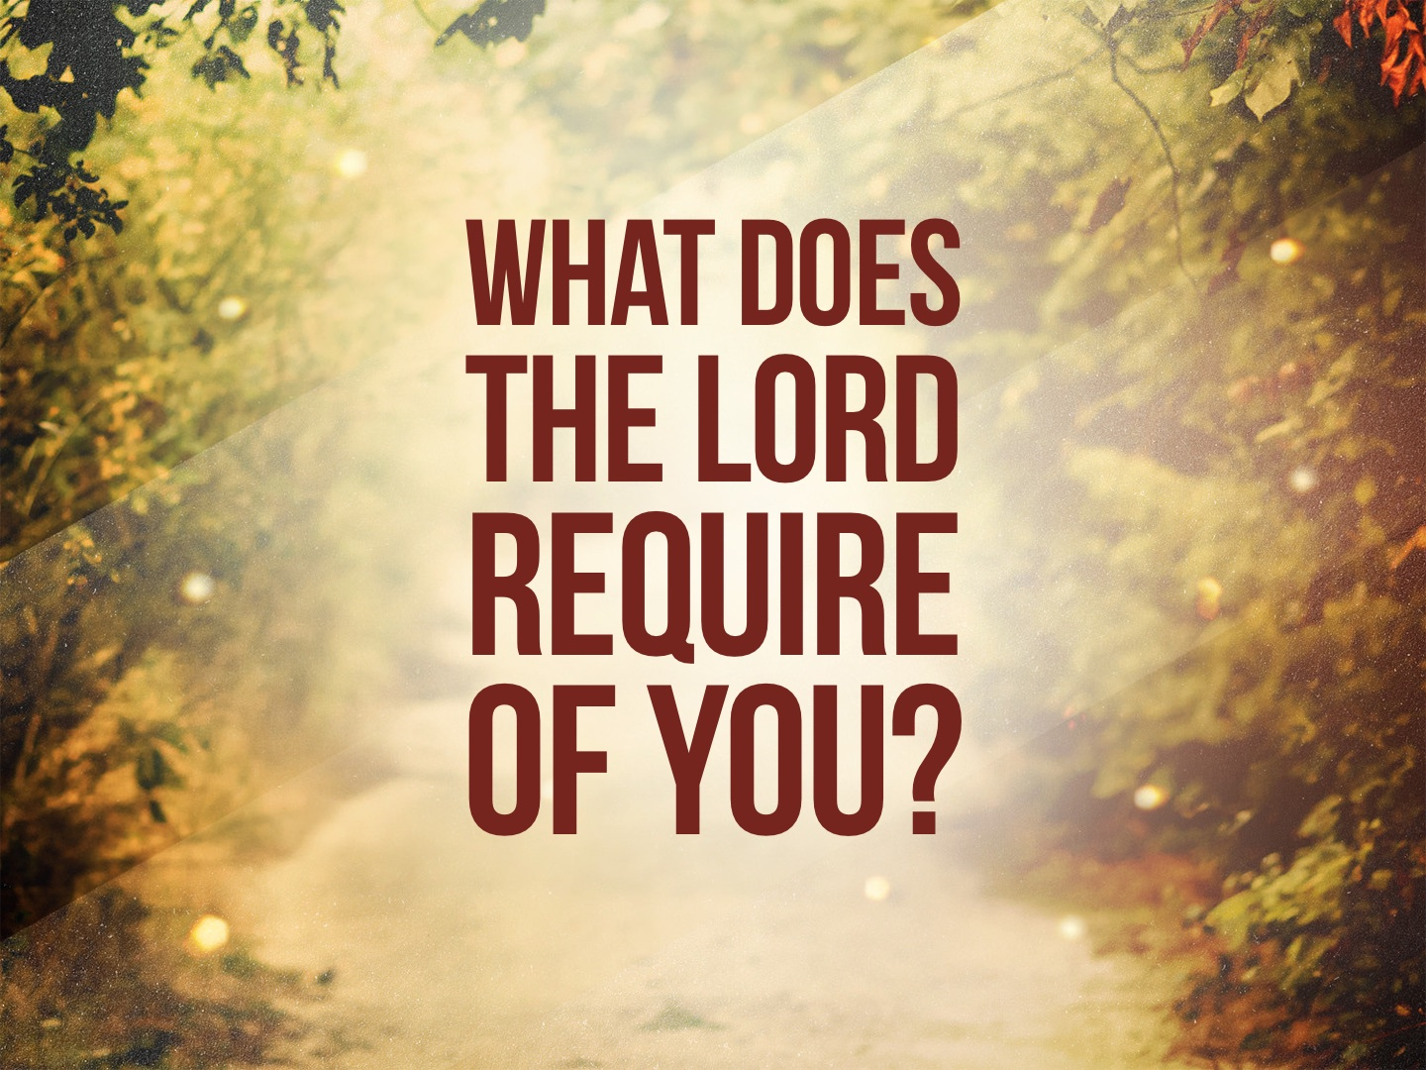

Slide 2
“...to do justice, and to love kindness, and to walk humbly with your God” is the CORE of TRUE religion.

Slide 3
To Do JUSTICE
We must treat everyone FAIRLY and impartially and be just and HONORABLE in all our dealings and relationships: Exo. 23.1-9; Micah 2.1-3; 3.1-3, 9-12; 6.10-12; Matt. 7.12; John 7.24; James 2.1, 8-9

Slide 4
To Love MERCY
Mercy involves kindness, compassion, charity, benevolence, etc. toward OTHERS: Matt. 25.34-40; Gal. 6.10, etc.
GOD has been merciful to us: Micah 7.18-20; Titus 3.5
We must be merciful to ALL: Matt. 5.7; 6.12, 14-15; Col. 3.12

Slide 5
To Walk HUMBLY with Your God
If we are walking humbly with our God, we will be pleased with the things He is pleased with, hate the things He hates, and desire the things that He desires. Every aspect of our LIFE will be yielding to His word and conforming to the image of His GLORY.

Slide 6
To Walk HUMBLY with Your God
A PRIDEFUL walk is opposed to God: Isaiah 66.1-2; 1 Peter 5.5
Walking humbly with God is MANIFESTED by
  our FAITH: Rom. 4.12
  our LOVE: Eph. 5.2
  our OBEDIENCE: 3 John 3-4
  our FEAR and COMFORT: Acts 9.31

Slide 7
What Does the Lord Require of You?
It does not matter how many sacrifices we make to God or how much those sacrifices COST us. TRUE obedience is not just doing the right thing – it’s doing the right thing for the right REASON.

