Slide 1
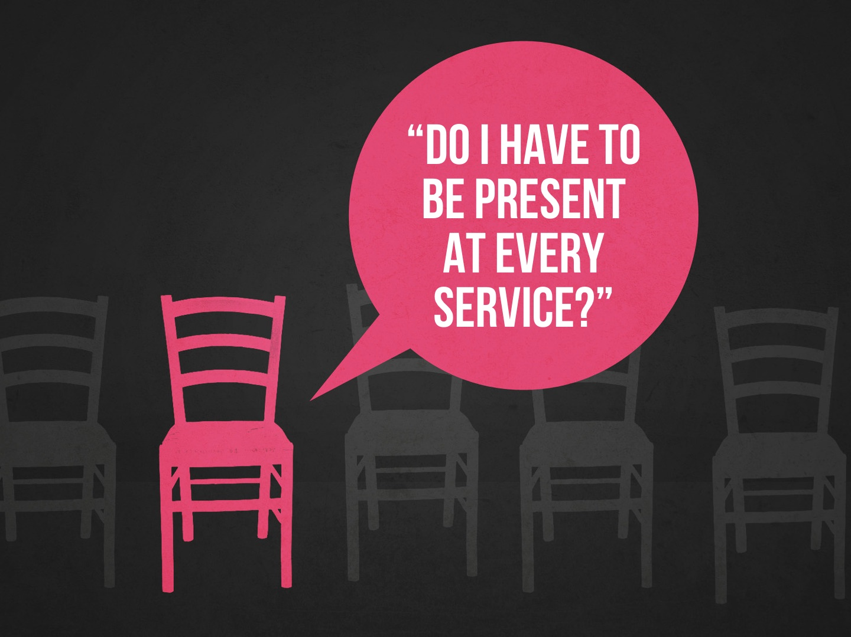

Slide 2
Disclaimer
We are not talking about members who are ill, disabled, elderly, or absent due to emergency or things beyond their control, etc.
We are talking about able members who have the attitude of not wanting to assemble; intentionally finding reasons not to assemble or just simply being lazy and deciding not to come.

Slide 3
Let's Be Honest
We never miss work and are never late for work.
We never allow our children to miss school and they are never late for school.
We can be found at all kinds of secular activities throughout the week: sports, social events, etc.
We have probably signed up for membership of some kind and do not miss a meeting, monthly or yearly dues, and are dedicated to the cause of the club/group.

Slide 4
Let's Be Honest
This is a HEART problem.
Remember, we are not talking about members who are ill, disabled, elderly, or absent due to emergency or things beyond their control, etc.

Slide 5
Honest Questions to Consider
Can our friends talk us out of assembling?
Do we consider opportunities to assemble when we make our plans and life decisions? Sports? Vacation? Work?
Does it bother you that you aren’t assembled with the brethren?

Slide 6
Honest Questions to Consider
When you attend on Sunday morning do you feel you’ve accomplished your duty as a Christian?
Is this not the same thing as “trying to get by with the least amount and still be saved” attitude?
Are additional services/Bible classes viewed as one of the hardest things about being a Christian?

Slide 7
Why Does the Local Church Exist?
Because God PLANNED it.
Because God does nothing UNNECESSARY.
Because Christians NEED each other.
Because the local church is INTENDED to keep us faithful, safe from the world, and spiritually growing.
Because God commanded/provided examples that we work TOGETHER.

Slide 8
Why Does the Local Church Exist?
Acts 2.42: Study, fellowship, break bread, pray together
Acts 2.46: Together daily
Acts 4.32ff: Share possessions with each other
Acts 6.1ff: Care for widows
Acts 11.25-26: Meet, teach, send contribution to saints
Acts 13.1ff: Fast, pray, send out workers
Acts 14.23: Appoint Pastors
Acts 15.1ff: Settle disputes
Acts 19.9: Reason daily with unbelievers
Acts 20.7: Meet on Sunday to break bread, hear a message
Acts 21.17: Receive preachers
1 Cor. 5ff: Discipline sinful members

Slide 9
Why Does the Local Church Exist?
1 Cor. 11.23ff: Take Lord’s Supper together
1 Cor. 12.26: Suffer with those who are suffering and rejoice with those who are rejoicing
1 Cor. 14: Orderly worship, considerate of visitors
1 Cor. 16.1ff; 2 Cor. 9.1ff: Collect to help saints
Phil. 4.15-18: Share with preachers
1 Thess. 5.13: Edify one another
1 Tim. 5.3-16: Take care of widows who have no family
1 Tim. 5.17: Take care of elders
Heb. 3.12-13: exhort one another every day
Heb. 10.23-25: Meet together

Slide 10
Why Does the Local Church Exist?
Heb. 13.17ff: Obey leaders, pray for teachers, bear the word of exhortation
James 2.1ff: Honor all equally
Rev. 2.1ff: Always remember our first love, repent when necessary
Rev. 2.9ff Do not fear
Rev. 2.12ff Repent of tolerating false teachers
Rev. 2.18ff Be steadfast until Jesus comes
Rev. 3.1ff Wake up from being dead
Rev. 3.7ff Persevere
Rev. 3.14ff Purify yourselves

Slide 11
Why Does the Local Church Exist?
After examining this list, how can anyone say that the local church and her work are not to be first in each individual Christian’s life?
“…seek first the kingdom of God and his righteousness…” Matt. 6.33

Slide 12
Why Does the Local Church Exist?
A local church comes into existence when Christians agree to work together.
This agreement is conditioned upon working together toward the common goals of spreading the gospel, edifying one another, and helping the needy among them as they strive to go to heaven.

Slide 13
Questions to Consider. You Decide.
Is it fair to say that if one chooses to work with a church that there should be some degree of expectation or obligation on their part?
Ex. One joins and yet does not attend, nor intend to actually work. Isn’t he obligated to the work if he agreed to it?
Ex. One joins and is expected to grow spiritually, serve others, evangelize, remain pure, etc. Shouldn’t he be held accountable for these things? Doesn’t God expect this of each member?

Slide 14
Questions to Consider. You Decide.
Is it fair to say that when one chooses to identify with a church, that he accepts the times, services and decisions currently in place?
Is it fair to say that when one breaks his agreement to work he is undermining the local church and her work?
Overall, is it fair to say that agreement with the brethren plays a factor in our attendance and our daily spiritual work in general?

Slide 15
Are we fulfilling our OBLIGATIONS to this local church?

Slide 16
What Does Our Attendance Teach Our CHILDREN?
It teaches them the importance of…
FAITHFULNESS: Matt. 6.33
FELLOWSHIP: Acts 2.42-47
God’s AUTHORITY: 2 Kings 17.34-41
God’s WORD: Deut. 6.6-9, 20-25

Slide 17
What Does Our Attendance Teach Our CHILDREN?
How much they learn correlates directly with the amount they attend.
Ages 3 to college:
2 Bible classes a week = 370 four-hour days of instruction
2 Sermons a Sunday = 598 four-hour days of instruction

Slide 18
Questions to Consider:
What does our attendance say to our children?
Do they see worshipping God as a priority in our lives?
Do they see assembling with the saints as a priority in our lives?
Do they see Sunday night and Wednesday night as less important than Sunday morning?

Slide 19
How to FIX the Heart Problem
Examine your heart and INTEREST: 2 Cor. 13.5
Why do we not want to spend time with our brethren?
What’s pulling us away from God? Sin? Love of the world? Do we have too much going on in our life? Does our “ox keep falling in the ditch”?
What is more important than gathering with the saints and worshipping our heavenly Father?
Are earthly and temporary things worth more to us than God and His desires?
What is going on in our lives that is hindering us from “wanting to do these things out of love for God and others” instead of being “forced to do these things”?

Slide 20
How to FIX the Heart Problem
ACCOUNTABILITY
We need loving and encouraging brethren that will call, write, and visit. Heb. 3.12-13

