Slide 1
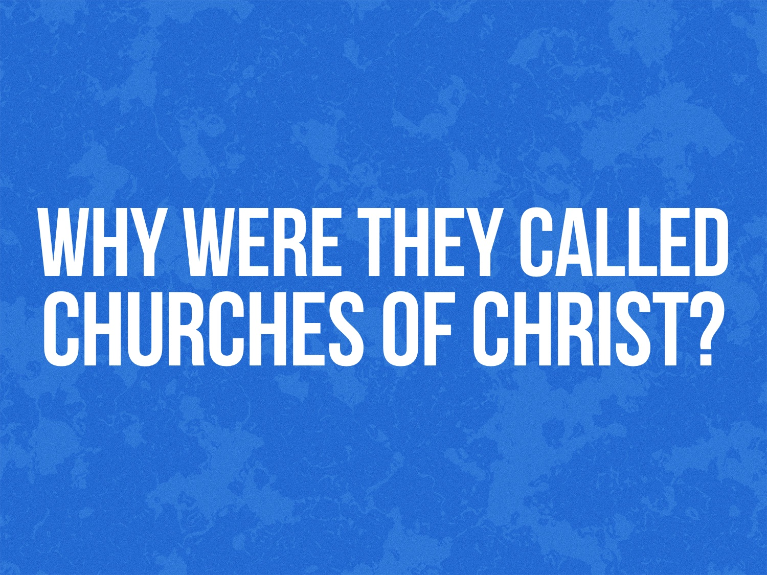
Notes:
Thanks to Andy Sochor for this lesson.

Slide 2
“…All the churches of Christ greet you…”
Romans 16.16

Slide 3
The Universal Church is “of Christ”
There is just one church in the universal sense (Matt. 16.18) – built by Christ (Matt. 16.18); bought by Christ (Acts 20.28); body of Christ (Eph. 1.22-23); bride of Christ (Eph. 5.23, 32); therefore, it is “of Christ.”
The universal church has no organizational structure on earth – it is simply the body of the saved.

Slide 4
The Members Are “of Christ”
“Make disciples” (Matt. 28.19) – disciples of whom?
Paul gave three reasons why we are to be “of Christ”: 1 Cor. 1.9-10 cf. Eph. 4.1-6; John 17.20-21; 1 Cor. 1.12-13; Heb. 10.10; Rom. 6.3-4; Gal. 3.26-27
“Church in ______” (Rev. 2.1, 8, 12, 18, etc.) – What kind of church is this?

Slide 5
Local Churches Are Not Part “of” Anything Else
Most local groups in the religious world are part of a larger denomination.
There were no denominations in the first century church.
The local churches were self-governing, autonomous churches who answer only to Christ.

Slide 6
Local Churches Uphold the Truth “of Christ”
Paul described the local church as “the pillar and ground of the truth”: 1 Tim. 3.15
Churches uphold the truth by teaching the truth and practicing the truth: 1 Thess. 1.8; Acts 20.27; Col. 3.17; John 4.24
We should expect unity of doctrine/practice because we hold to the same standard and pattern (n.t.): 1 Cor. 4.17; Eph. 4.1-6; 2 Tim. 1.13; John 12.48

Slide 7
What Is Wrong with “Church of Christ”?
No other name better describes to us and to the world what a local church ought to be and who we represent.
It’s scriptural: “The designations ‘Christian’ and ‘Disciple’ each have the sanction of Scripture, and that in itself is a mighty argument for them.” (Tupper, Kerr Boyce [Pastor of the First Baptist Church, Denver, CO]. Seven great lights. Cranston & Curts, 1892)

Slide 8
Notes:
Thanks to Andy Sochor for this lesson.

