Slide 1
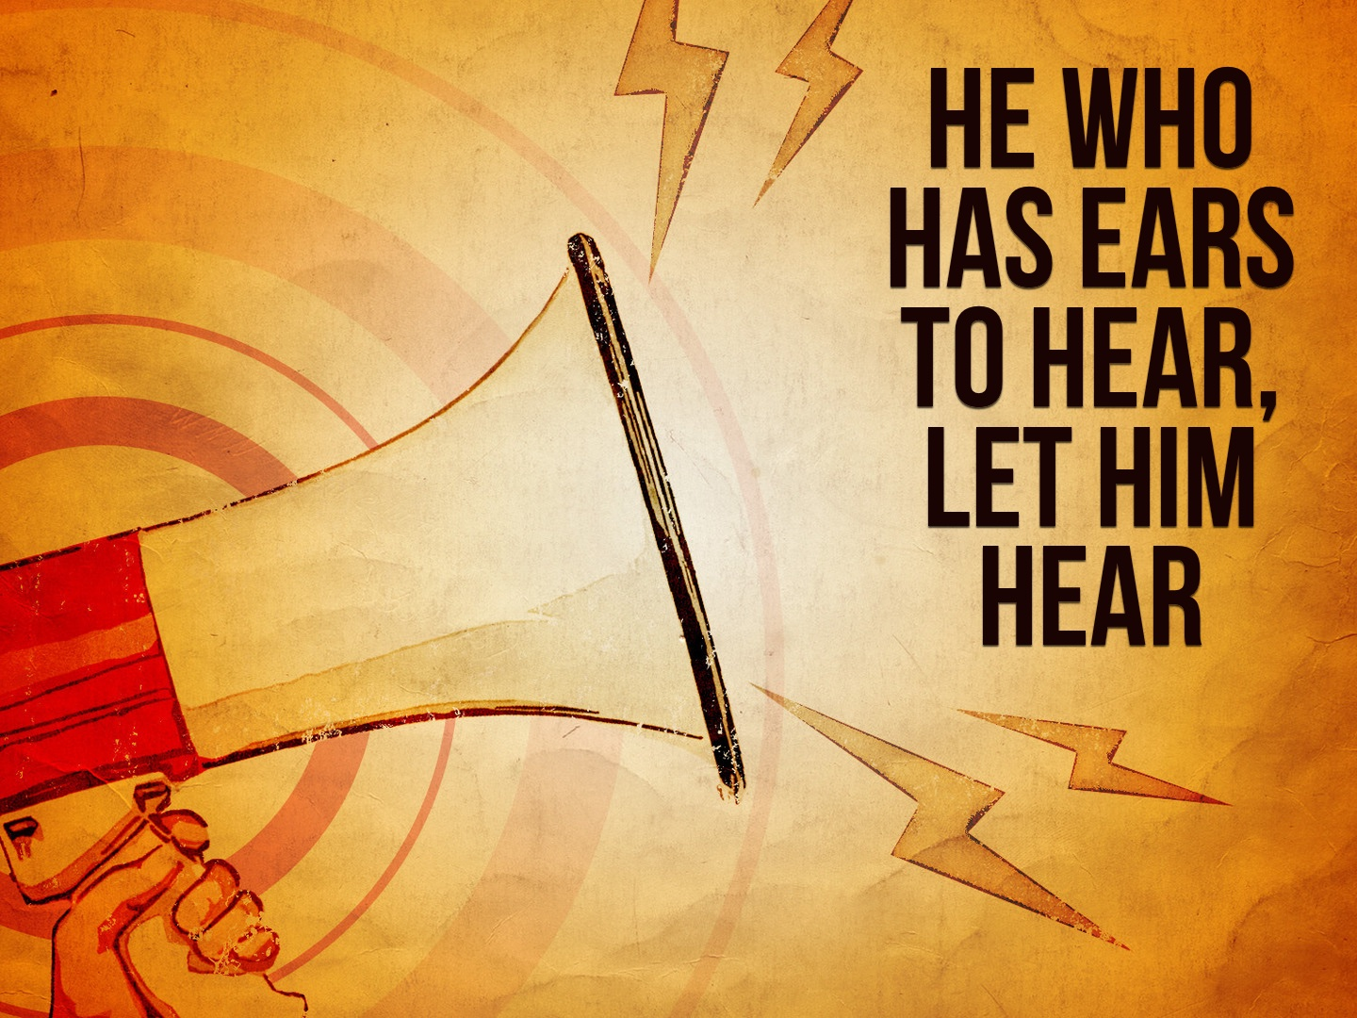

Slide 2
FAITH Comes by Hearing
For “whoever calls on the name of the Lord shall be saved.” How then shall they call on Him in whom they have not believed? And how shall they believe in Him of whom they have not heard? And how shall they hear without a preacher? And how shall they preach unless they are sent? As it is written: “How beautiful are the feet of those who preach the gospel of peace, Who bring glad tidings of good things!” But they have not all obeyed the gospel. For Isaiah says, “Lord, who has believed our report?” So then faith comes by hearing, and hearing by the word of God.

Slide 3
Hearing is ESSENTIAL to salvation.

Slide 4
We Must Hear with the HEART
A Christian who is “dull of hearing” will never grow, FORFEITING his or her salvation: Heb. 5.11-6.12
A DULL ear will never lead a sinner to obey the gospel: Acts 8.24-28; Luke 8.4-15; Matt. 7.24-27; Mark 4.24; Acts 3.22-26; 2.37, 41; 7.54, 57; 10.33; 17.11-12

Slide 5
Hearing Is a CONTINUAL Process
“My sheep hear my voice, and I know them, and they FOLLOW me” John 10.27; cf. 2 Tim. 4.3-4; Prov. 28.9
We must always be ready to hear and BEAR FRUIT (be a doer of the word): James 1.19-25; cf. Ezek. 33.30-32; Zech. 7.11-12; Jer. 6.16-19

Slide 6
The more one hears God’s word and neglects or fails to obey it, their heart is HARDENED (Heb. 3.12-19) and the DULLER he or she becomes (Heb. 5.11-14) and the less they are able to UNDERSTAND it (2 Tim. 3.7).

Slide 7
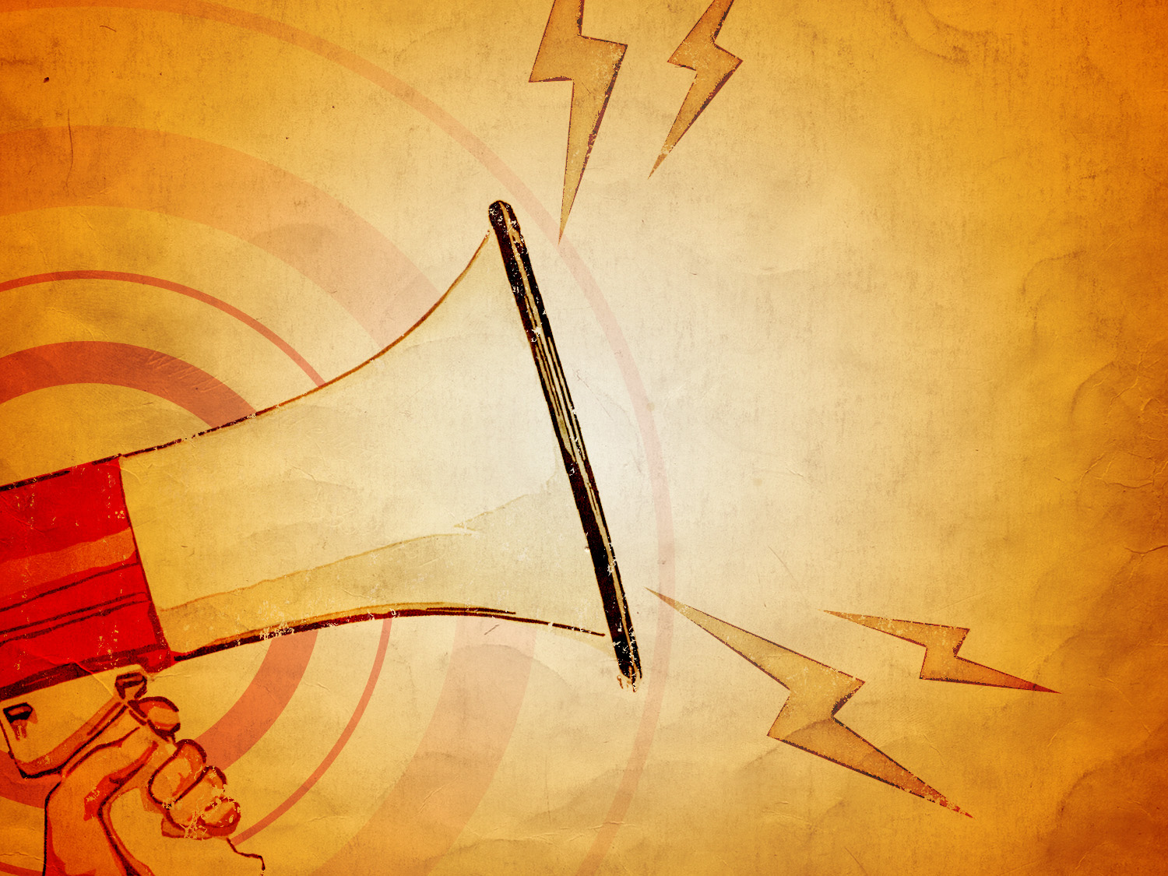
“...blessed are those who hear, and who keep what is WRITTEN...” Revelation 1.3

