Slide 1
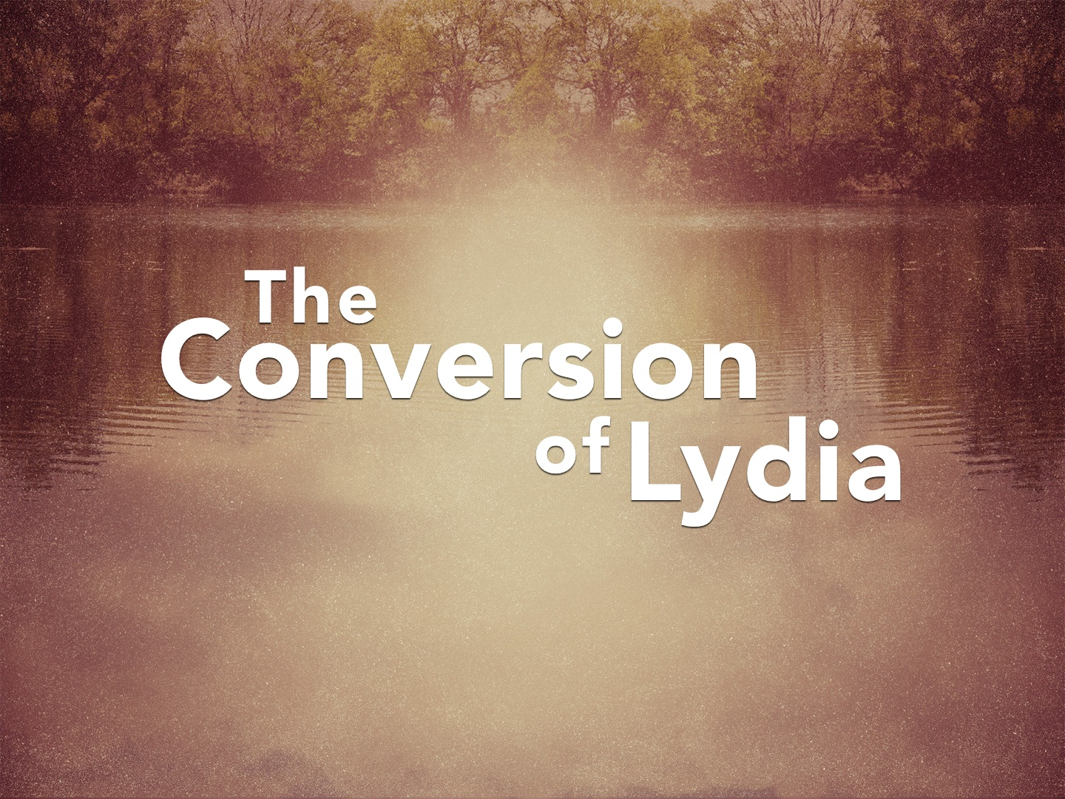

Slide 2
The Conversion of Lydia
She was a business woman, but interested in spiritual things: 14
She was religious, but religiously wrong: 14
She was once lost, but now found: 15
  By her obedience: Mark 16.16
  By her hospitality: 40; 3 John 5-8
  By her share in gospel work: Phil. 1.3-5; 4.14-18

Slide 3
How Did God Open Lydia’s Heart?
Her heart was honest and good: Luke 8.15
  She wanted to serve God!
  She was a worshipper of God!
  She prayed to God!
  She was not closed minded!
  She listened with the intent to obey!
  As she heard, she applied the Scriptures to her life and obeyed!
Everyone’s heart is opened the same way: Luke 24.25-27, 44-46; Acts 2.37; Rom. 10.17, etc.

