Slide 1


Slide 2


Slide 3
We Assume a Godly Example Is Sufficient.
A good example is important: Matt. 5.16; 1 Peter 3.16; Phil. 2.14-15
While we do need to be a good example, it takes words to save the lost: Acts 11.13-14; Rom. 10.13-14, 17; Eph. 1.13
Are we trying to persuade others? 2 Cor. 5.11

Slide 4


Slide 5
We Get Discouraged If Results Are Lacking.
The gospel is an invitation which draws some and repels others: Luke 10.16; Isaiah 55.10-11, etc.
We should not be surprised. We should expect this: 1 Peter 3.20; Isaiah 6.8-10; Jer. 20.8-9; Luke 19.10; Acts 2.41
God places upon us the responsibility to teach, not accountability for the results: Matt. 28.19-20; 1 Cor. 3.5-7

Slide 6
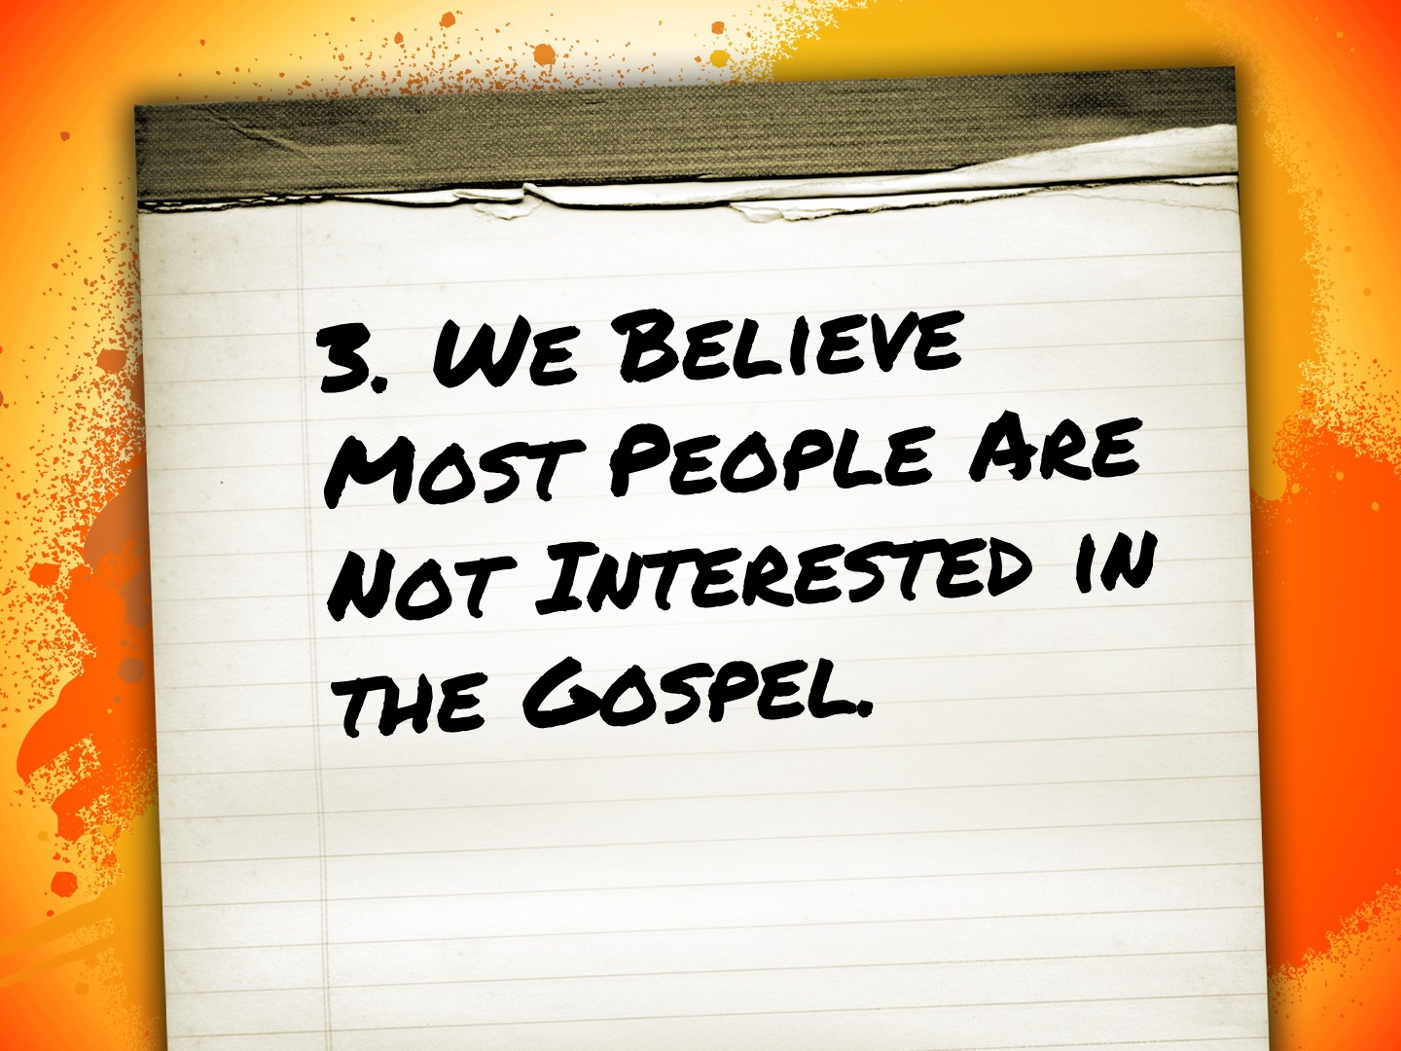

Slide 7
We Believe Most People Are Not Interested in the Gospel.
The first century was the same as today, if not worse: cf. 1 Cor. 6.9-11
Matt. 9.37, “The harvest is plentiful but the workers are few...” Workers are the limiting factor in the harvest.
One problem is that we choose who is worthy of the gospel and who is not.

Slide 8
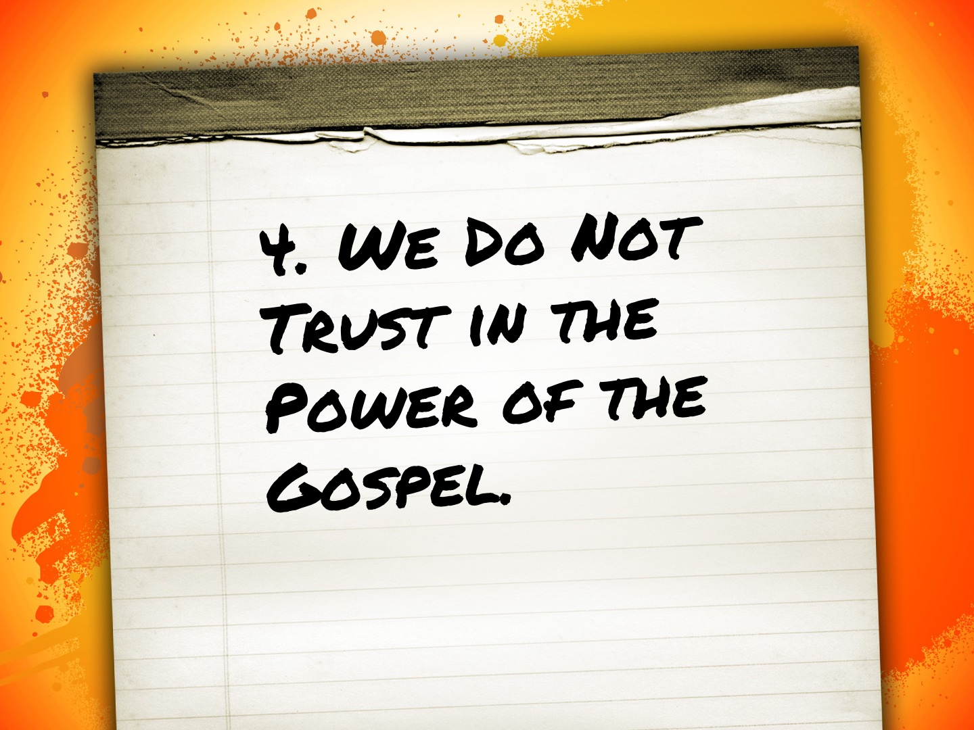

Slide 9
We Do Not Trust in the Power of the Gospel.
God’s word will produce faith in man: Rom. 10.17, John 20.30-31
We must plant the seed and let God’s word work in the hearts of men.
Do we believe in the power of the gospel or not? Rom. 1.16; 1 Cor. 1.21-24

Slide 10
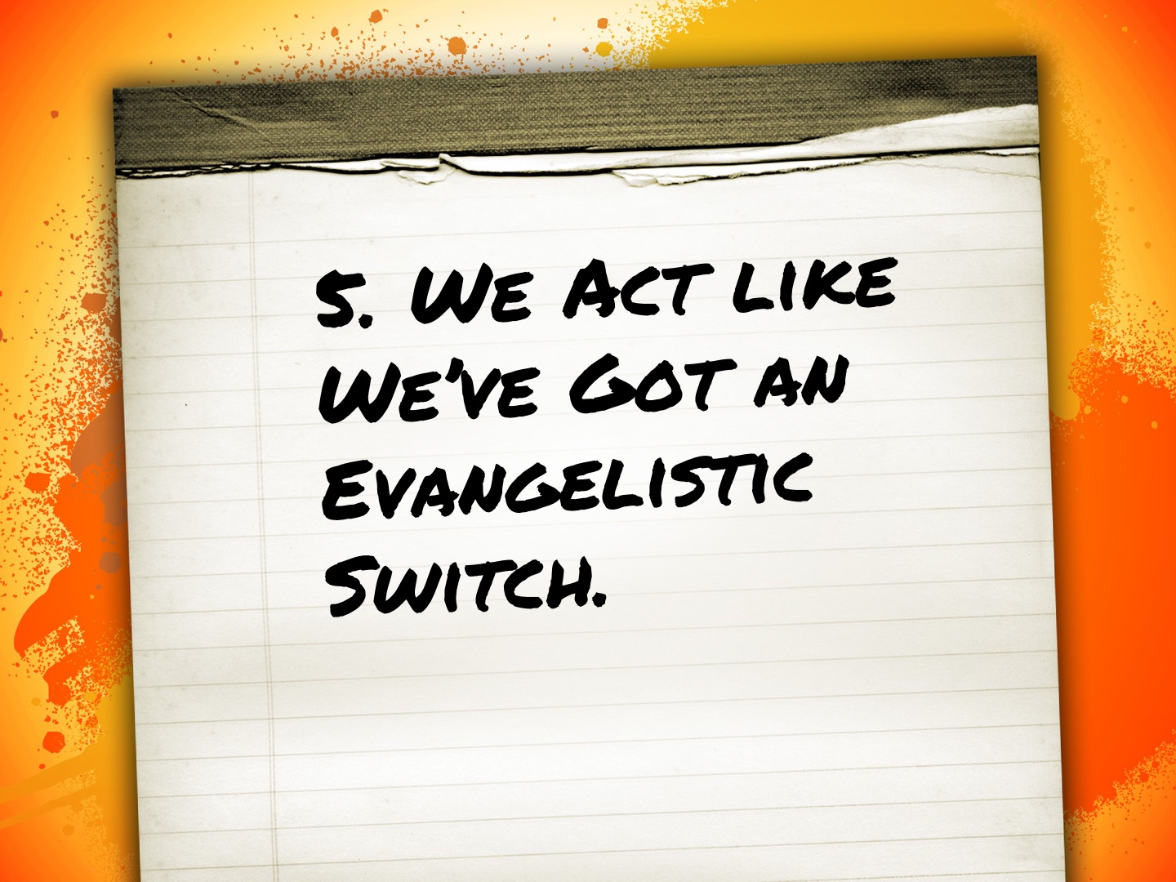

Slide 11
We Act like We’ve Got an Evangelistic Switch.
We need to stop thinking about evangelism something we turn on and off or as blocking out time.
Evangelism is way of life! We cannot turn evangelism off.
As we go about our daily lives, we must consider the lost and do something about it.

Slide 12


Slide 13
We’re Afraid of Offending People.
We must be respectful, tactful, speak with wisdom, and share the truth in love, but we must always be straightforward with sinners and their condition before God: Matt. 10.16; Eph. 4.15; Col. 4.6
Jesus: Matt. 15.12; John 6.60-61, 66
The world hated Jesus, He promised us the world would hate us. We should not be surprised. We should expect it. Matt. 10.22; John 15.18-19; 17.14

Slide 14


Slide 15
We Do Not Pray.
Jesus said to pray: Matt. 9.38
Do we pray for “open doors of opportunity”: Col. 4.3-4; Eph. 6.18-20; cf. Acts 14.27; 1 Cor. 16.8-9; 2 Cor. 2.12
This prayer is not an option. Do we pray for God’s word to go forth in Texarkana?

Slide 16
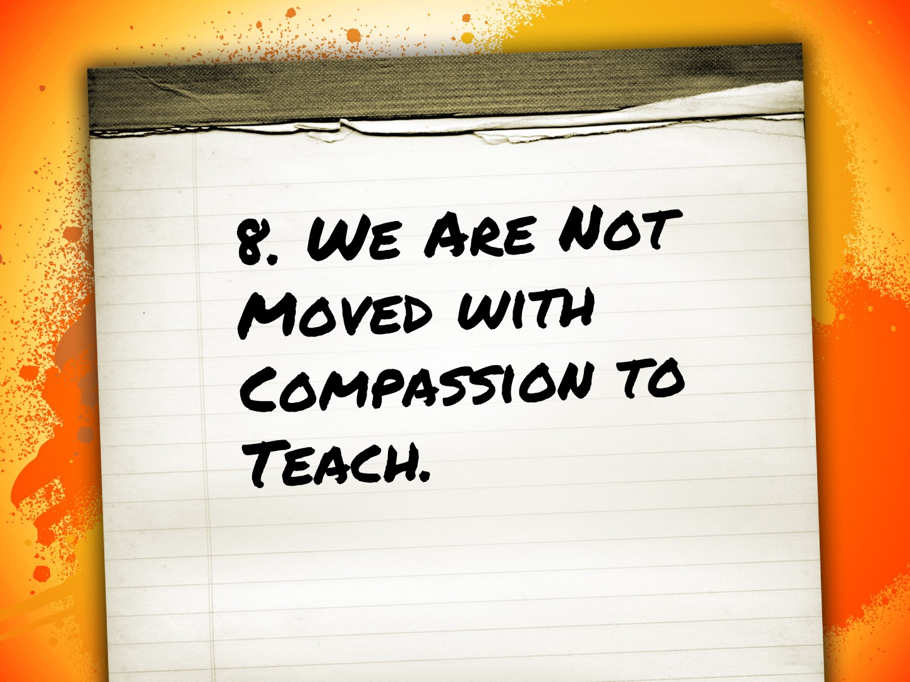

Slide 17
We Are Not Moved with Compassion to Teach.
Matt. 9.36: “When he saw the crowds, he had compassion for them”
John 4.35: “Look, I tell you, lift up your eyes, and see that the fields are white for harvest.”
The harvest that is not picked will be destroyed.

Slide 18


Slide 19
We Stay in Our Comfort Zone.
We come up with all kinds of excuses to stay in our comfort zone.
Fact: we will never grow if we stay in our comfort zone.
Why do we not step out of our comfort zone?

Slide 20


Slide 21
We Don’t Do Anything.
Do we really believe that God would save us and then command us to go and evangelize and then accept anything less?
We must not forget that we are left to fulfill the purpose of Jesus: Matt. 28.19-20
We must have the attitude of “here I am, send me”: Isaiah 6.8

