Slide 1
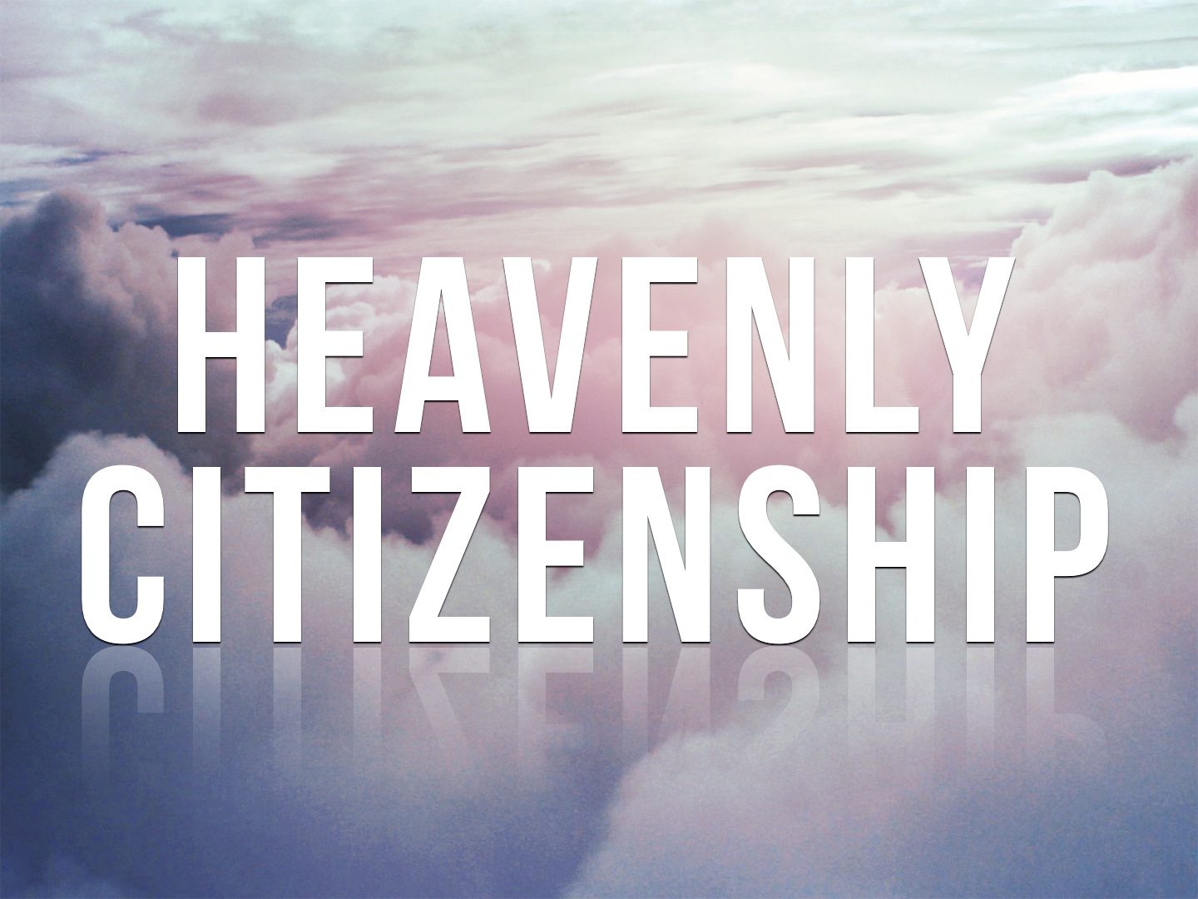

Slide 2
Heavenly Citizenship Calls for UNITY
Strive to be of the same MIND in the Lord: 4.2
We must MAINTAIN unity: Phil. 4.2
We must walk WORTHY of the gospel: Phil. 1.27
We must GENUINELY love: Phil. 2.1-5
We must EXHORT one another: Phil. 4.3

Slide 3
Heavenly Citizenship Produces JOY
Joy is a FRUIT of the Spirit that we are to bear.
It comes by KNOWING the truth: 1 John 1.4
It comes by OBEYING the truth: Acts 8.39; 15.3
Paradoxically, we can rejoice in PERSECUTION: Acts 5.41; Heb. 12.2; 1 Peter 1.6-9

Slide 4
Heavenly Citizenship Produces a Life Free of ANXIETY
Anxiety is a DISTRACTION from serving God.
Anxiety is a symptom of LITTLE faith: Matt. 6.24-31
Anxiety is ELIMINATED when we are content with what God has blessed us with, when we are engaged in constant prayer with thanksgiving, and our minds are focused on spiritual things: Phil. 2.14-15; 4.11-13; Heb. 4.16

Slide 5
Heavenly Citizenship Demands Wholesome THOUGHTS
Our mind CONTROLS our lives: 3.19
If we conform to this world, our thinking will be CORRUPTED: Rom. 12.1-2
We must REPLACE sinful and negative thoughts with good and positive thoughts.

Slide 6
“If you are a Christian, you are not a citizen of this world trying to get to heaven; you are a citizen of heaven making your way through this world.”
Notes:
Thanks to Joe Price for the sermon idea and his work on this subject.

