Slide 1
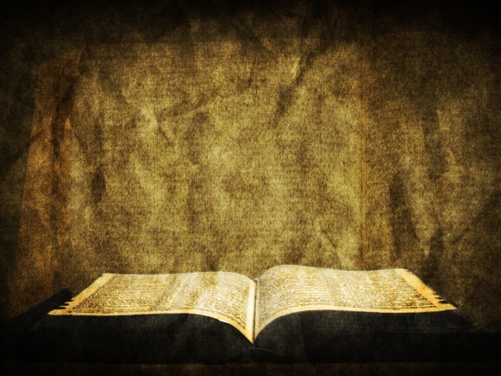
BARRIERS TO
ForgivenesS

Slide 2
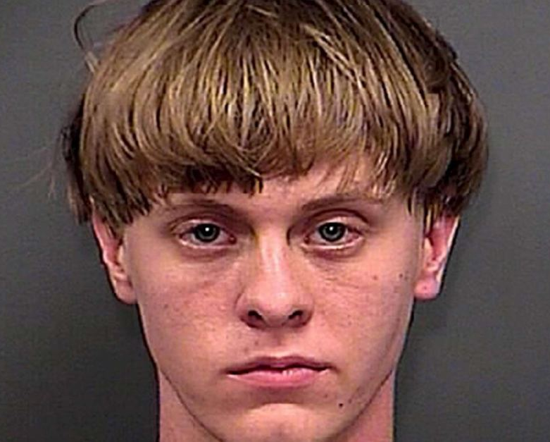
Dylann Storm Roof

Slide 3
On June 17, 2015 twenty-one year old Dylann Storm Roof walked into Emanuel African Methodist Episcopal Church in Charleston, South Carolina sat for a Bible Study and then opened fire killing nine innocent worshippers, that included the church’s senior pastor and state senator Clementa C. Pickney.

Slide 4
Is forgiveness possible?

Slide 5
“If we say we have no sin, we deceive ourselves, and the truth is not in us. If we confess our sins, he is faithful and just to forgive us our sins and to cleanse us from all unrighteousness. If we say we have not sinned, we make him a liar, and his word is not in us.”
1 John 1:5-10

Slide 6
“For there is NO DISTINCTION: for ALL have sinned and fall short of the glory of God, and [ALL] are justified by his grace as a gift, through the redemption that is in Christ Jesus.”
Romans 3:22-24

Slide 7
The barrier of UNFORGIVENESS
UNREADINESS
SELF-PROTECTION
SAVING FACE
“Forgive us our debts, as we forgive our debtors” Matthew 6:12

Slide 8
Eric Manning, leader of Emanuel, gave the last victim impact statement during the sentencing phase of Roof’s trial:
“For the past 19 months, Mother Emanuel has gone through its struggles, its challenges. As we have tried our best to move forward at times we have made several mistakes. At times we have questions. Dylann Roof, God finds value in you, not for material things, but because you are you. He would go any distance and pay any price to possess you. In fact he did, not just for you but for all of us, when he gave his only Son.
God still loves you. If you repent and seek his forgiveness, he will surely do that for you.”

Slide 9
“Put on then, as God’s chosen ones, holy and beloved, compassionate hearts, kindness, humility, meekness, and patience, bearing with one another and, if one has a complaint against another, forgiving each other; as the Lord has forgiven you, so you also must forgive.”
Colossians 3:12-14

Slide 10
1 John 1:5-10
The Barrier of DENIAL
“If we say we have no sin, we deceive ourselves…” 1 John 1:8

Slide 11
1 John 1:5-10
The Barrier of CONFESSION
“If we confess our sins, he is faithful and just to forgive us our sins…” 1 John 1:9

Slide 12
1 John 1:5-10
The Barrier of REPENTANCE
“If we say we have not sinned, we make him a liar…” 1 John 1:10

Slide 13
The barrier of ACCEPTANCE
GUILT
PUNISHMENT
FORGIVENESS
“Whoever believes in the Son of God has the testimony in himself…” 1 John 5:10

Slide 14
The barrier of ACCEPTANCE
GUILT
PUNISHMENT
FORGIVENESS
SUFFERING

Slide 15
Accepting God’s forgiveness is an ACT of faith

Slide 16
Extending forgiveness is an ACT of obedience

Slide 17
Trusting His forgiveness is our ONLY hope

Slide 18
Forgiveness is a matter of faith, not feeling. We can be forgiven. ALL can be forgiven. It is left to us to accept His payment on the cross and trust its power.
No, we don’t deserve it. Yes, we deserve Hell, but He offers us
GRACE and MERCY!

Slide 19
BARRIERS TO
ForgivenesS

