Slide 1
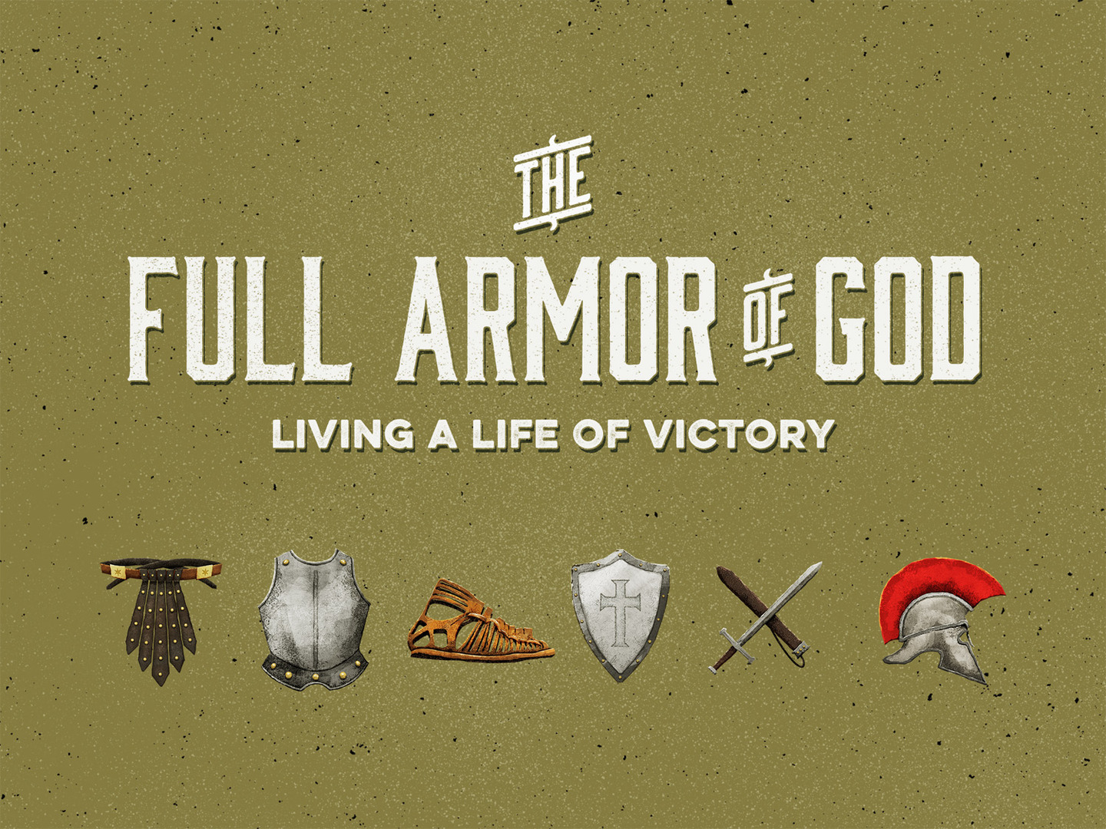

Slide 2
Eph. 6.10- 20 - Review
Be strong in the Lord: 6.10
Put on “the whole armor”: 6.11, 13
Take a stand: 6.11, 13-14
Understand the nature of this battle: 6.12
Recognize your enemy: 6.11-12
Do not to fight alone: 6.12, 18-19
Our armor must be put on properly with prayer: 6.18

Slide 3
The Belt of Truth
Stability and security is attached to truth: Col. 2.6-7
The belt of truth is about preparedness: 1 Peter 1.13
Without truth, we cannot be pure (Eph. 5.26-27), grow (Eph. 4.14-16), or fight the devil and his schemes.

Slide 4
The Breastplate of Righteousness
The spiritual breastplate protects the spiritual heart.
The gospel reveals God's plan for bestowing righteousness: Rom. 1.16-17; 3.21-22; Phil. 3.9
Righteousness is obtained by obeying God: Psalm 119.172; cf. Matt. 3.15

Slide 5
The Breastplate of Righteousness
A commitment to purity in thought and action: Psalm 119.11; 2 Cor. 10.5
We must pursue righteousness: 2 Tim. 2.22; Matt. 5.6
We must not only know the truth, we must apply it! 2 Tim. 3.16-17; Eph. 4.1-3; 17-32

Slide 6
The Gospel of Peace
We must have shoes that allow us to not only stand firm, but to stand ready: 1 Peter 3.15
If we let Him, we have a Savior that will guide our feet into the way of peace: Luke 1.79
How beautiful are the feet of those who preach the gospel: Rom. 10.15

Slide 7
The Shield of Faith
Our shield must be our faith: Rom. 10.17
It is a faith in God’s power, authority, and word.
  An unshakable trust: Do I believe that God will keep His promises? Abraham did! Heb. 11.17-19
  An unshakable trust: Do I believe that God will deliver me? David did! 1 Sam. 17.34-39

Slide 8
The Helmet of Salvation
Protection during the spiritual battle: 1 Thess. 5.8
We fight with the hope of victory: Col. 1.23; 1 John 5.4; 1 Peter 1.7-9
We must keep our minds focused on heaven and our salvation!

Slide 9
The Sword of the Spirit
Our weapon is powerful: Heb. 4.12; 2 Cor. 10.4
We must be familiar with our weapon and know how to use it properly! Prov. 27.17
Since it protects, helps us overcome, guides, etc. (1 John 2.14, etc.), we must carry it with us daily!

